Slide 1
AGATA detectors summary report
AGATA Demonstrator @ LNL
Peter Reiter for the AGATA detector working group
12th AGATA week
11-13 June 2012
GSI Darmstadt, Germany

Slide 2
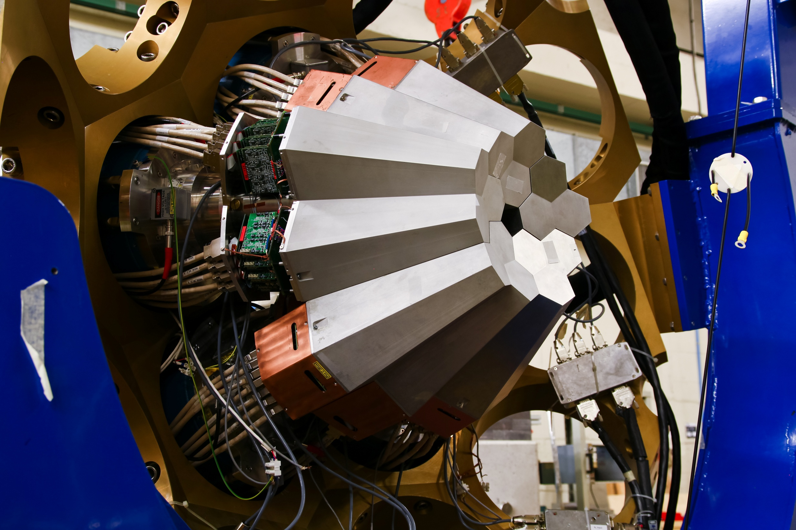
The AGATA sub-array
installed at LNL

Slide 3
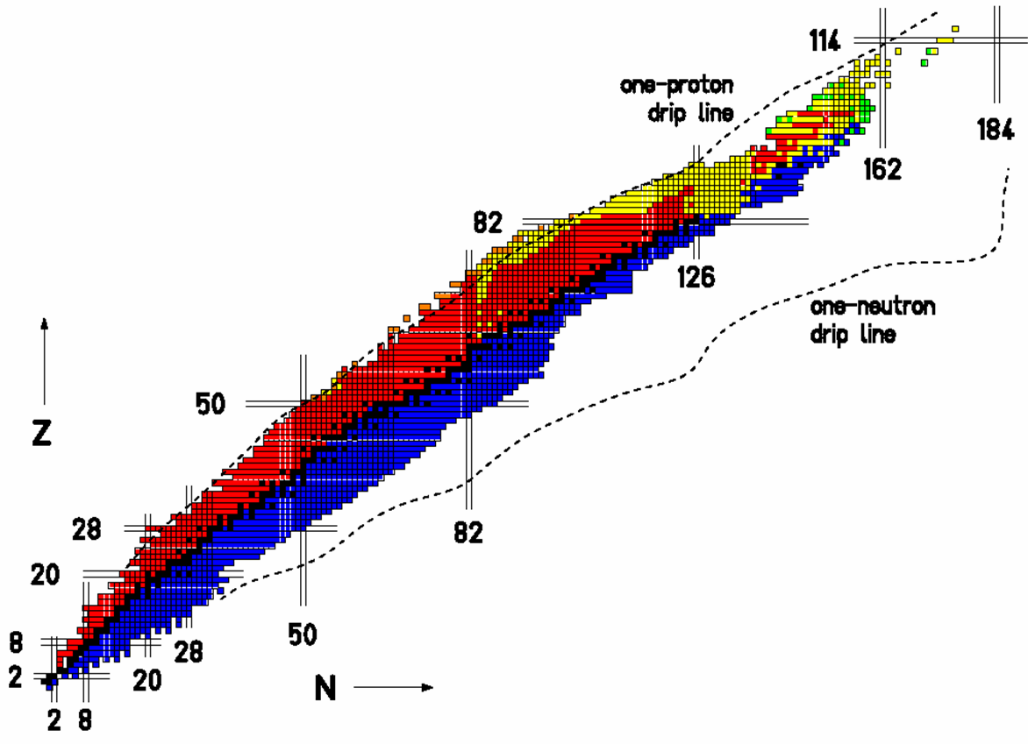
The Experimental Campaign at LNL
Octupole-deformed Ra and Th nuclei
Isospin Mixing in ⁸⁰Zr
Neutron-rich nuclei in the vicinity of ²⁰⁸Pb
n-rich Th and U
Pygmy and GQR states
Neutron drip-line
High-lying states in ¹²⁴Sn and ¹⁴⁰Ce
g.s. rotation in Dy, Er, Yb
Shape transition in ¹⁹⁶Os
Molecular structure of ²¹Ne
n-rich nuclei
Proton drip-line
Order-to-chaos transition in ¹⁷⁴W
Lifetime of ¹³⁶Te
protons
Coulex of ⁴²Ca
N=84 isotone ¹⁴⁰Ba
N=51 nuclei
Neutron-rich nuclei populated by fission
20(+3) exp. 148 days
Lifetimes of the n-rich Cr isotopes
A lot of
neutrons,
neutrons,
neutrons!
Lifetimes near the island of inversion
Lifetimes in n-rich Ni, Cu and Zn isotopes
neutrons
Lifetime of the 6.792MeV state in ¹⁵O

Slide 4
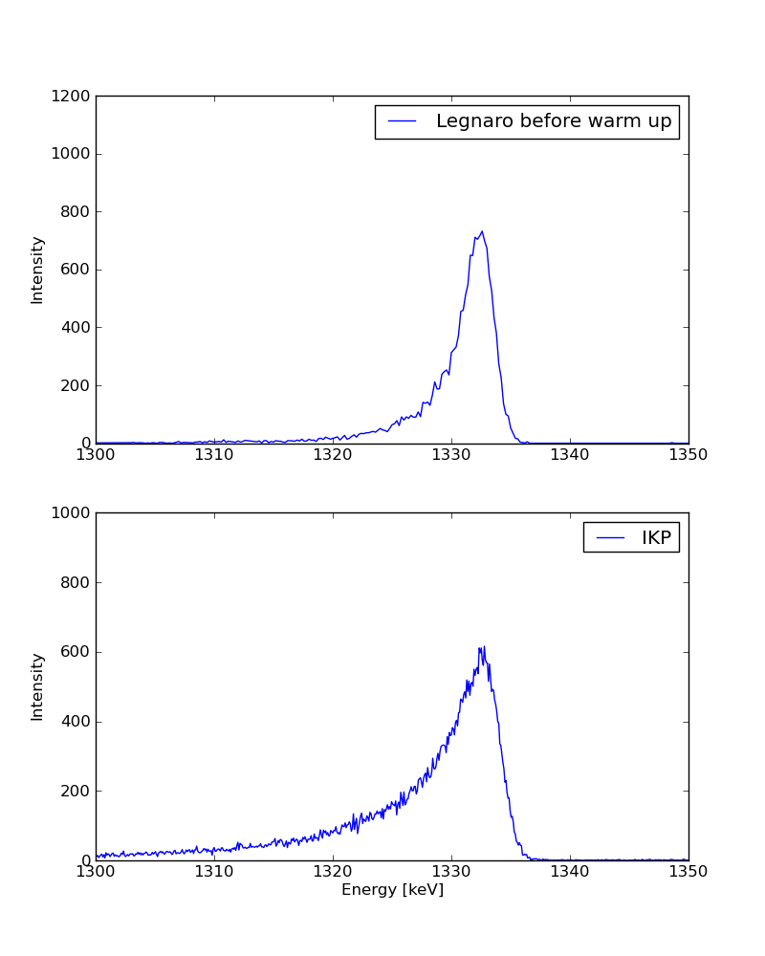
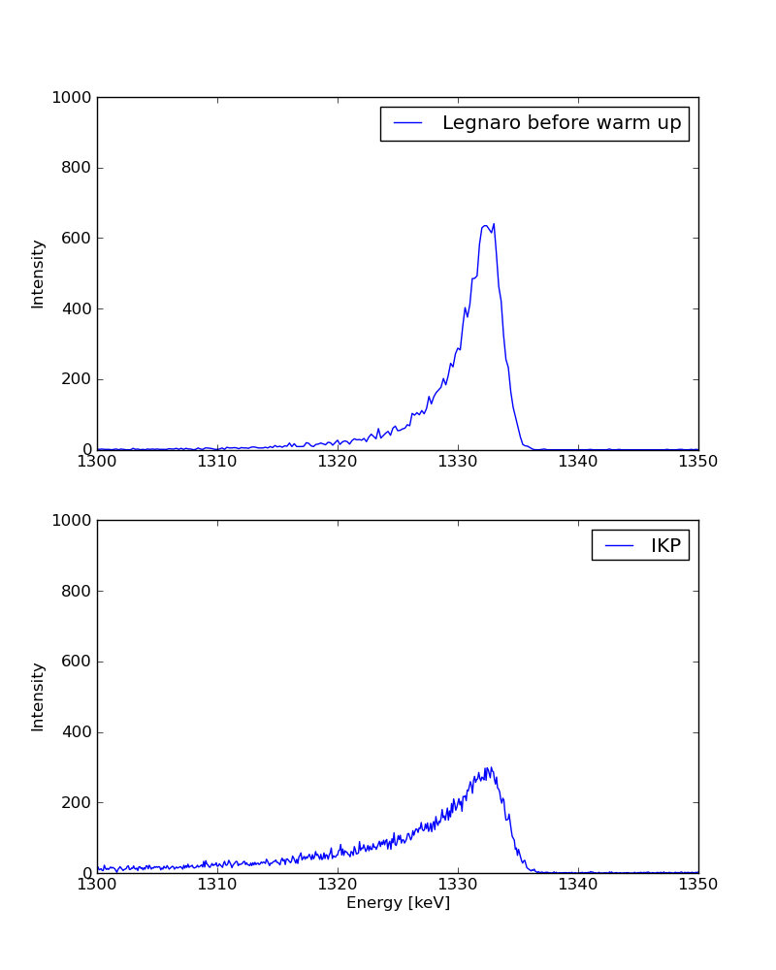
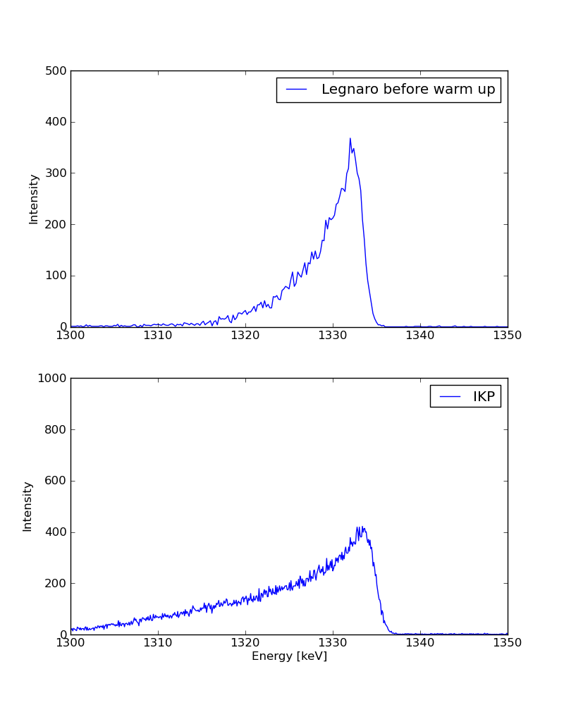
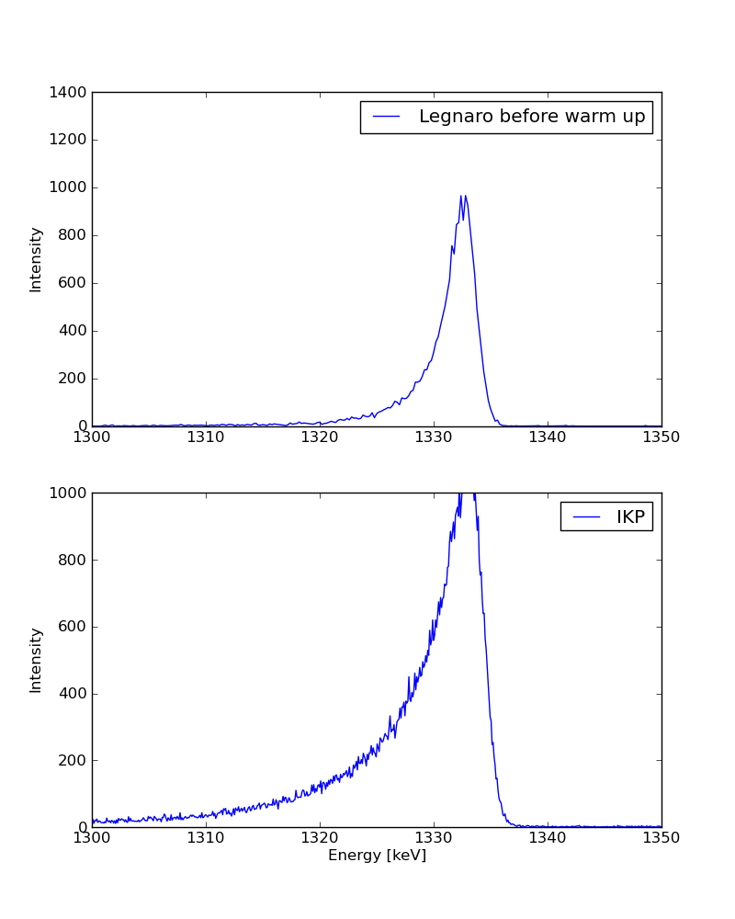
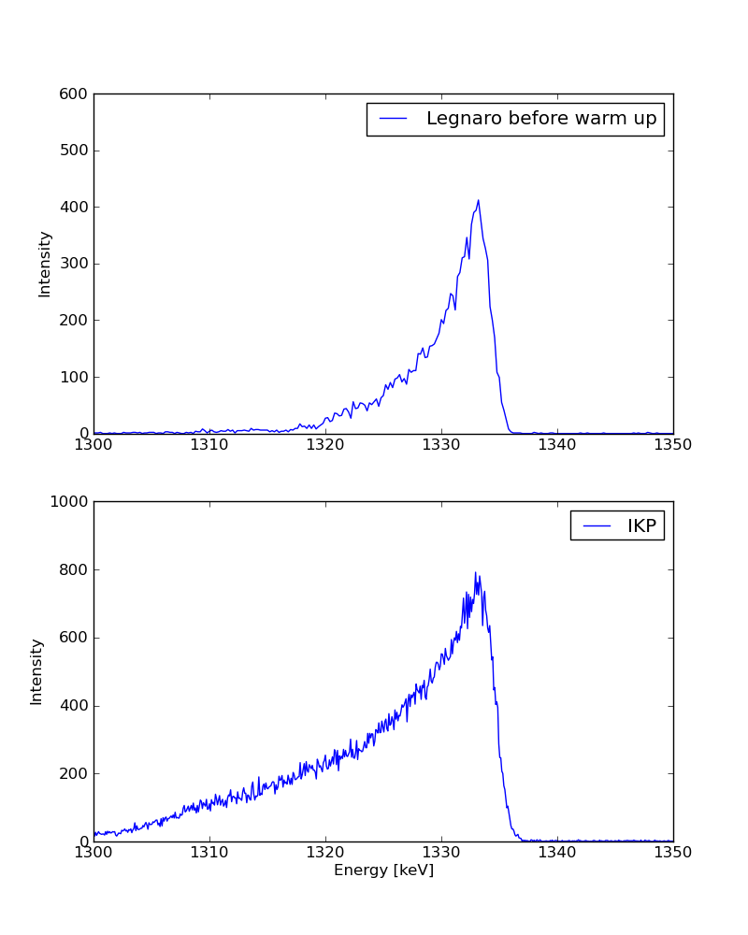
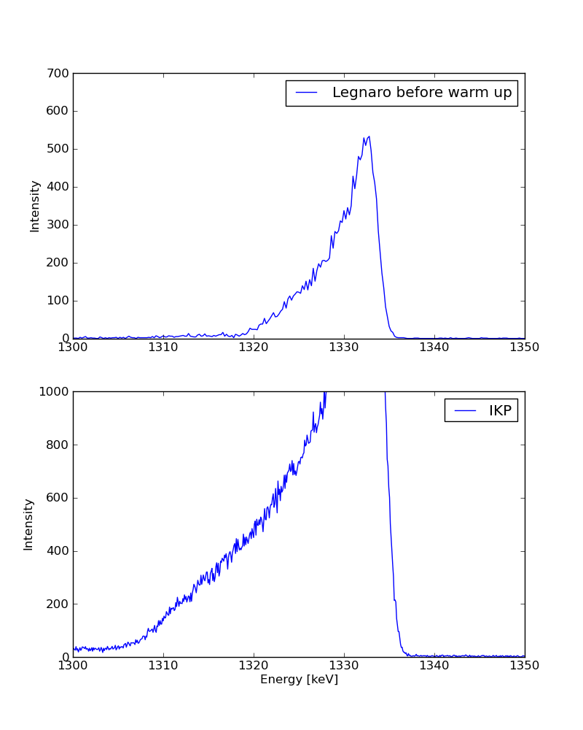
Status after LNL campaign: before (LNL) and after warm up (IKP), no annealing
ATC1 B A1
ATC1 B D1
ATC1 B D4
LNL
LNL
LNL
IKP
IKP
IKP
ATC1 B E1
ATC1 B E2
ATC1 B E3
LNL
LNL
LNL
IKP
IKP
IKP

Slide 5
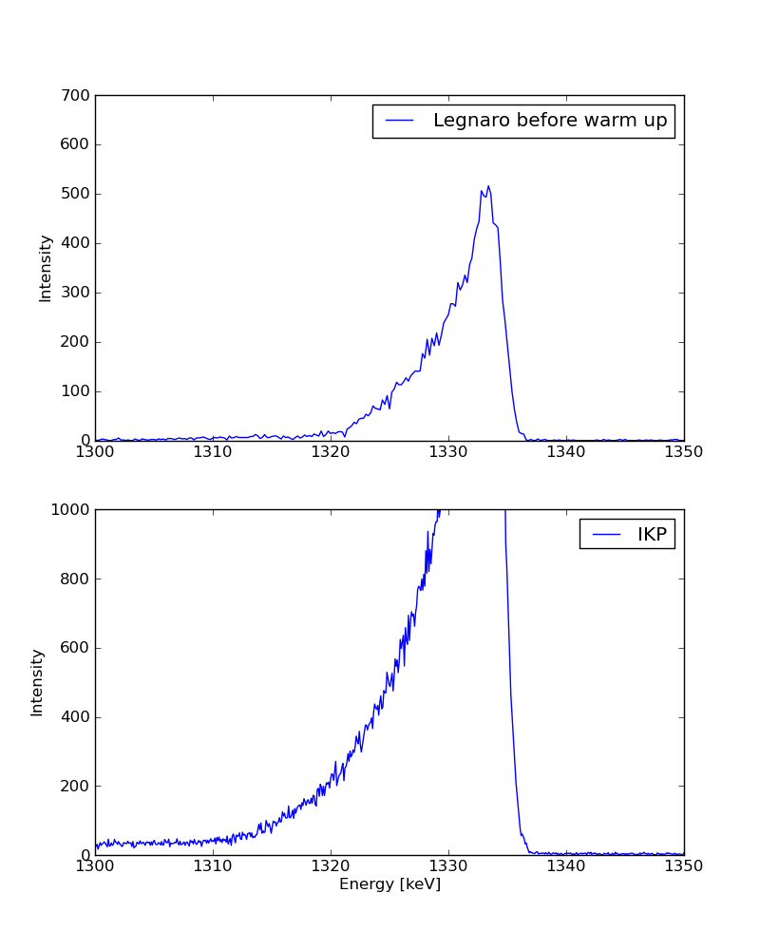
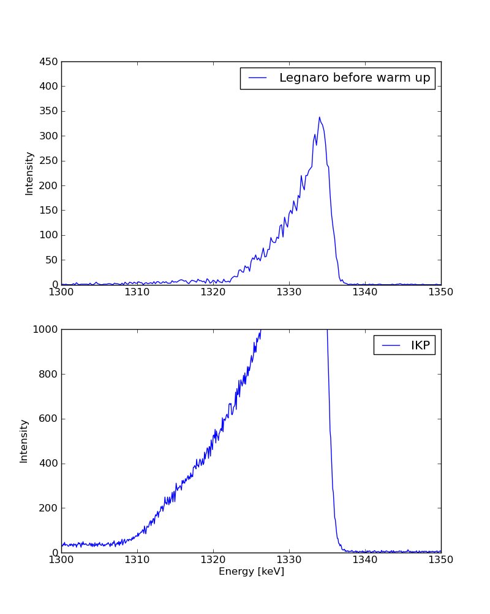
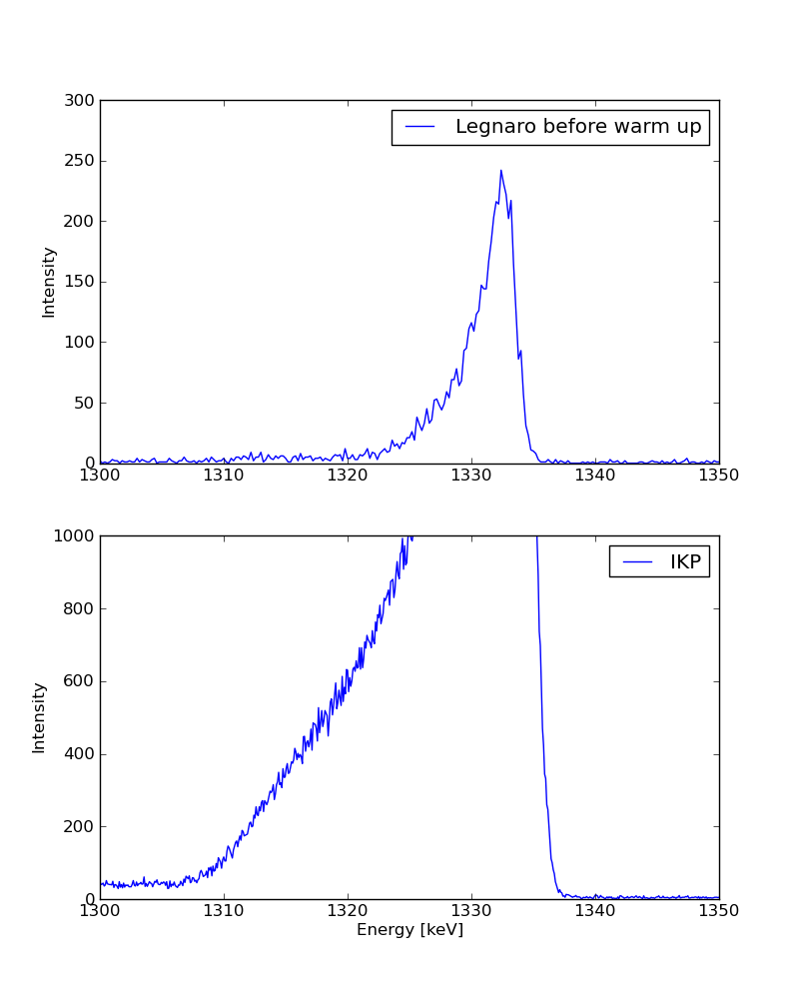
Status after LNL campaign: before (LNL) and after warm up (IKP), no annealing
ATC1 B E4
ATC1 B E5
ATC1 B E6
LNL
LNL
LNL
IKP
IKP
IKP
ATC1 B E1
ATC1 B E2
ATC1 B E3
LNL
LNL
LNL
IKP
IKP
IKP

Slide 6
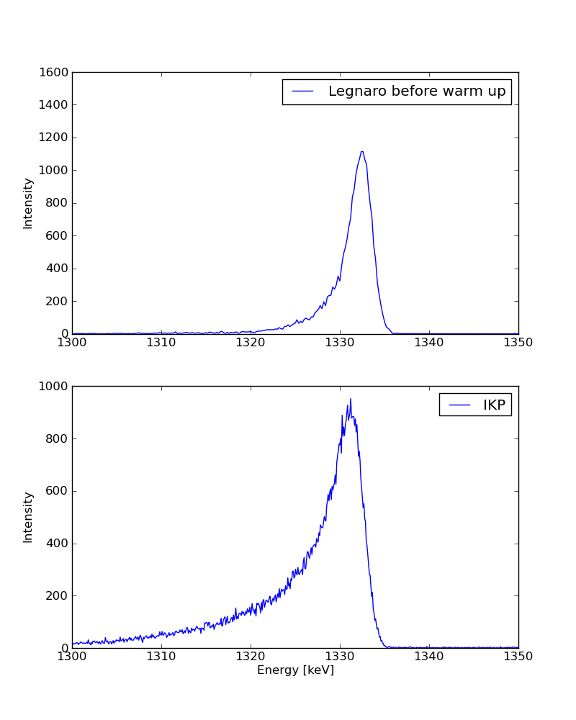
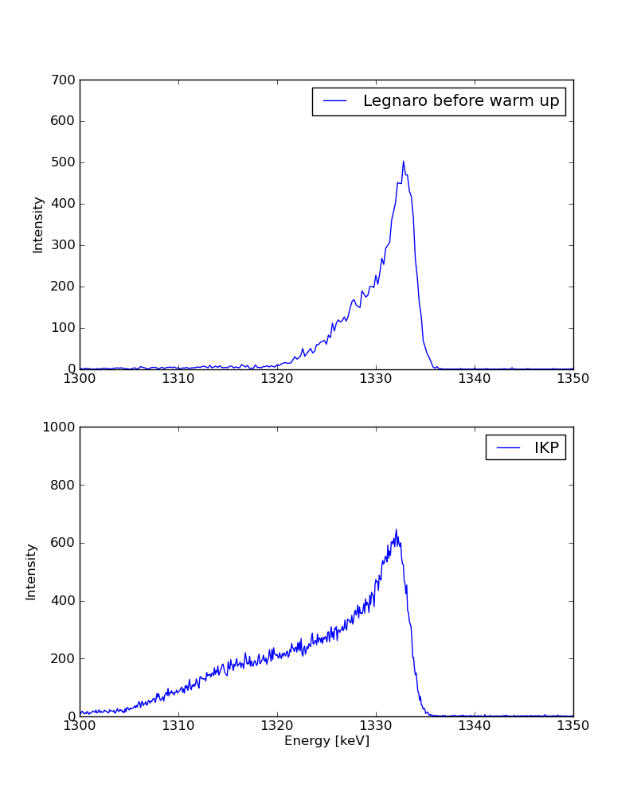
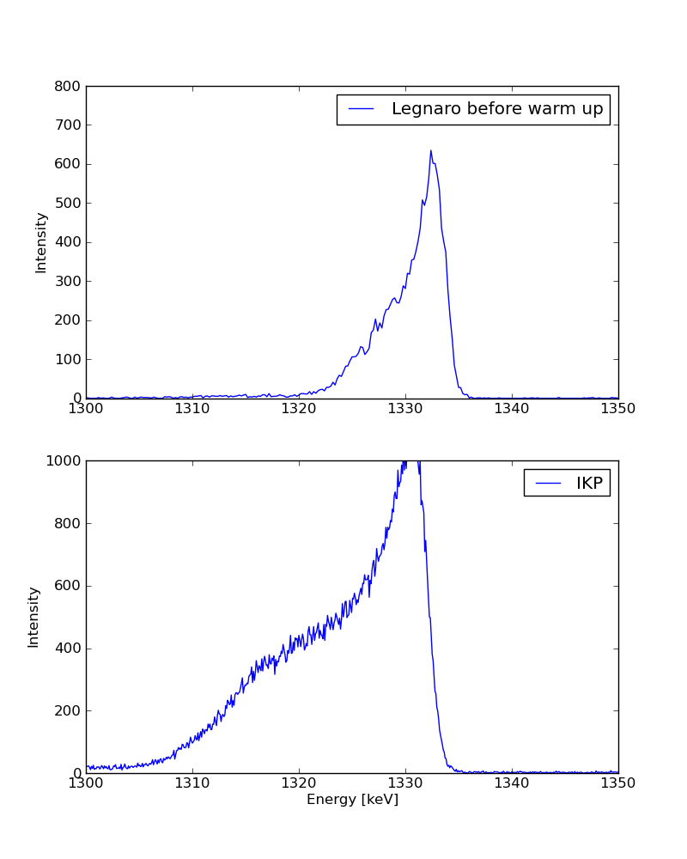
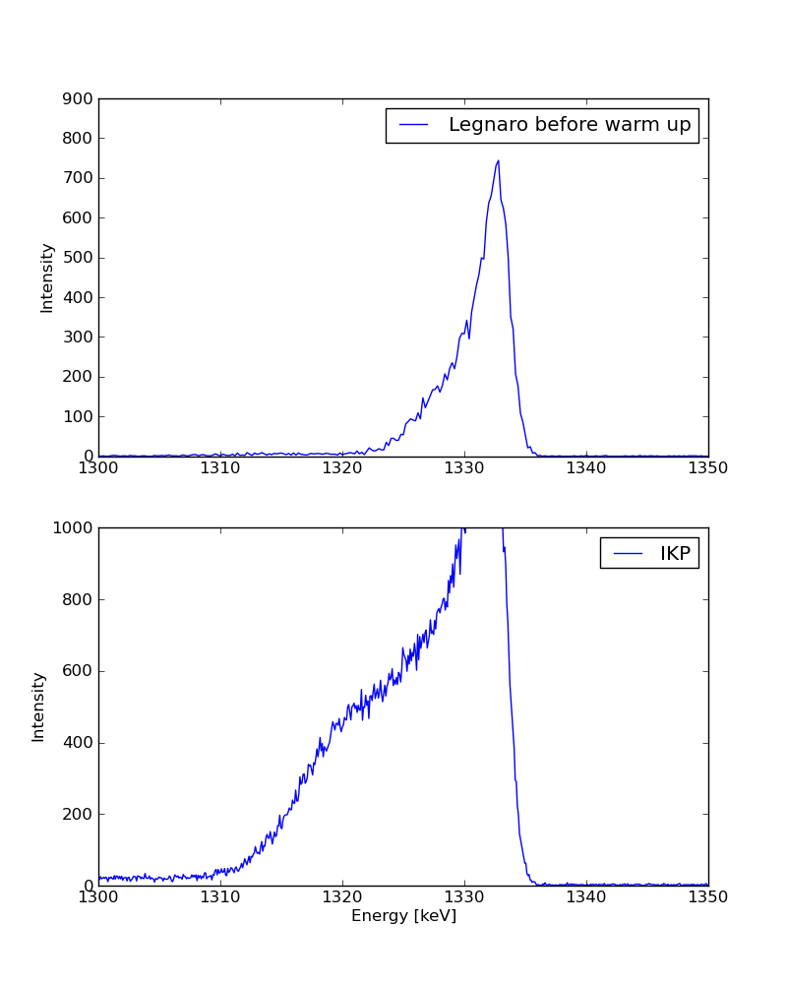
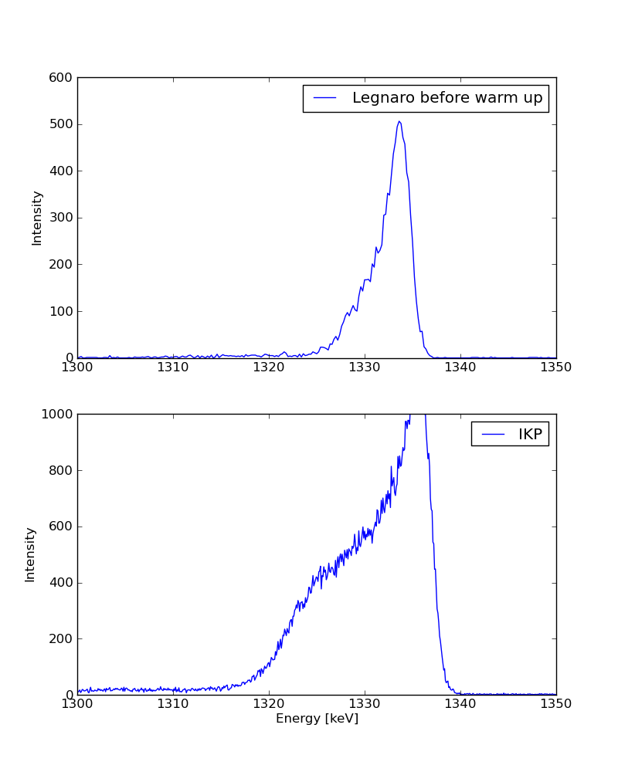
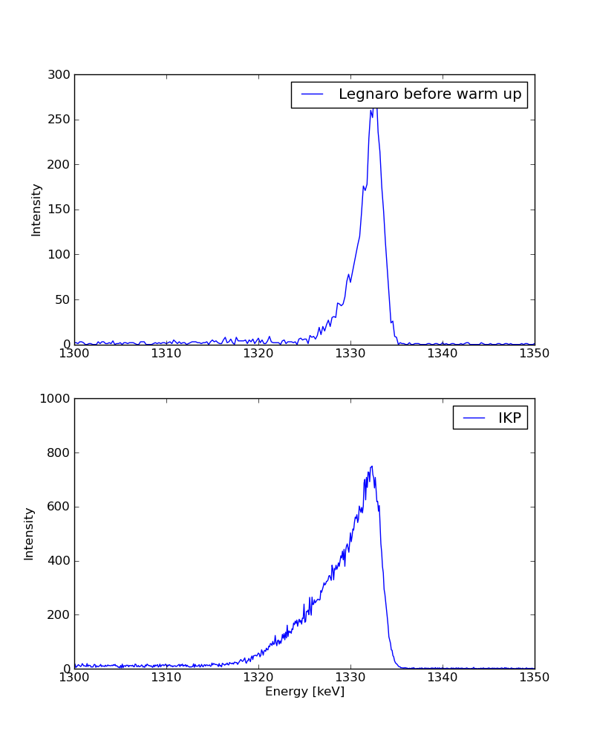
Status after LNL campaign: before (LNL) and after warm up (IKP), no annealing
ATC1 C E1
ATC1 C E2
ATC1 C E3
LNL
LNL
LNL
IKP
IKP
IKP
ATC1 C E4
ATC1 C E5
ATC1 C E6
LNL
LNL
LNL
IKP
IKP
IKP
It’s difficult to determine the FWHM due to the peak shapes, varies between 5 and 20 keV.

Slide 7
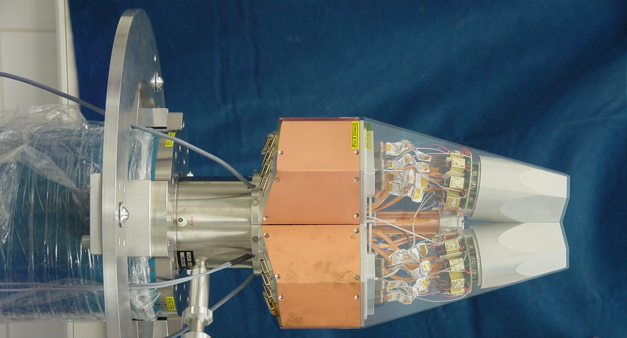
Disassembly and Reassembly of
five AGATA Triple Cryostat @ IKP
- mechanical precision
- heat development
- LN2 consumption
- microphonics
- noise, high frequencies
- integration of 111 high resolution
spectroscopy channels
- cold FET technology for all signals
J. Eberth, A. Wiens, IKP Köln
H.-G. Thomas, CTT

Slide 8
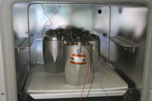
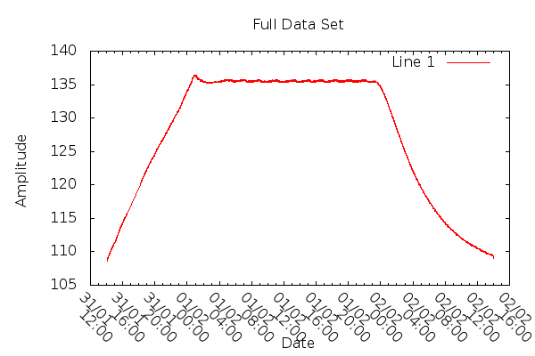
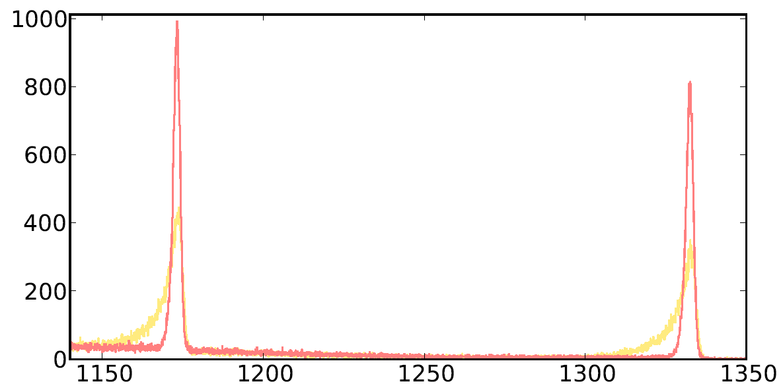
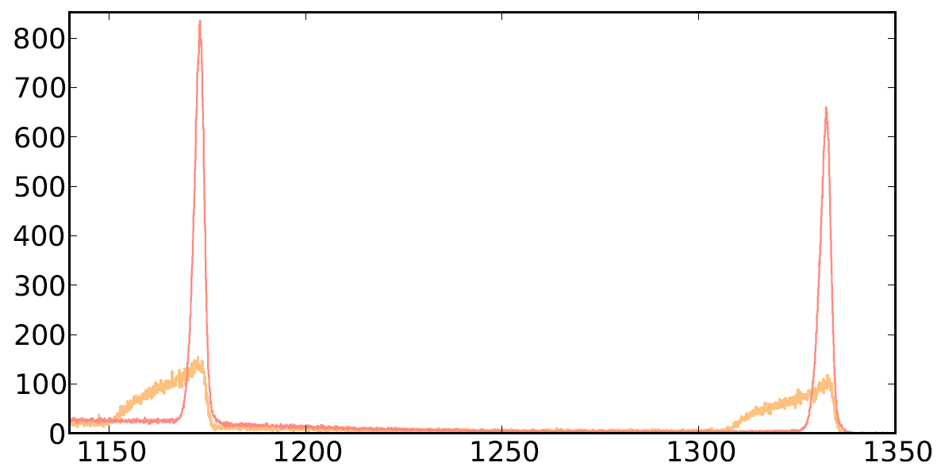
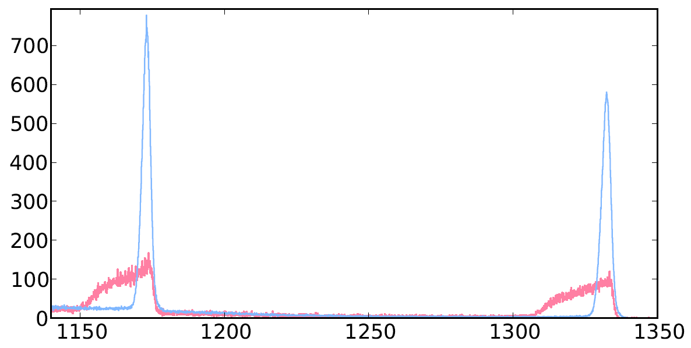
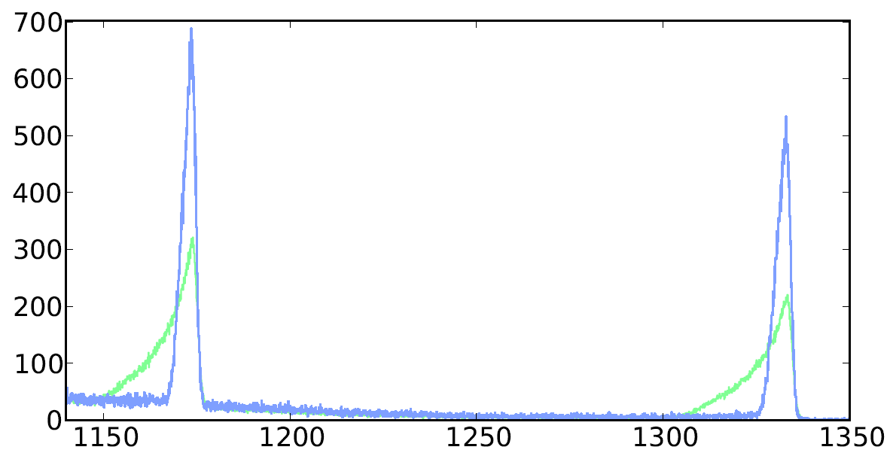
24 hours annealing of ATC 1
detectors
PT 100 read out

Slide 9
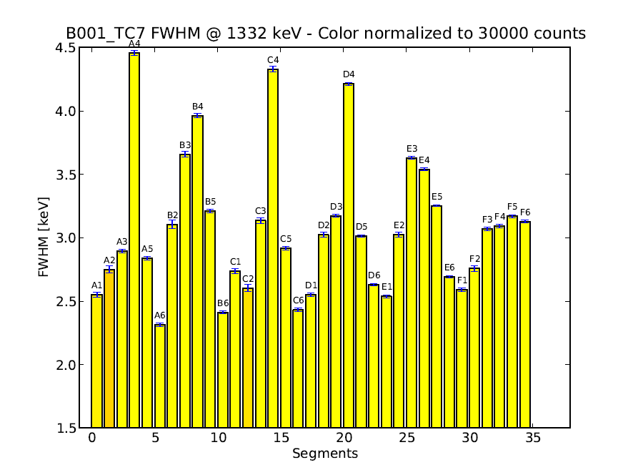
Energy resolution after 24 hours of ATC 1 B001 detector
Conclusion: insufficient annealing period

Slide 10
Test of ATC2 with A003, B003, C005 after 96 hours annealing period
A003, HV=4500V Core resolution at 59.6keV: 1.53keV, at 60Co: 2.43keV
Segment resolution at 59.6keV in keV:
A1 1.16 B1 1.11 C1 1.11 D1 1.14 E1 1.19 F1 1.15
A2 1.00 B2 0.99 C2 1.04 D2 1.03 E2 1.04 F2 1.14
A3 0.97 B3 1.02 C3 1.08 D3 1.16 E3 1.09 F3 0.95
A4 1.12 B4 1.08 C4 1.31 D4 1.24 E4 1.20 F4 1.13
A5 1.10 B5 1.16 C5 1.06 D5 1.35 E5 1.20 F5 1.21
A6 0.99 B6 0.97 C6 0.97 D6 1.03 E6 1.05 F6 1.09
B003, HV=4500V Core resolution at 59.6keV: 1.51keV, at 60Co: 2.37keV
Segment resolution at 59.6keV in keV:
A1 1.11 B1 1.18 C1 1.05 D1 1.12 E1 1.11 F1 1.05
A2 0.98 B2 1.08 C2 0.94 D2 0.98 E2 0.94 F2 0.94
A3 1.04 B3 1.07 C3 1.00 D3 1.02 E3 0.96 F3 1.02
A4 0.99 B4 1.10 C4 1.06 D4 1.08 E4 1.06 F4 1.02
A5 1.09 B5 1.08 C5 1.01 D5 1.03 E5 1.10 F5 1.07
A6 0.97 B6 0.93 C6 0.93 D6 0.97 E6 0.97 F6 1.05
C005, HV=4000V Core resolution at 59.6keV: 1.46keV, at 60Co: 2.36keV
Segment resolution at 59.6keV in keV:
A1 1.08 B1 1.01 C1 1.05 D1 1.10 E1 1.10 F1 1.05
A2 1.01 B2 0.91 C2 0.93 D2 0.95 E2 0.95 F2 0.94
A3 1.00 B3 0.97 C3 0.94 D3 0.97 E3 1.02 F3 0.94
A4 1.19 B4 1.24 C4 1.30 D4 1.03 E4 1.36 F4 0.90
A5 1.00 B5 1.03 C5 1.07 D5 1.10 E5 1.00 F5 1.05
A6 1.07 B6 0.93 C6 0.96 D6 1.00 E6 1.16 F6 3.20

Slide 11
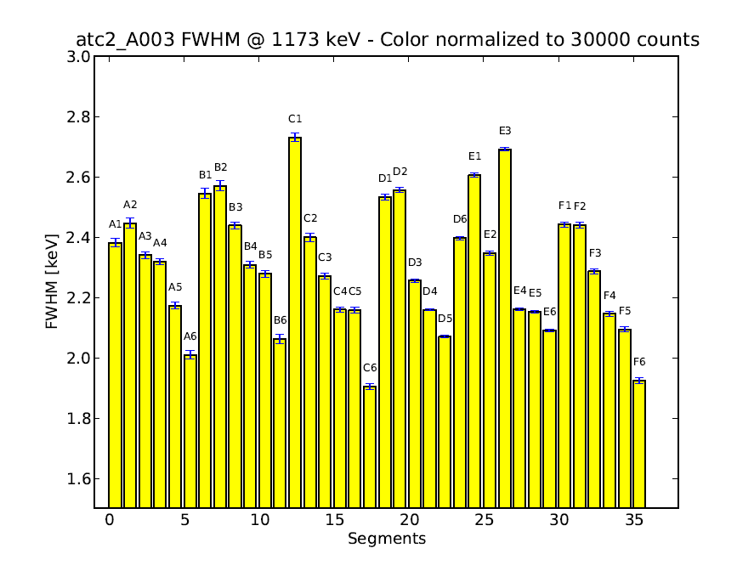
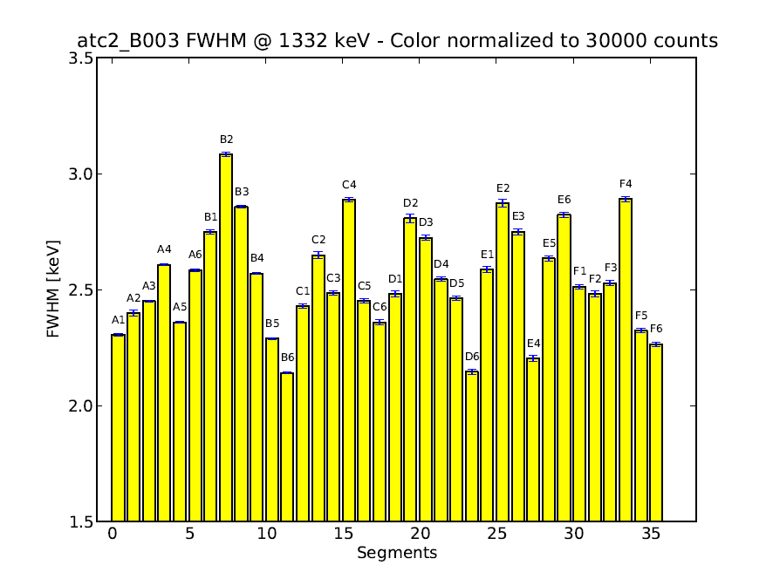
4 days annealing: energy resolution ATC 2
A003 detector
B003 detector
Energy resolution of ATC 2 at 1.3 MeV after 96 hours annealing
Conclusion: improved resolution, but is annealing period sufficient?

Slide 12
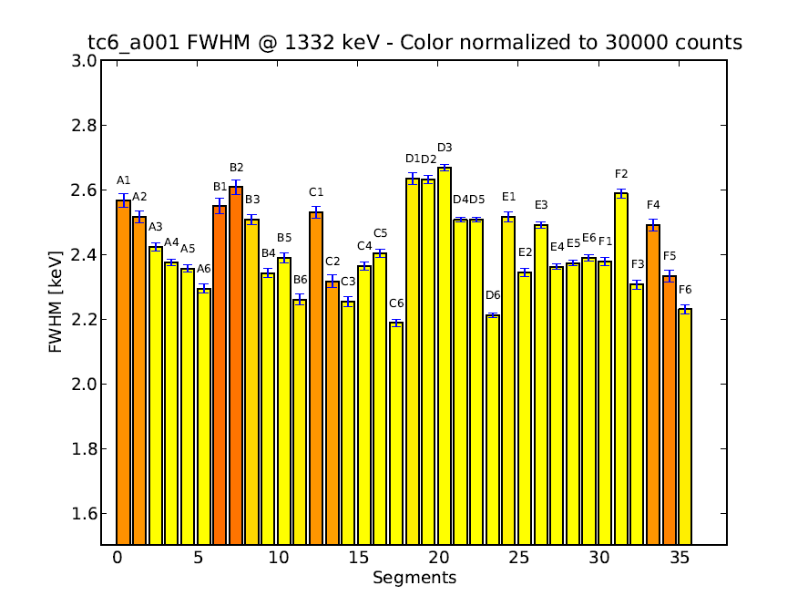
5 days annealing: energy resolution ATC 4
Results of A001 after annealing for 120h Core 59,5keV: 1,22 keV at ⁶⁰Co: 2.27keV
Seg. 59,5keV Seg. 59,5keV A1 1,18 A2 1,22 A3 1,09 A4 1,10 A5 1,07 A6 1,03 B1 1,13 B2 1,08 B3 1,07 B4 1,12 B5 1,12 B6 1,19 C1 1,19 C2 1,11 C3 1,13 C4 1,18 C5 1,19 C6 1,00
D1 1,22 D2 1,05 D3 1,05 D4 1,07 D5 1,30 D6 1,05 E1 1,29 E2 1,00 E3 1,04 E4 1,12 E5 1,21 E6 1,10 F1 1,21 F2 1,08 F3 1,11 F4 1,07 F5 0,96 F6 0,98
Energy resolution at 1.3 MeV clearly reduced
with respect to new detector (next page)
Even 120 hours of annealing do not recover
neutron damage!
- Energy resolution at low energies reproduced,
electronic noise properties of detector ok

Slide 13
Energy resolution of new A001 detector

Slide 14
AGATA – status of detectors
Working detectors delivered in cluster cryostats to GSI:
ATC1: A008, B001, C003 was at GSI, now IKP Cologne 16.5.12
ATC2: A003, B003, C005 at GSI
ATC3: A002, B010, C001 at GSI
ADC1: B008, C006 at GSI
ADC2: B012, C010 at GSI
ADC3: B011, C008 at IKP, ready for GSI
Working detectors available at IKP:
A001, A004, A006
B002, B004
C009
Detectors being tested (CAT):
A007 (Liverpool)
20 detectors are available
2 CAT results pending

Slide 15
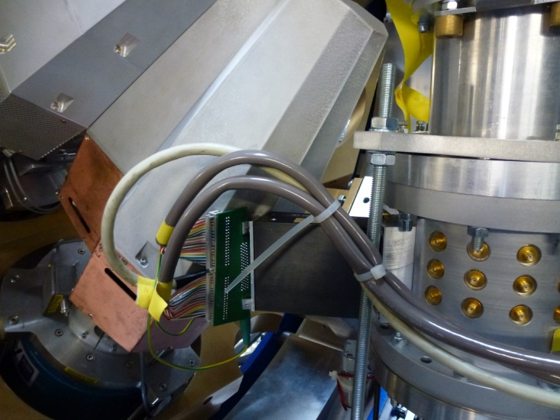
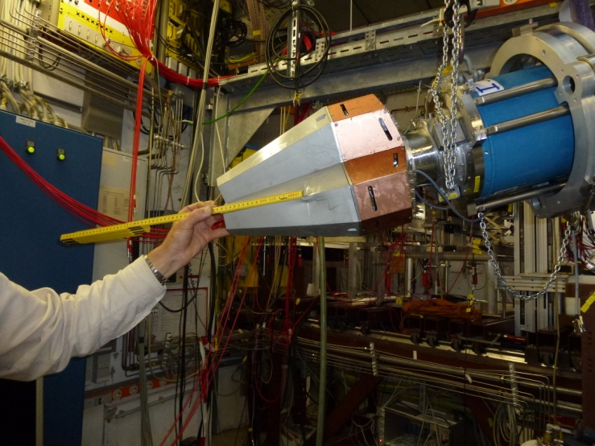
ATC 1 accident at GSI
28. March 2012, ATC 1 at GSI:
Core RED: 1.41 keV 2.41 keV
Core GREEN: 1.38 keV 2.42 keV
Core BLUE: 1.35 keV 2.45 keV
selected segments at ⁶⁰Co energies:
- ATC1 is affected by mechanical damage.
- Three detectors were tested at IKP after
accident to be within specs.
- Reassembly is ongoing with new end cap
10. May 2012, ATC 1 at GSI:
 | RED Row B | GREEN Row C | BLUE Row D
1 | 2.12/2.40 | 3.26/3.24 | 3.09/3.20
2 | 2.00/2.11 | 2.95/3.25 | 2.98/3.24
3 | 2.20/2.27 | 3.17/3.37 | 2.89/3.20
4 | 2.15/2.29 | 3.22/3.10 | 2.57/2.78
5 | 2.32/2.43 | 3.10/2.84 | 2.50/2.72
6 | 2.04/2.24 | 2.80/2.79 | 2.26/2.32

Slide 16
AGATA – status of detectors
Detectors with leakage current stored at IKP:
A005 (leakage current at LNL after warm-up to room temperature)
B005 (leakage current after annealing)
B009 (leakage current of segm. A1 at LNL, increased current of A1 after annealing)
C002 (leakage current at LNL of segm. A5, leakage current of D6 after annealing
C004 (leakage current of segm. B4 after annealing)
Detectors being repaired at Canberra:
A009 B006 B007 C007
Detectors to be delivered by Canberra:
B013
Returned for repair Feb. 2012 Diagnostic planned for June Delivery scheduled late June 2012
Returned for repair Jul 2009 Delivery scheduled Nov 2011 Delivery re-scheduled April 2012 Failed May 2012 Delivery re-scheduled July 2012 (repair time >3 years)
Returned for repair April. 2011 Delivery scheduled March 2012 Delivery re-scheduled June 2012 (repair time >14 months)
Returned for Repair Sep. 2011 Delivery scheduled Jan 2012 Delivery re-scheduled April 2012 Delivery re-scheduled May 2012 Delivery re-scheduled July 2012 (repair time >10 months)
Due since end 2011 Delivery scheduled Nov 2011 Failed May 2012 Delivery re-scheduled early July 2012
9 detectors are broken
1 new detector pending

Slide 17
Crystals & Failures
time
B001 – segments out of specs
B006 – leakage current after CAT
A001 – hole trapping
C003 – leakage current
A002 – leakage current
A007 – microphony in segments
A003 – leakage current
B004 – leakage current
C003 – leakage current
C003 – microphony in segments
B004 – missing segment
S003 – leakage current after CAT
A004 – segments out of specs
C004 – leakage current after CAT
B001- leakage current
C006 – leakage current after CAT
A005 – leakage current
C007 – leakage current after CAT
B005 - leakage current
B007 – leakage current
B001 – leakage current
C008 – leakage current
A005 – leakage current after CAT
A009 – segments out of specs
B005 – leakage current
B009 – leakage current
28 AGATA detector failures occurred
21 AGATA detector failures are caused by leakage current
C002 – leakage current
C004 – leakage current

Slide 18
AGATA crystals - evolution

Slide 19
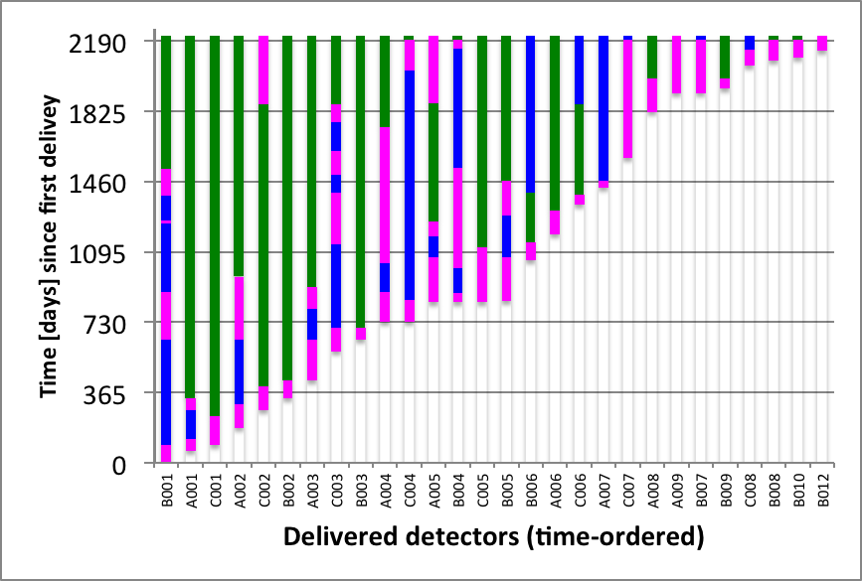
Repair time
CAT periods (purple), repair time periods (blue), operation time (green).
Time line starts with detector B001 in September 2005 and ends in September 2011.
Did not improve during last months.

Slide 20
AGATA crystals - overview
31 detectors were delivered:
A001,A002,A003,A004,A005,A006,A007,A008,A009
B001,B002,B003,B004,B005,B006,B007,B008,B009,B010,B011,B012
C001,C002,C003,C004,C005,C006,C007,C008,C009,C010
Usage of the available detectors:
A008, A003 A002 A001 A004 A008,
B001, B003 B010 B002 B004 B008 B012 B011 B012
C003, C005 C001 C006 C010 C008
Efficiency is limited by available C-type detectors.
Colorcode:
Working
broken
CAT pending
ATC1
ATC2
ATC3
ATC4
ATC5
ATC6
ATC7
ADC1
ADC2
ADC3
ADC4
ADC5

Slide 21
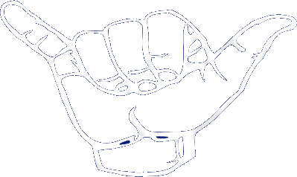
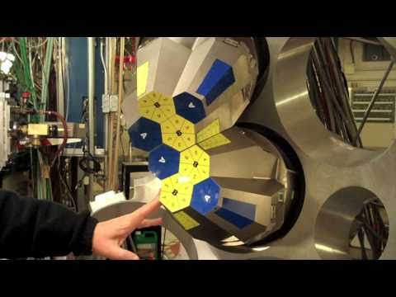
Many Thanks to Andreas
hang loose

Slide 22
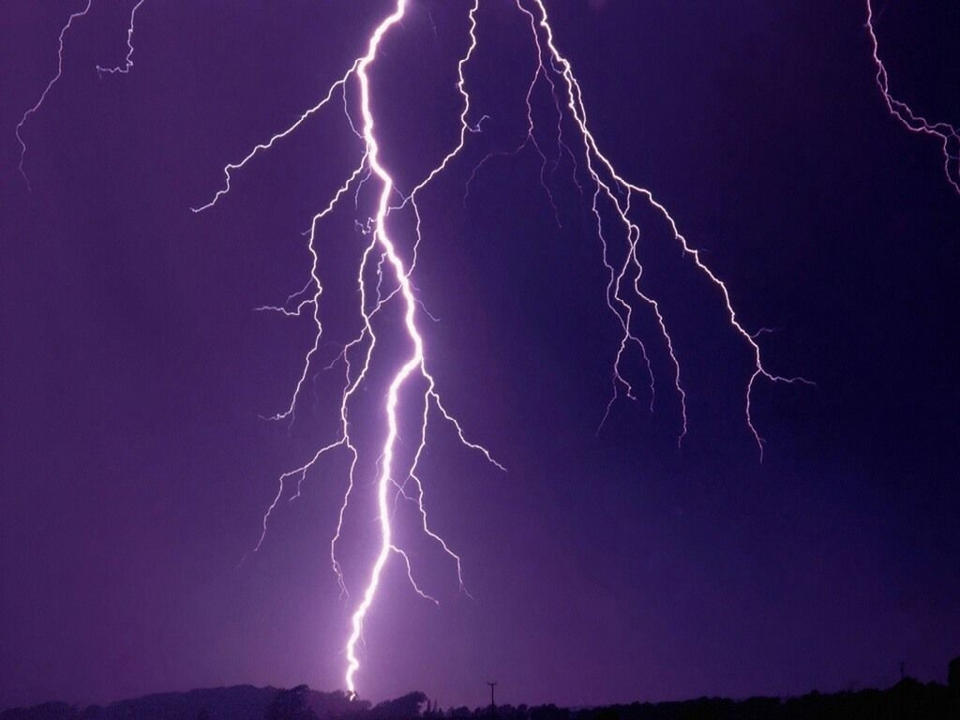
Summary Conclusions
Annealing
Available detectors
Future perspectives

