Slide 1
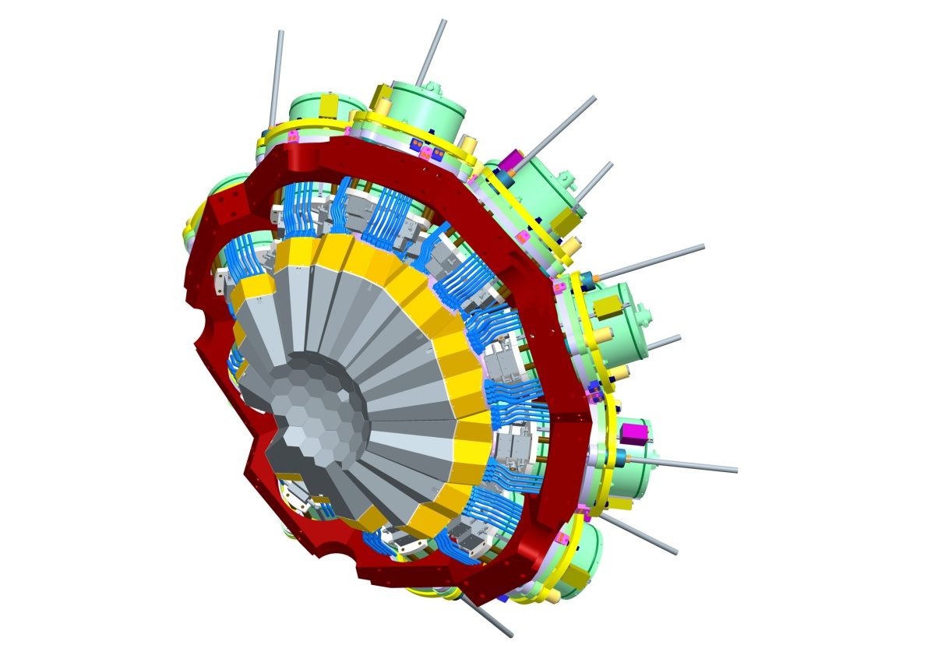
Science opportunities with the
Advanced GAmma Tracking Array
      Motivation
      γ-tracking
      AGATA Demonstrator
      Experiments @ Legnaro
      Physics case @ GSI
      Summary / Outlook
B. Birkenbach, B. Bruyneel, J. Eberth, H. Hess, D. Lersch, G. Pascovici, P. Reiter, A. Wiens — IKP, Köln
A. Pullia, F. Zocca — INFN, Milano
D. Bazzacco — INFN, Padova P. Reiter on behalf of the AGATA-Collaboration
H. G. Thomas — CTT Montabaur
ANL, Physics Division Seminar June 11, 2010
Notes:
Welcome…
First of all, I would like to introduce you to AGATA,
Why we really need AGATA,
And explain one of the keywords behind agata – namely Tracking.
In the second part of my talk, I would like to highlight two specific developments in which our institute – IKP Cologne – was particularly involved.
The first issue is related to the core preamplifier which was developed at Cologne.
The second issue deals with cross talk in segmented detectors and how one can correct for it.
But first: Why do we need AGATA…? >>>

Slide 2
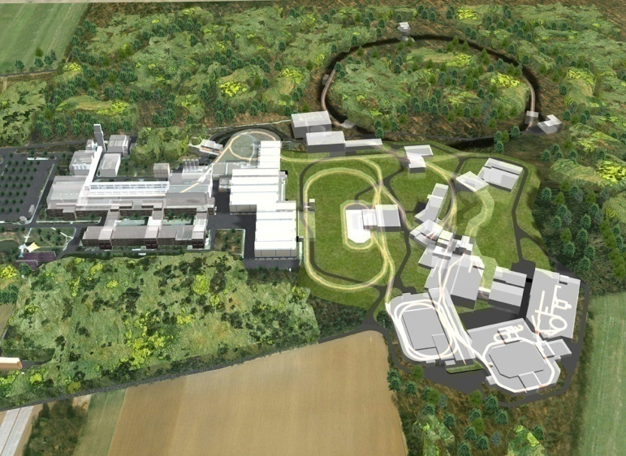
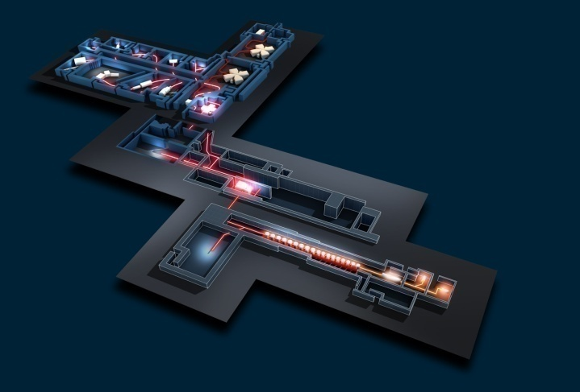
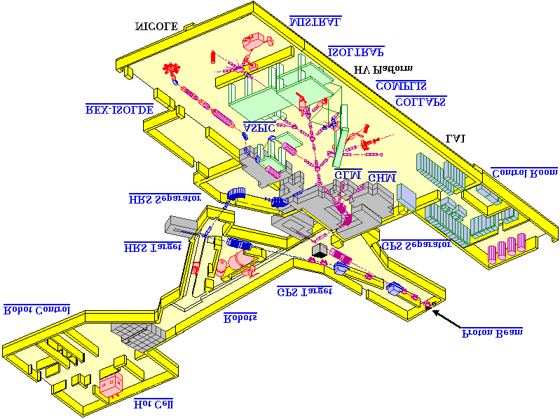
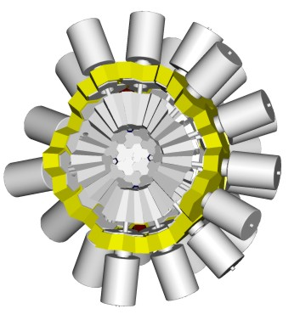

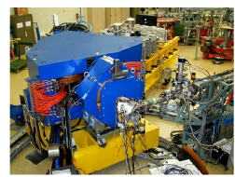
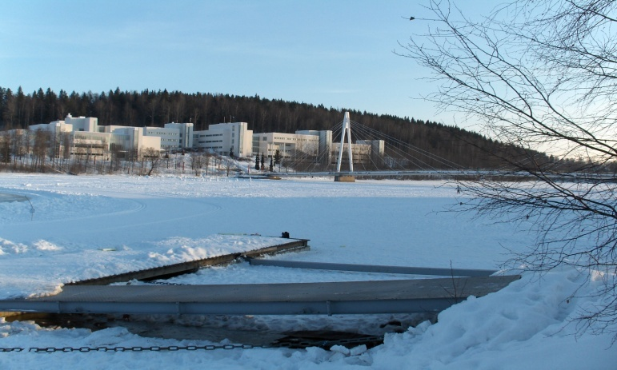

4π γ-array for Nuclear Physics Experiments at European accelerators
providing radioactive and stable beams
HIE-ISOLDE
GANIL
SPIRAL 2
FAIR
Jyvaskyla
AGATA
LEGNARO

Slide 3
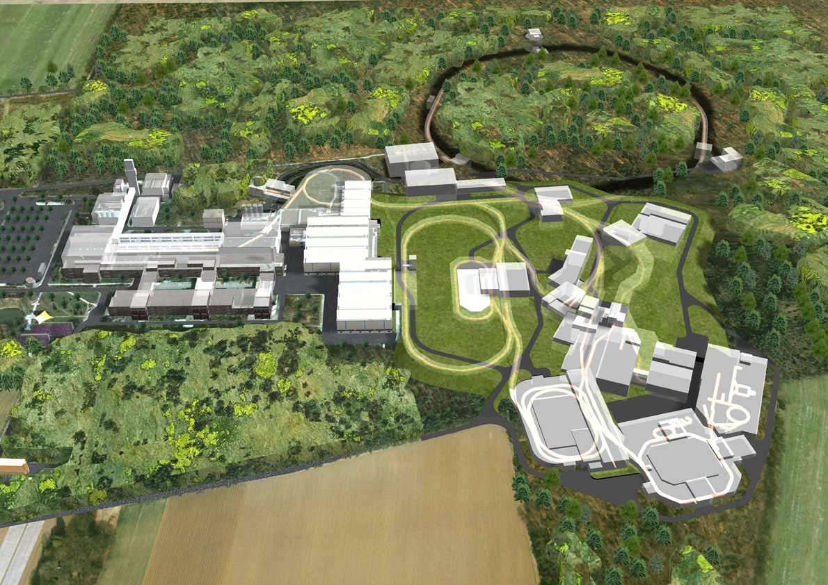


Example: High resolution γ-spectroscopy at NUSTAR
Relativistic exotic beams
Low intensity beams
High backgrounds
Large Doppler broadening
High counting rates
Need:
High efficiency
High sensitivity
High position resolution
High peak/total
High throughput

Slide 4
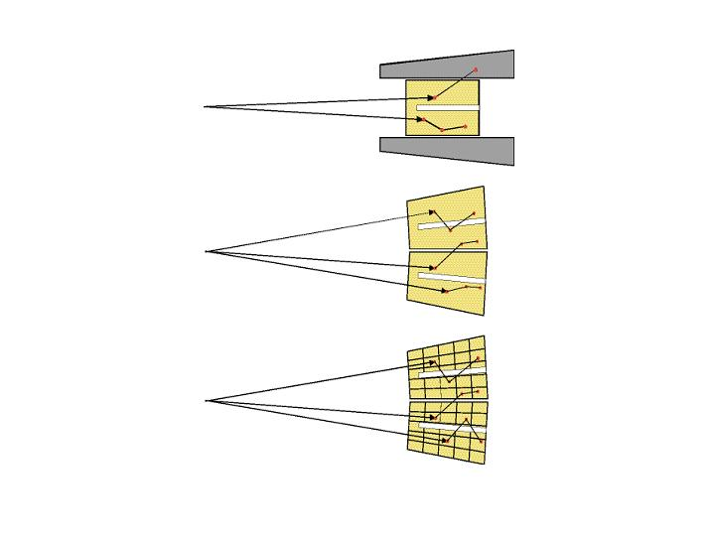
Idea of γ-ray tracking
Compton Shielded Ge
ε_{ph} ~ 10%
N_{det} ~ 100
Ω ~40%
large opening angle means poor energy resolution at high recoil velocity.
θ ~ 8º
Previously scattered gammas are wasted.
Technology is available now to track them.
θ ~ 3º
Ge Tracking Array
Combination of:
segmented detectors
digital electronics
pulse processing
tracking the γ-rays
ε_{ph} ~ 50%
N_{det} ~ 100
Ω ~80%
θ ~ 1º
Notes:
Present spectrometer technology relies on anti-compton shields to increase the peak to total ratio:
Gammas that scatter out of the detector are detected in the compton shields. When this happens, the event is thrown away.
Throwing away means a loss in efficiency.
Moreover, such detector has a relative large opening angle, and therefore these spectrometers are not optimized for relativistic beams.
Nowadays, technology is available to track such gammas.
What one needs is – instead of compton shields – is a full array of highly segmented detectors.
Tracking will tell us then that these three interactions belong together, such that there energy, collected in separate segments can be added, and none of these events has to be thrown away.
Moreover, tracking will also tell us which of these three interactions happened first. The high position sensitivity of this first interaction will than allow good Doppler correction. >>

Slide 5
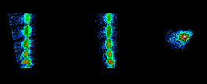
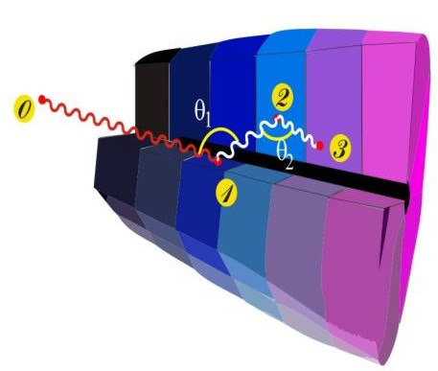
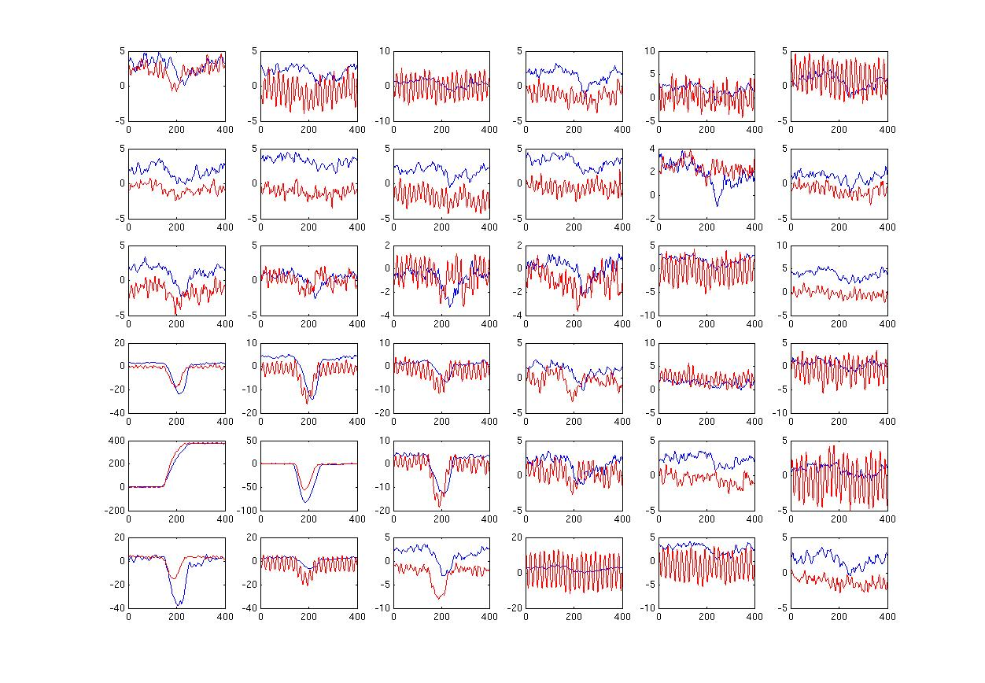
Ingredients of γ-ray tracking
4
1
Reconstruction of tracks
e.g. by evaluation of permutations
of interaction points
Highly segmented
HPGe detectors
Identified
interactions
γ
(x,y,z,E,t)_{i}
·
·
·
Pulse Shape Analysis
to decompose
recorded waves
·
2
3
Digital electronics
to record and
process segment signals
reconstructed γ-rays
Notes:
Thus what does one needs for Tracking?
First of all: Highly segmented detectors, such that individual interactions are mechanically separated.
However the volume of these segments is still too large: tracking needs a position resolution less than 5mm to work.
Therefore, digital electronics is needed to capture all 37 signals from this detector.
The shape of these signals uniquely determines the position of the interaction – more about these shapes later –
It is than the duty of Pulse Shape analysis (PSA) to convert these traces online into position information.
All coordinates of all coincident interactions are sent then further to the tracking algorithm, which task it is to identify:
-which of these interactions belong together and
-by usin the compton rule to find out in which order they occured.
>>

Slide 6

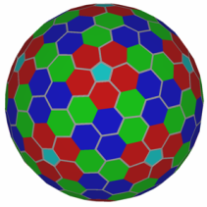













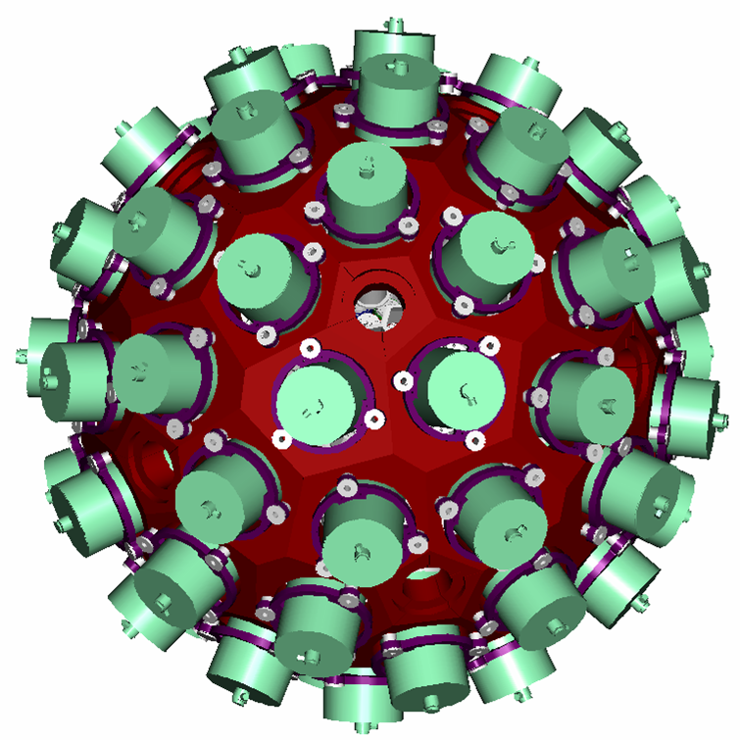
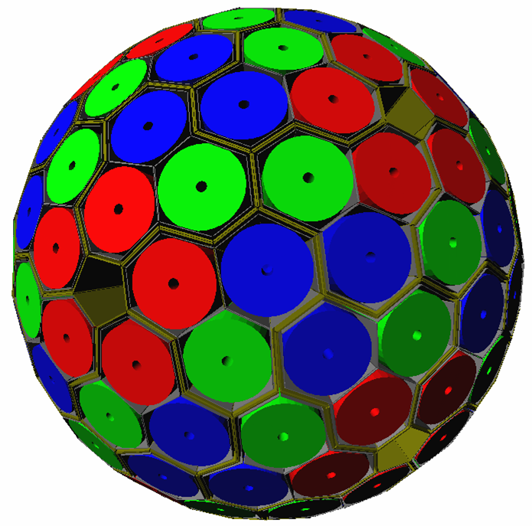
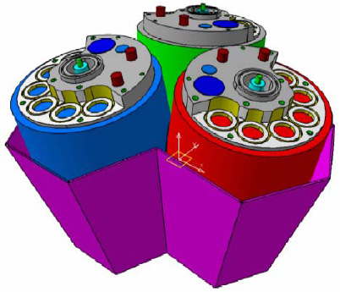
Advanced GAmma Tracking Array
180 hexagonal crystals 3 shapes
60 triple-clusters all equal
Inner radius (Ge) 23.5 cm
Amount of germanium 362 kg
Solid angle coverage 82 %
36-fold segmentation 6480 segments
Singles rate ~50 kHz
Efficiency: 43% (M_{γ}=1) 28% (M_{γ}=30)
Peak/Total: 58% (M_{γ}=1) 49% (M_{γ}=30)
6660 high-resolution digital electronics channels
Coupling to ancillary detectors for added selectivity

Slide 7
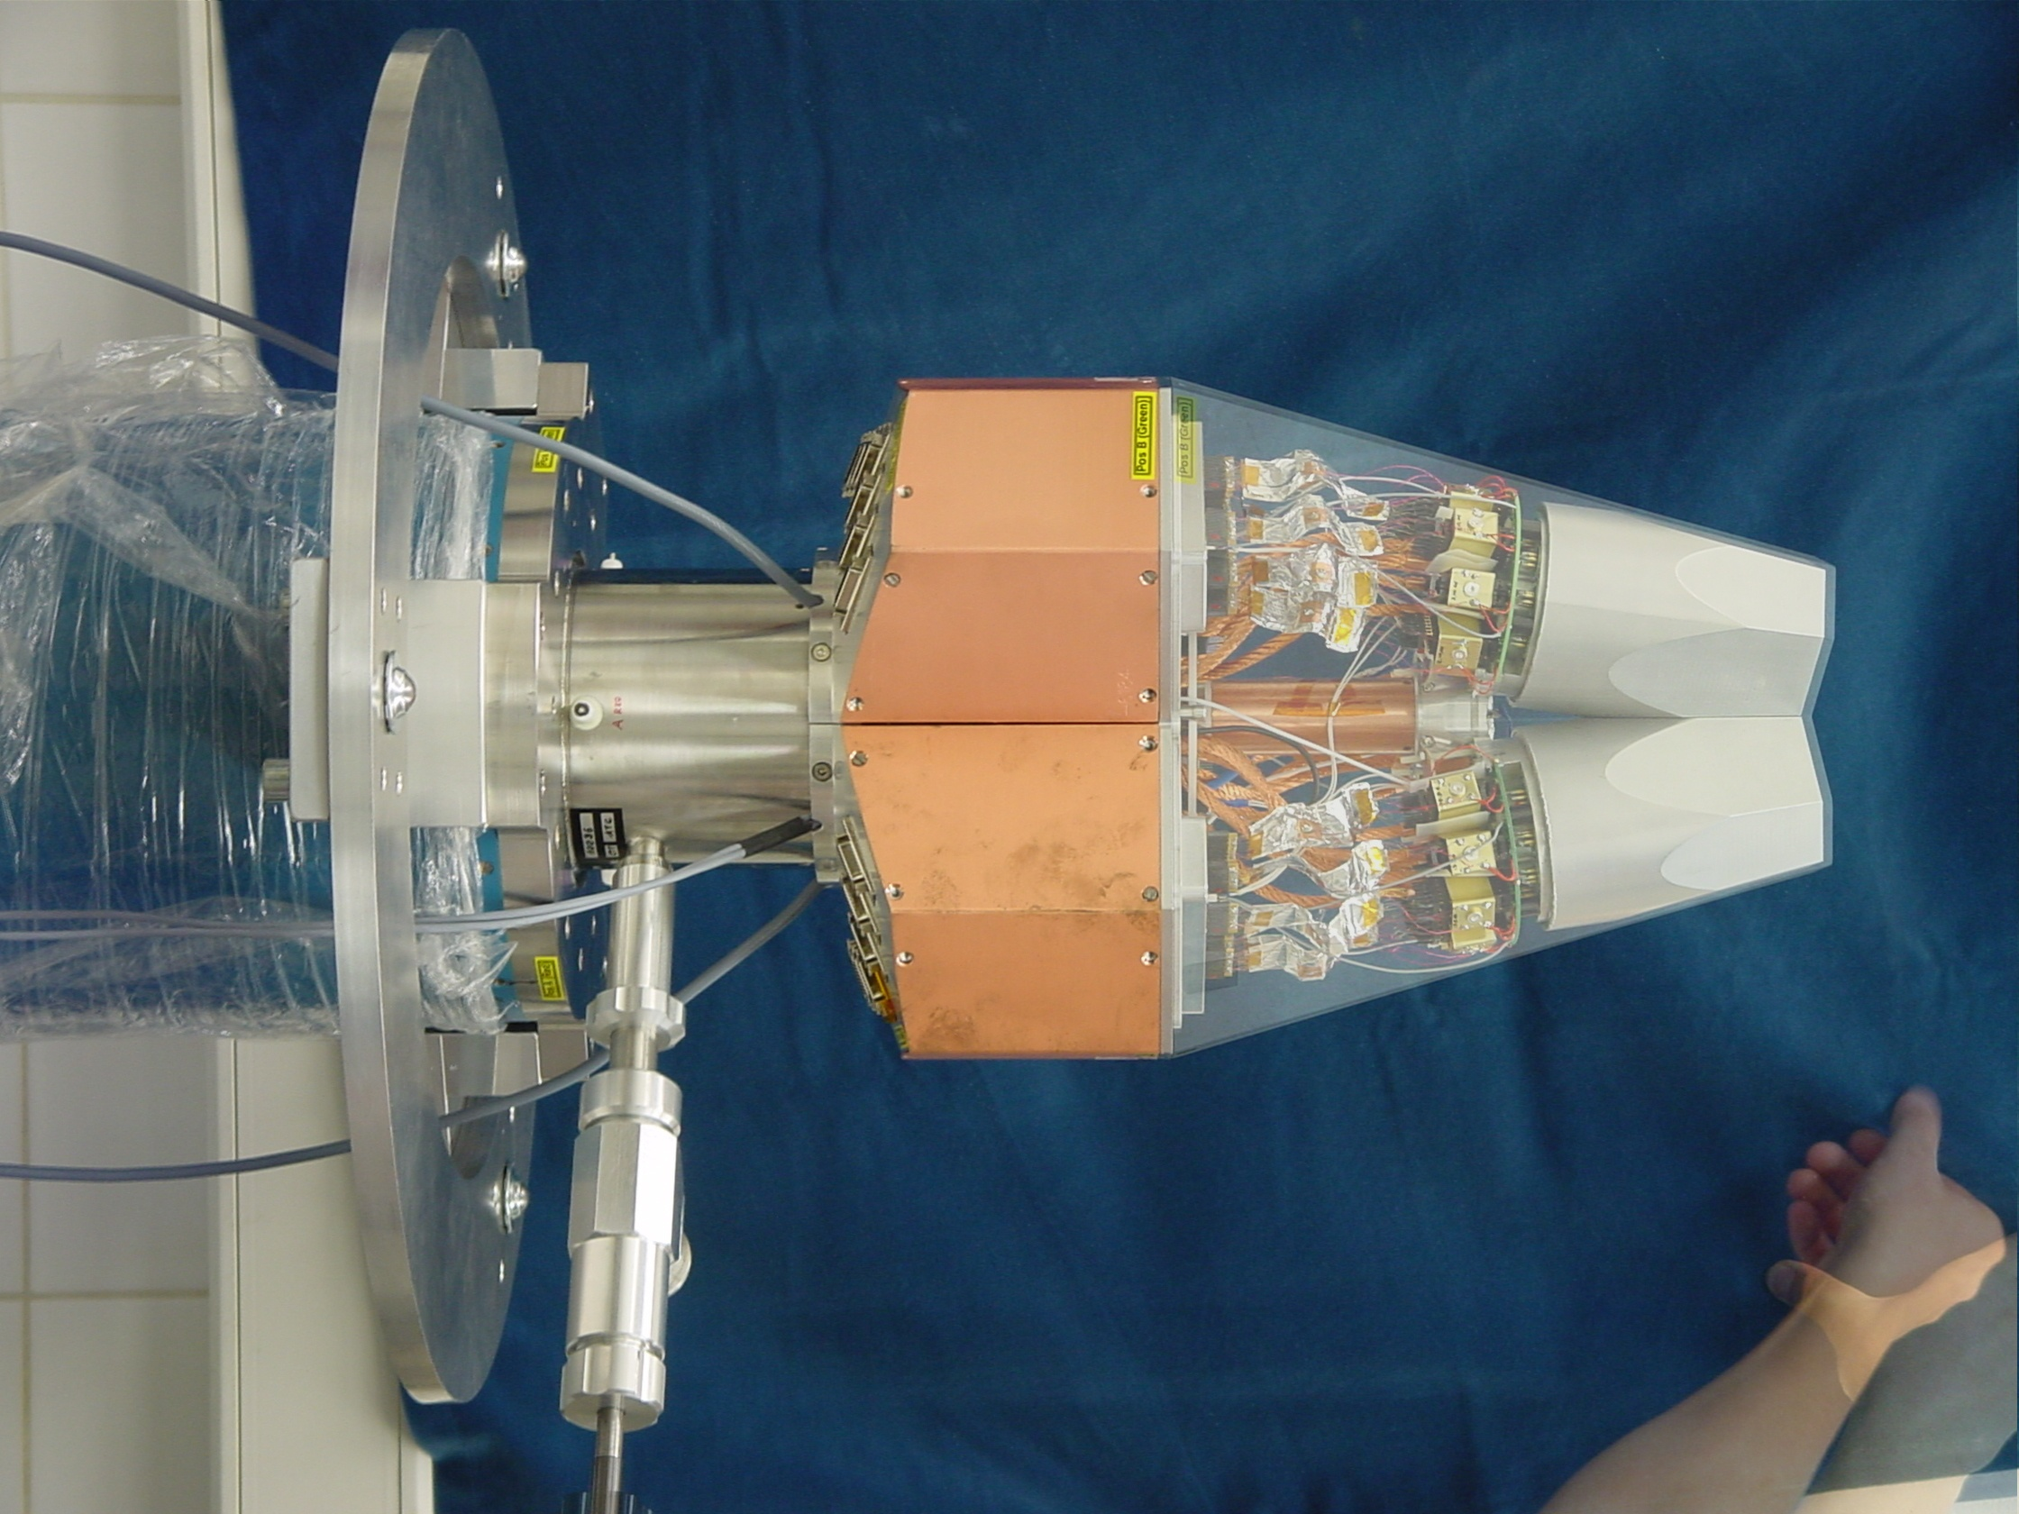
Asymmetric AGATA Triple Cryostat
- integration of 111 high resolution
spectroscopy channels
- cold FET technology for all signals
Challenges:
- mechanical precision
- LN2 consumption
- microphonics
- noise, high frequencies
A. Wiens, et al., Nucl. Instr. and Meth. A (2010), doi:10.1016/j.nima.2010.02.102

Slide 8


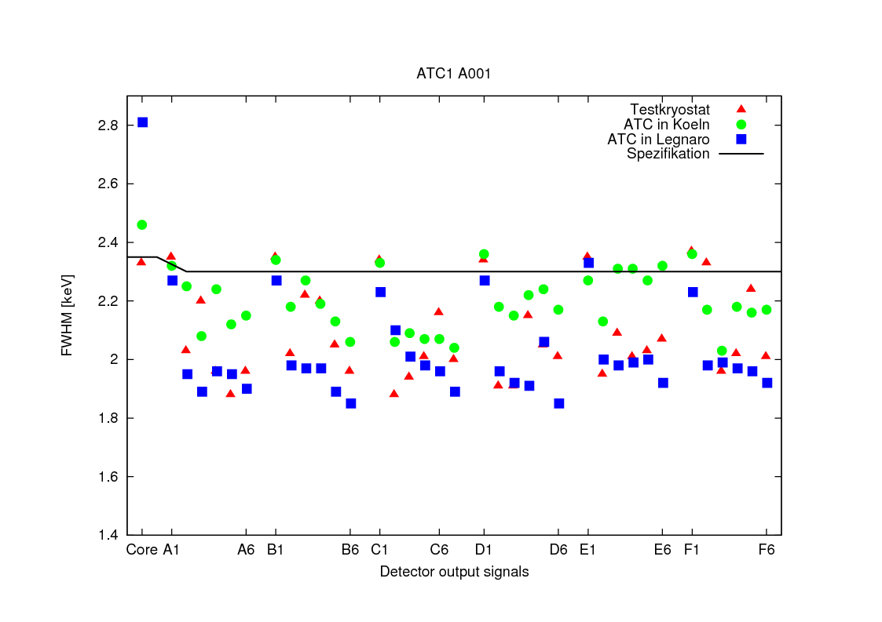
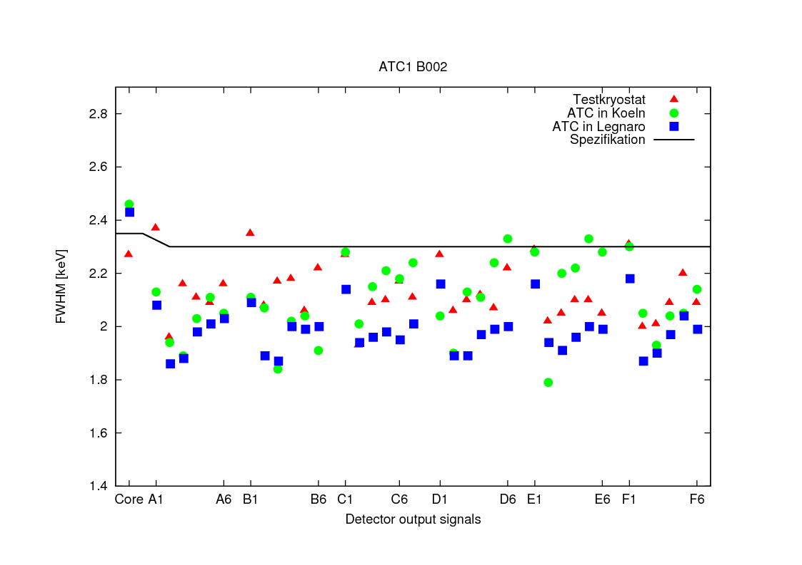
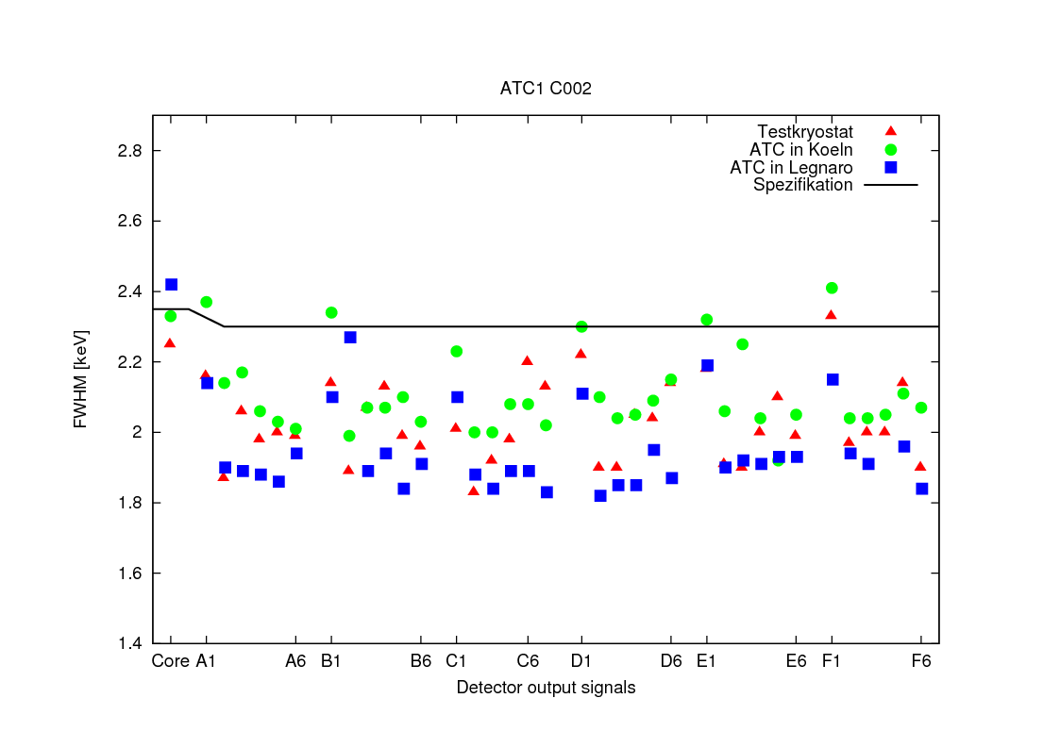
AGATA tripel cluster ATC1
Measured at Köln and Legnaro
Mean values of energy resolution of
segments at 60 keV and 1,3 MeV:
A001 : 1011 +/- 53 eV 2,00 keV
B002 : 1039 +/- 70 eV 1,98 keV
C002 : 965 +/- 63 eV 1,94 keV

Slide 9
Extended energy range - dual core preamplifier
Ideal non-saturated output without pulsed-reset
Saturated output without pulsed-reset
G. Pascovici, IKP
ADC overflow voltage level
Δt
Preamplifier output with continuous-reset (50μs decay time constant)
Output with pulsed-reset
An ADC overflow condition would saturate the system for a long while
Pulsed-reset mechanism allows fast recovery of the output
(upto x4/x5 in throughput)
“Time Over Threshold” (T.O.T) : Δt ∝ E
Notes:
If a high energetic signal occurs in the detector, the output of the preamp could go in saturation for a long time,
such that one is not able to process the next pulses.
With our de-saturation circuitry, one is able to detect such pulses and to restore the output quickly to zero.
One is then immediately ready to accept the next pulse.
But instead of just waiting till the baseline is restored, we can do more…
>>

Slide 10
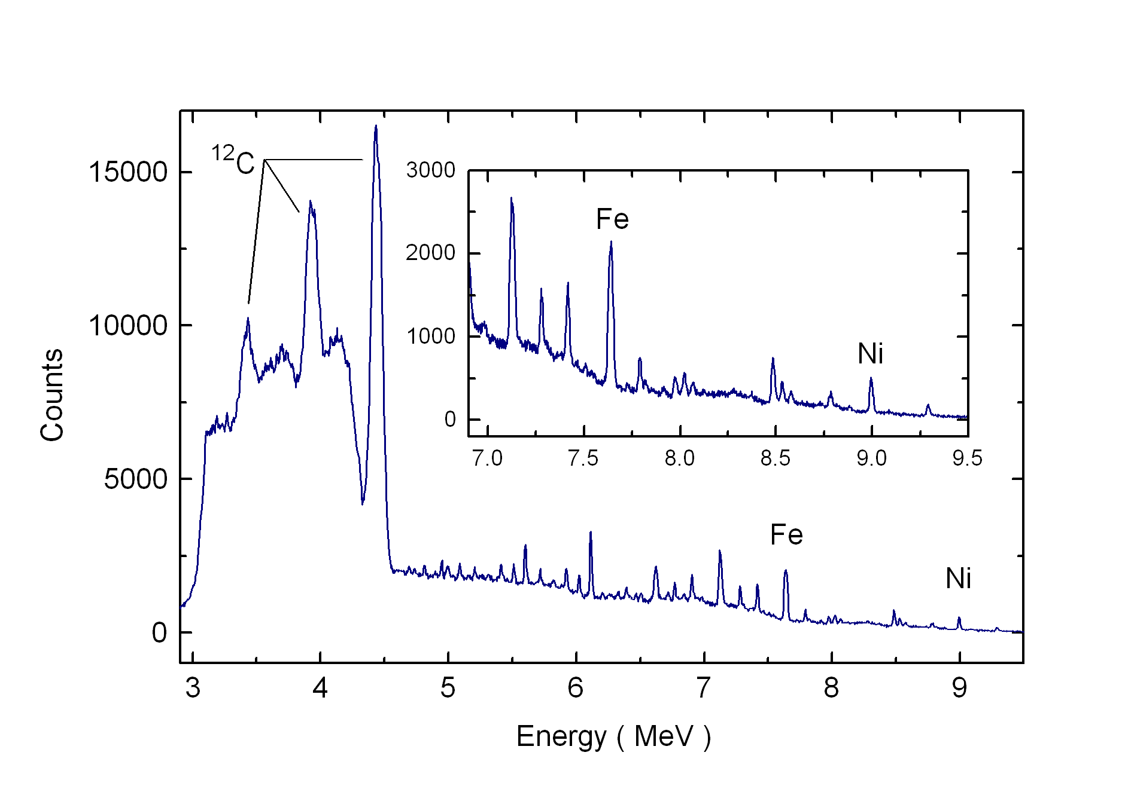
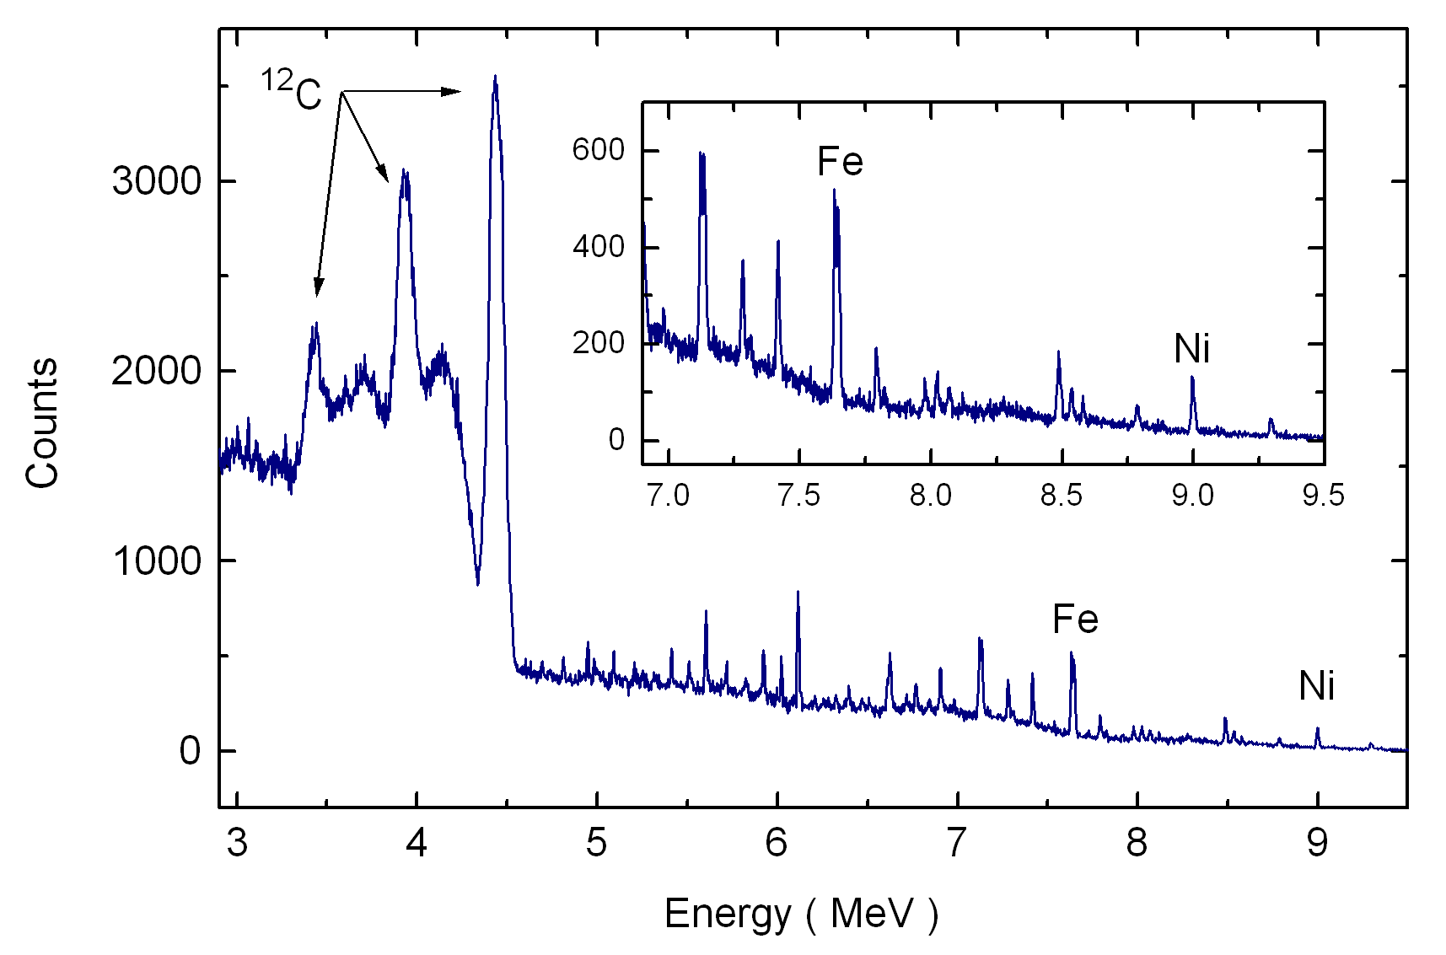
Extended energy range
“reset” mode (by TOT technique)
Energy | Resolution (fwhm) pulse-height mode |  | Resolution (fwhm) reset mode
5.6 MeV | 10.5 keV | 0.14 % | 18.8 keV | 0.34 %
6.1 MeV | 15.1 keV | 0.17 % | 17.1 keV | 0.28 %
7.6 MeV | 11 keV | 0.14 % | 18.8 keV | 0.25 %
9.0 MeV | 15 keV | 0.17 % | 18.9 keV | 0.21 %
Reset threshold
At high energies (> 10 MeV)
TOT mode ~ pulse-height mode
“pulse-height” mode
Notes:
Here are some results obtained with this new method.
Above you see a spectrum taken with the new Time ove Threshold method.
The reset threshold was set to 3MeV.
One observes that indeed an increase takes place in throughput when this level is reached,
From 1500cts at 3MeV in the pulse height spectrum to over 6000 cts in the TOT spectrum.
Below you see the same spectrum taken with the common “pulse-height” method.
You see that, although al lower energies the pulse-height method performs better,
From 9/10 MeV on, TOT really performs as good as the pulse-height method.
>>

Slide 11
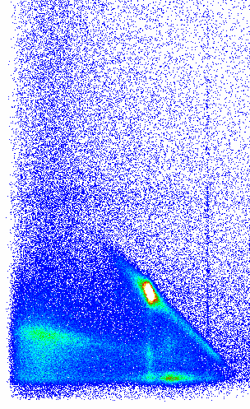
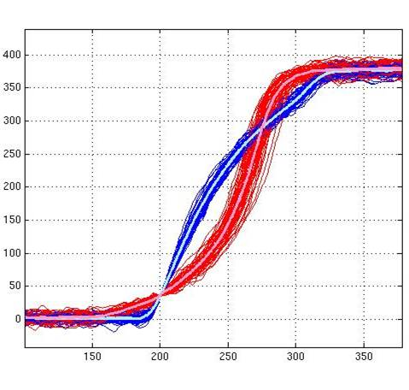
Characterization of Ge detectors
U. Liverpool
Ge Energy
920 MBq ¹³⁷Cs source
1 mm diameter collimator
NaI Energy
Region of
Interest
288keV
288 keV
374keV
374 keV
662keV
<110>
<010>
T30
T60
T90

Slide 12
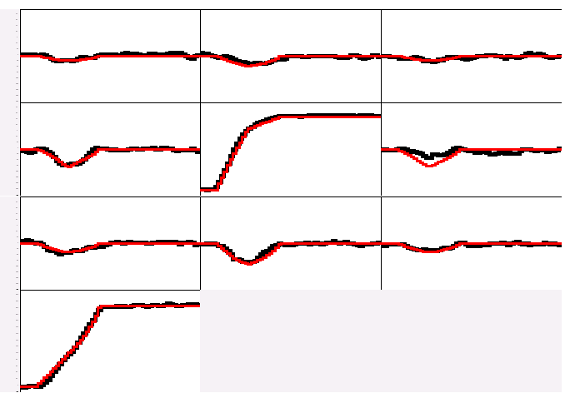
Pulse Shape Analysis concept
A3
A4
A5
Result of
Grid Search
Algorithm
B3
B4
B5
(10,25,46)
C3
C4
C5
y
CORE
C4
B4
measured
calculated
D4
A4
x
791 keV deposited in segment B4
E4
F4
z = 46 mm

Slide 13
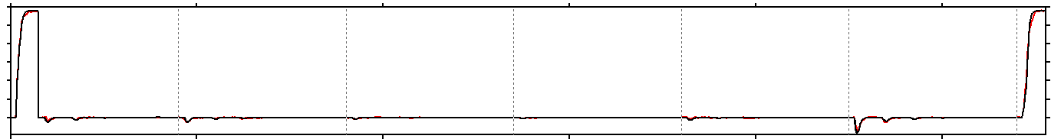
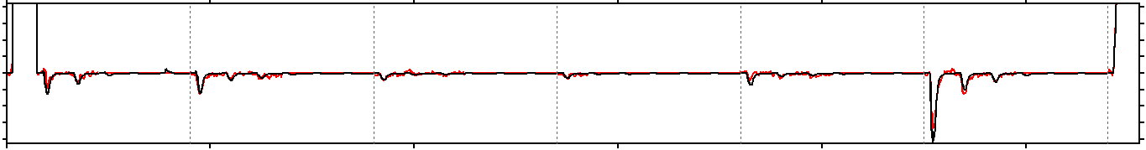
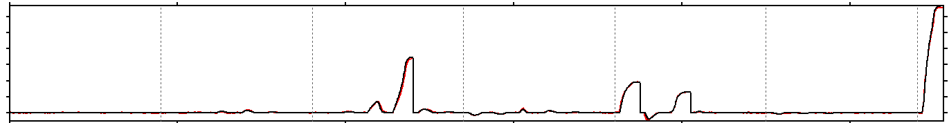
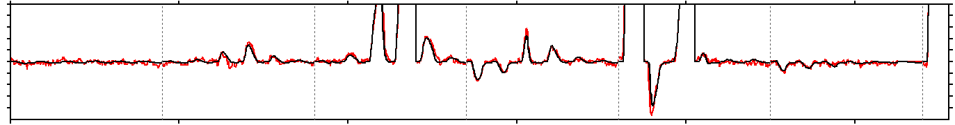
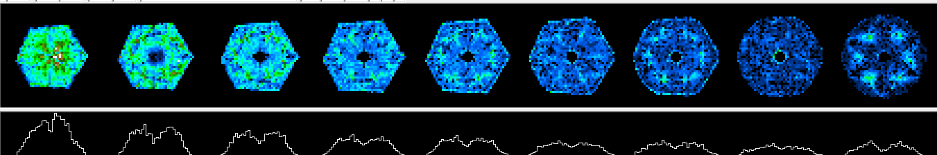
Examples of signal decomposition
Eγ = 1172 keV net-charge in A1
A B C D E F CC
Eγ = 1332 keV net-charge in C3, E1, E3

Slide 14
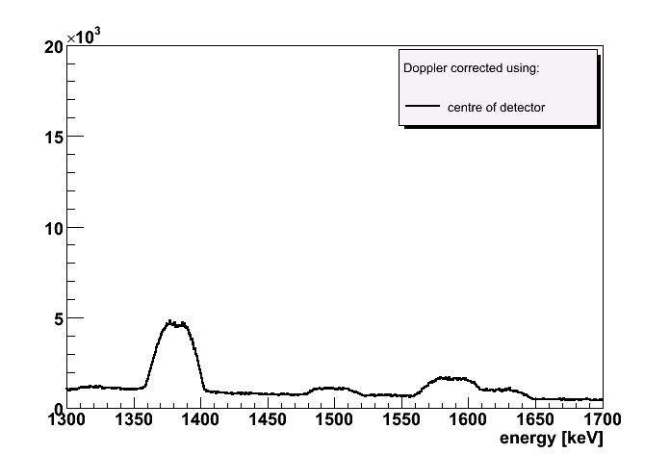
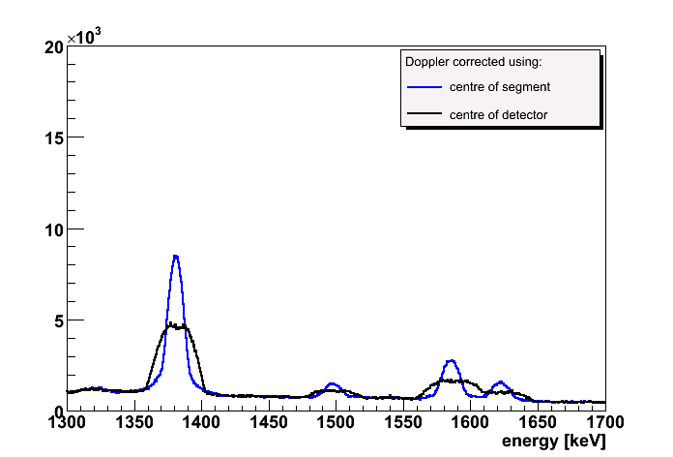
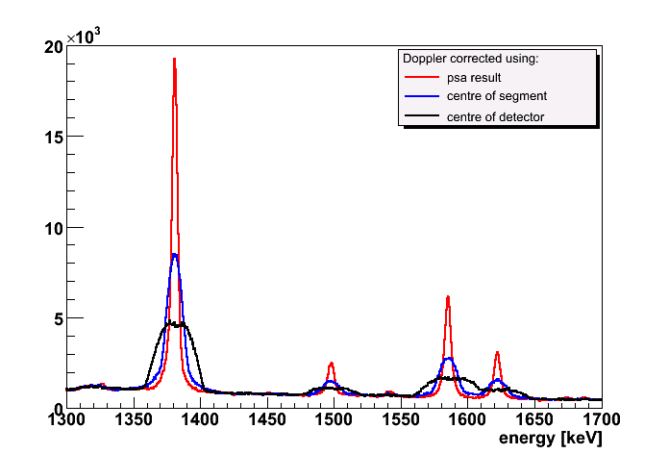
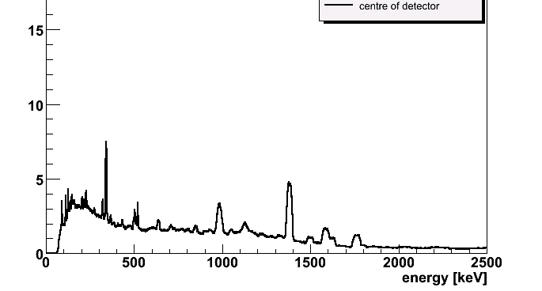
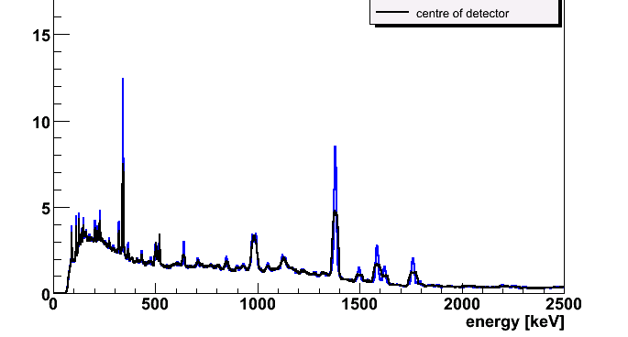
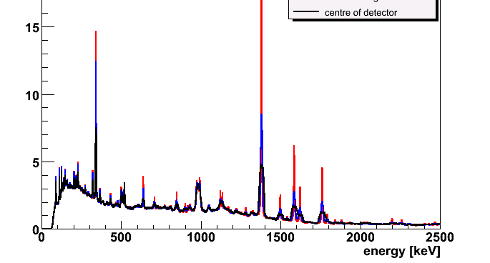
Doppler correction using PSA results
d(⁴⁸Ti,⁴⁹Ti)p
4.8 keV
11 keV
11 keV
32 keV
32 keV
32 keV
Position resolution derived by comparing with MC
➔ 5 mm FWHM

Slide 15
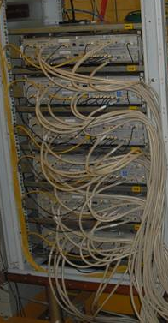
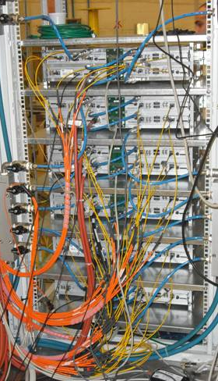
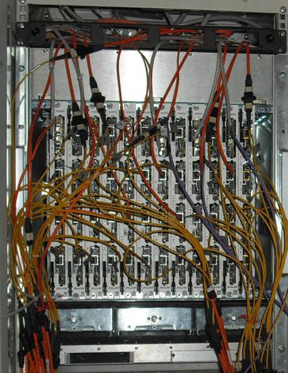
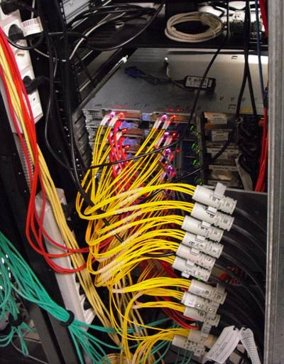
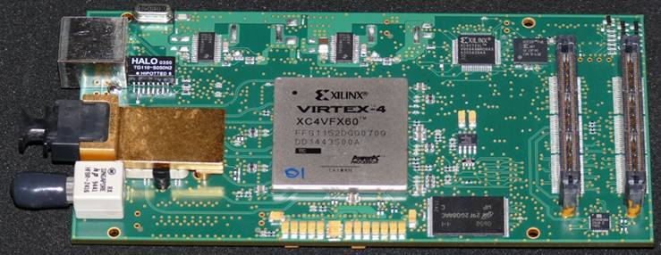
AGATA Electronics
Digitisers
in the experimental hall
Digital proc. electronics
in the users area
Computer farm
in the computing room
10 m long MDR cables
80 m long optical fibers
20 m long optical fibers
LAN to the disk servers
2 ATCA carriers per crystal:
- Master with
1 GTS mezzanine
3 proc. mezzanines (Core A B)
- Slave with
4 proc. mezzanines (C D E F)
One digitizer per crystal:
- core module with
1 core board (clock + 2 cores)
2 segment boards (A B )
- segment module with
4 segment boards (C D E F )
1 pizza-box per crystal:
Readout and save orig. data
Pre-processing of events
PSA
10 pizza-boxes for
Event Builder and Merger
Ancillary and Tracking
120 TB of storage +
Archiving on Grid T1
6 channels processing mezzanine

Slide 16
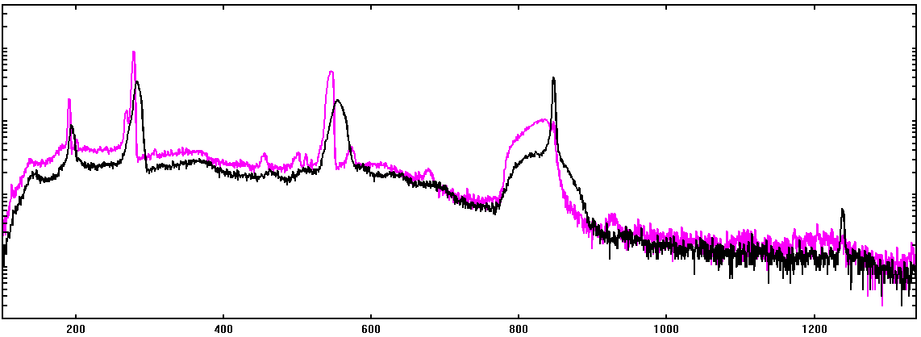
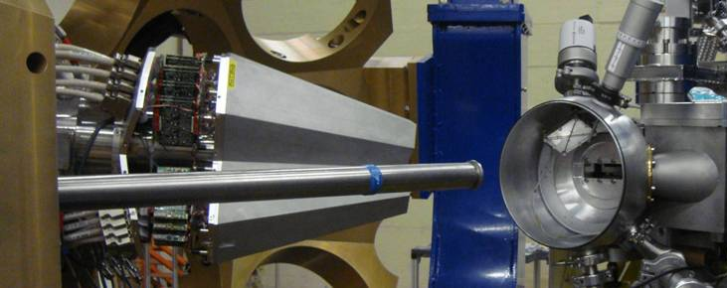
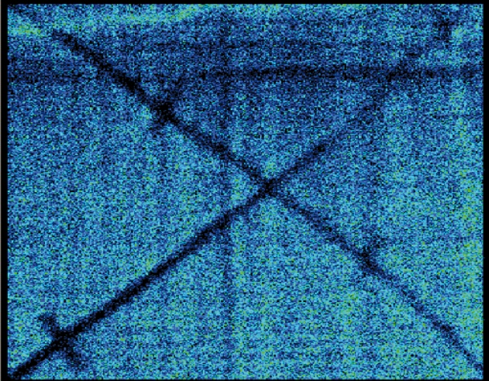
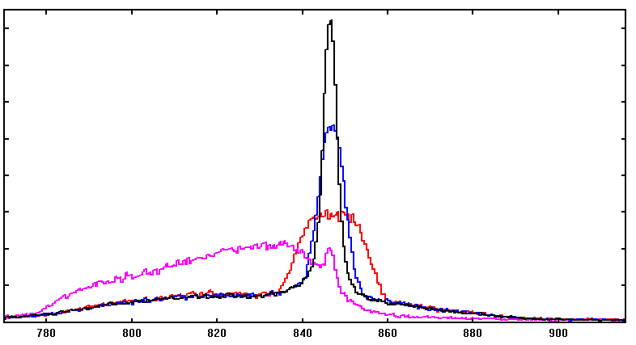
220 MeV ⁵⁶Fe → ¹⁹⁷Au
ATC1 + DANTE - MCP
Commissioning phase in 2009 INFN Legnaro
Au recoils also seen by Dante
⁵⁶Fe 2⁺ → 0⁺
846.8 keV
⁵⁶Fe 4⁺ → 2⁺
1238.3 keV
4.8 keV FWHM
Original
Corrected
Doppler correction using
PSA (AGS) and tracking
FWHM = 3.7 keV
(3.5 keV if only single hits)
v/c ~ 8%
E(2⁺) = 846.8 keV
Doppler correction using
center of hit segments
FWHM = 7 keV
Total projection.
Detector FWHM = 2.2 keV
Doppler correction using
center of crystals
FWHM ~20 keV
E_{γ} (keV)

Slide 17
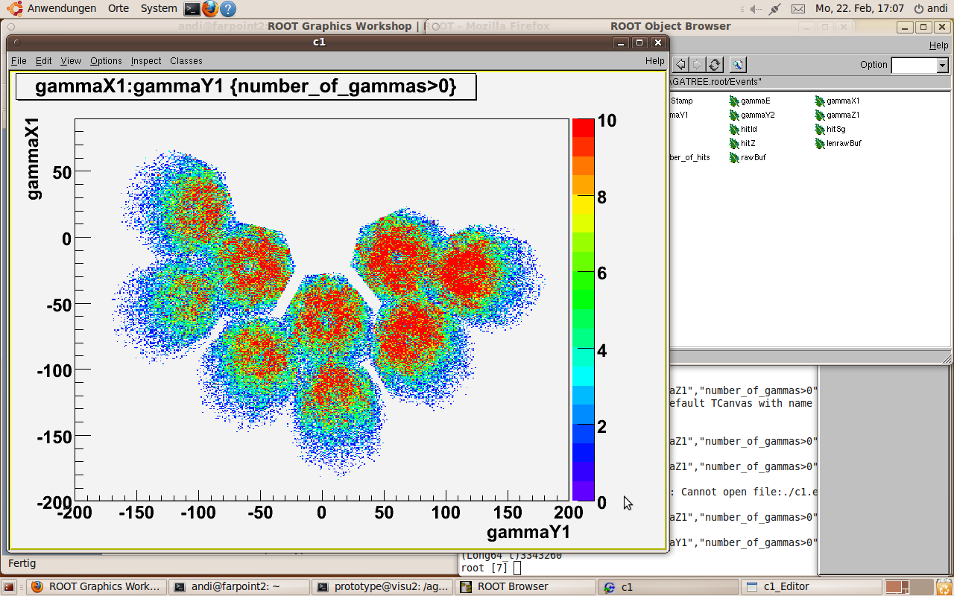
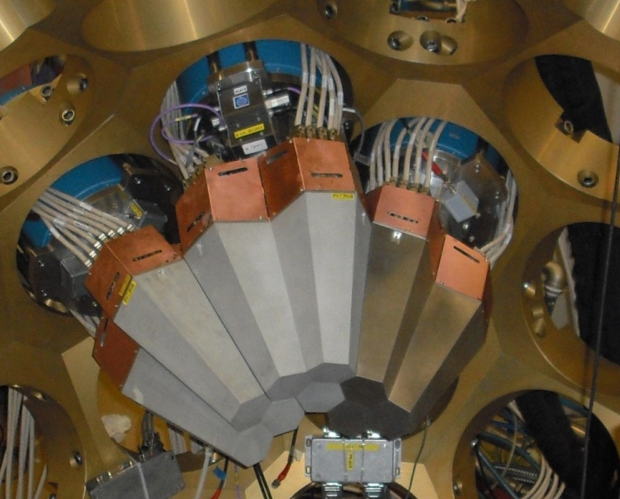
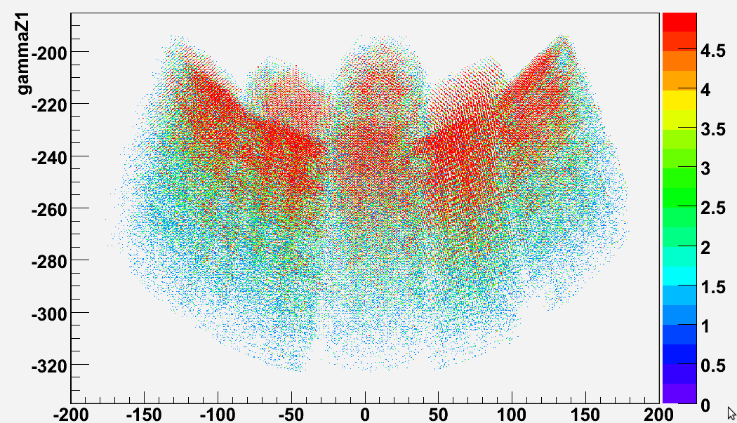
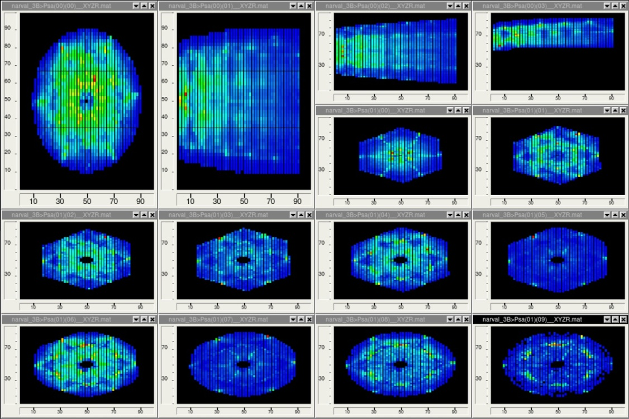
AGATA PSA online

Slide 18
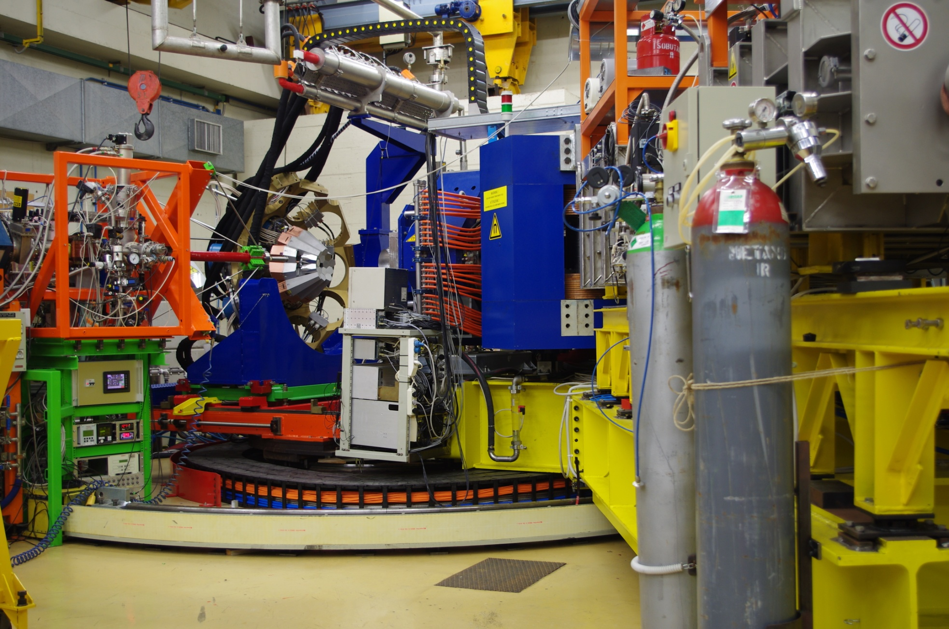


AGATA Demonstrator + PRISMA installation started mid 2008, completed mid 2009
31 March 2010

Slide 19


AGATA Demonstrator
5 asymmetric triple-clusters
15 ×36-fold segmented crystals
540 segments
555 high resolution digital-channels
Efficiency: 3 – 6 % (M_{γ}=1)
2 – 4 % (M_{γ}=30)
Improved energy resolution
Operate in real time:
pulse shape analysis
γ−tracking
LNL PRISMA

Slide 20



Superdeformed band in ⁴²Ca??
Evidence of GDR feeding from very deformed hot ⁴⁶Ti of highly-deformed band in ⁴²Ca (HECTOR + EB IV exp.)
M. Kmiecik et al., Acta Phys. Pol. B36, 1169 (2005).
2⁺ → 0⁺
1525 keV
⁴²Ca @170MeV+²⁰⁸Pb
Doppler-corrected
Original
preliminary
2⁺₂ → 0⁺ ??
2424 keV
M. Lach et al., Eur Phys J. A12, 381 (2001)
4⁺ → 2⁺
1228 keV
1⁻ → 2⁺
2045 keV
3 ATC’s
²⁰⁸Pb target
x10
The quality of Doppler correction is consistent with the predictions from Monte Carlo simulations
3 DANTE’s
beam (⁴²Ca@170 MeV)
Courtesy: A.Maj, F.Azaiez, P.Napiórkowski

Slide 21




AGATA demonstrator coupled to PRISMA
Efficiency at 1MeV:
~3% at 23.5 cm
~6% at 13.5 cm
Improved energy resolution due to tracking
v/c distribution
β ~ 8.9%
AGATA-PRISMA
CLARA-PRISMA

Slide 22








Ion tracking in PRISMA
q
v/c
BEAM LIKE
IC Energy [a.u.]
TARGET LIKE
TRUE RECOIL VELOCITY+ TRAJECTORY IN DIPOLE+ TOTAL ENERGY
ρv [a.u.]
DIPOLE
MWPPAC
IONIZATION CHAMBER
5‰ Energy resolution
MCP Start Detector
Z
A
MCP-MWPPAC ΔTOF=0.5 ns
IC Energy [a.u.]
S.Beghini et al. NIM A551, 364 (05)
G.Montagnoli et al. NIM A547, 455 (05)
IC Range [a.u.]

Slide 23



Fe isotopes from ⁶⁴Ni+²³⁸U at E_{lab}=404 MeV
2⁺→0⁺
4⁺→2⁺
Fe (-2p)
2⁺→0⁺
4⁺→2⁺
2⁺→0⁺
4⁺→2⁺
2⁺→0⁺
4⁺→2⁺
gating on mass
S.Lunardi et al., Phys. Rev. C 76(2007)034303
Neutron rich nuclei produced in fission of ²³⁸U from ¹³⁶Xe+²³⁸U
N.Marginean et al., Phys. Rev. C80 (2009) 021301 R

Slide 24



⁵¹Ca and ⁵²Sc nuclei from deep inelastic reaction ⁴⁸Ca+²³⁸U at E_{lab}=330 MeV
CLARA-PRISMA
reaction product-γ coincidences
GAMMASPHERE thick-target
γ γ coincidence
Notes:
24

Slide 25


Differential RDDS Measurements at the
AGATA – PRISMA setup
Lifetime measurements
plunger
γγ coincidences
PRISMA
degrader
target
New plunger setup for RDDS measurements in grazing reactions
Lifetimes: ~0.5 to ~500 ps
A.Dewald, et al, IKP-Uni. Köln
beam
Also at EXOGAM-VAMOS

Slide 26



Differential RDDS Measurements
Example: CLARA – PRISMA setup
J.J.Valiente-Dobon et al, PRL102(2009)242502

Slide 27

AGATA demonstrator @ LNL Scientific programme
More than 26 LoI:
Highly Excited Collective Modes.
Proton rich mirror nuclei populated by transfer reactions.
Order-Chaos transition in
warm rotating nuclei.
Proton drip-line
Neutron drip-line
Evolution of collectivity and dynamical Symmetries in the rare earths
Mixed-symmetry states
Quenching of the N=82 shell gap in n-rich nuclei
N=50 shell gap: lifetimes, new excited states
Spectroscopy and lifetimes in the n-rich region A~60, N~40
Lifetimes in the region of the island of inversion
protons
neutrons

Slide 28



N=20, N=50 and N=82 Shell Gaps
Contribution of tensor interaction to the monopole term in
N=20, 50 and 82
T. Otsuka et al., PRL 95, 232502 (2005)
GXPF1 interaction
Ni isotopes
neutrons in g_{9/2}
C.Petrache, et al., E.Sahin, et al., R.Chapman et al., G. Duchêne et al., F.Azaiez et al., A.Gadea et al.

Slide 29


Single-Particle Behavior
Evolution of single-particle states with N/Z.
Tests of large-scale shell model interactions: level energies and transition rates
Transition rates in ⁵²Ca as a test of different shell model interactions.
Studies of ⁷¹⁻⁷⁵Cu to provide information concerning the tensor-driven monopole shifts in the vicinity of ⁷⁸Ni
Transition rates around ¹³²Sn as a probe of unusual behaviour of “d_{5/2}” states in ^{133,135}Sb
Multi-nucleon transfer PRISMA
RDDS Lifetimes
Structure of n-rich nuclei in the vicinity of ²⁰⁸Pb
Multi-nucleon transfer PRISMA

Slide 30




New magic numbers and shape evolution
Zn
Ni
Fe
Cr
Ti
Ca
πf_{7/2}
g_{9/2}
40
νf_{7/2}
νp_{3/2}
32
p_{1/2}f_{5/2}
Shell evolution produces new magic numbers and regions of deformation:
N=32 shell closure for Z~20, N→40 Z<28 transitional and deformed
Shape evolution in nuclei Z>28 with 40<N<50
J.J.Valiente-Dobón et al., D.Mengoni et al., S.M.Lenzi et al., A. Görgen et al., A.D.M.Cullen et al.,

Slide 31
Shapes and Collectivity
Shape coexisting intruder cross-shell sd-fp excitations near island of inversion in neutron–rich Mg, Si, P and S. Collective negative parity states
Effects of the g_{9/2} orbital in neutron-rich fp-shell nuclei Cr, Mn, Fe and Ni: shape changes and ground-state deformation.
Measurement of lifetimes and quadruple moments
in neutron-rich Zn isotopes. Lifetimes in n-rich Ni isotopes
Multi-nucleon transfer - PRISMA
RDDS lifetimes
States at moderate spin around the deformed closure at N=98 in rare-earth nuclei. Investigate interaction strengths and sp-collective interplay in weak pairing regime. ¹⁷⁸Yb: Most rigid?
Proton sub-shell closure at Z=74 and neutron magic number at N=116. ¹³⁶Xe +¹⁹²Os Partners detected with PRISMA
Collective and symmetry properties of nuclei around the ¹⁷⁰Dy valence maximum
Multi-nucleon transfer - PRISMA

Slide 32



Collective modes in the continuum
Collective Rotation
- Order-to-Chaos Transition
CN reactions and
Deep-Inelastic collisions
Collective Vibrations
- Prompt dipole emission
CN reactions
- Highly excited/Pygmy
states in n-rich nuclei
Deep-Inelastic Collisions
- Giant Quadrupole Resonance
Inelastic Scattering
Fusion - evaporation
Compound
Nucleus
Chaos
n
n
n
10⁻¹⁹ sec
I
I+2
p
I-2
Band mixing
T≠0
ü
γ−decay
10⁻¹⁵ sec
focus on the connection between chaotic and ordered regime
T=0
Regular bands
Order
G. Benzoni, N. Blasi , A. Bracco, S. Brambilla, F. Camera, A. Corsi, F.C.L. Crespi, S. Leoni, B. Million, D. Montanari, O. Wieland, et al.

Slide 33
Experiments approved/performed
Coulomb Excitation of the Presumably Super-Deformed Band in ⁴²Ca (A.Maj, F.Azaiez, P.Napiórkowski)
Precision lifetime study in the neutron-rich N=84 isotone ¹⁴⁰Ba from DSAM measurements following Coulomb-barrier alpha-transfer reactions on a ¹³⁶Xe beam (J.Leske)
Neutron-rich nuclei in the vicinity of ²⁰⁸Pb (Zs.Podolyák)
Inelastic scattering as a tool to search for highly excited states up to the region of the Giant Quadrupole Resonance (R.Nicolini)
Lifetime measurements of the neutron-rich Cr isotopes (J.J.Valiente-Dobón)
Lifetime measurement in neutron-rich Ni, Cu and Zn isotopes (E.Sahin, M.Doncel, A.Görgen)
Lifetime measurement of the 6.792MeV state in ¹⁵O (R.Menegazzo)
Order-to-chaos transition in warm rotating ¹⁷⁴W nuclei (V.Vandone)
ü
ü
ü

Slide 34



AGATA Demonstrator and AGATA 1π
Plans for the next few years
LNL: 2010-2011
5 TC
Total Eff. ~6%
GSI: 2012-2013
≥ 8 TC
Total Eff. > 10%
GANIL: 2014-2015
15 TC
Total Eff. > 20%
AGATA D. + PRISMA
AGATA + FRS
AGATA+VAMOS

Slide 35


Relativistic beams at GSI
accelerators:
UNILAC (injector) - E<15 AMeV
SIS - E < 1 AGeV
beams:
All ion species up to ²³⁸U
Currents:
  ²³⁸U - 2* 10⁸ pps
  medium mass nuclei - 10⁹ pps

Slide 36



AGATA set-up at GSI
In flight high resolution γ-spectroscopy at the FRS
production
<1GeV/u
selection
spectroscopy
identification
reaction
identification
35m
100-700MeV/u
Bρ - ∆E - Bρ
AGATA array
CATE
SI-CsI
LYCCA

Slide 37
γ-spectroscopy at relativistic energies
High cross sections
Coulomb excitation
Secondary fragmentation
Thick targets
Lorentz boost of γ-rays
Doppler shift
Gain in geometrical efficiency
Doppler broadening
Atomic background, a limiting factor
σ (atomic) ~ 10000 * σ (nuclear)
Doppler broadening
Detector opening angle Δθ=3°
ΔE_{γ0}/E_{γ0} [%]
β=0.57
β=0.43
β=0.11
θ_{lab} [deg]

Slide 38






Towards AGATA 1π array
10 Triple Clusters (S2) + 5 Double Cluster detectors closing part of the central hole ➔ beam pipe diameter ≈9-12cm (5 hexagons + pentagon hole)
10 triple Cluster + 5 double Cluster = 45 Ge detectors

Slide 39




AGATA vs. RISING
High-energy Coulomb excitation of ⁵⁴Cr
RISING
exp. data
AGATA-15
simulation
Counts/4 keV
390 cts
σ: 6.7 keV
Counts/4 keV
830 cts
σ: 3.1 keV
RISING
simulation
AGATA-180
simulation
Counts/4 keV
400 cts
σ: 8.4 keV
Counts/4keV
4950 cts
σ: 4.9 keV

Slide 40


Particle identification before/after secondary target
Double fragmentation reaction:
⁴⁰Ca (420 MeV/u) + ⁹Be (4.0 g/cm²) → ³⁷Ca (196 MeV/u ) + ⁹Be (0.7 g/cm²)
Selection by FRS
Selection by CATE
³⁷Ca (85 %)
2*10³ p/sec
³⁶K (10 %)
Future: improved selection by LYCCA

Slide 41


E(2⁺)-transition in ³⁶Ca
β = 0.545
Cluster
³⁶Ca E(2⁺) = 3015(16) keV
MINIBALL
HECTOR
Z, N
³⁶Ca E(2⁺) - ³⁶S E(2⁺) = -276(16) keV

Slide 42
Shell model calculation for T=1,2 nuclei in sd-shell
Confirmation of modifications by
recent MSU result on last and
missing 2⁺ MED in sd-shell for
²⁰Mg and ²⁰O pair.
Motivation for future work
with AGATA up to Sn
Spectroscopy beyond the N=Z
line
*H. Herndl et al., Phys. Rev. C 52 (1995) 1078
P. Doornenbal et al., Phys. Lett. B647, 237 (2007).
A. Gade et al. Phys. Rev. C 76, 024317 (2007)

Slide 43
Enhanced B(E2) values towards ¹⁰⁰Sn
Enhanced B(E2) values towards ¹⁰⁰Sn
GSI
relativistic energy Coulex RISING
¹⁰⁸Sn B(E2) = 0.230(57) e²b²
A. Banu et al, Phys. Rev. C 72 061305(R) (2005)
sub-barrier Coulex REX-ISOLDE
¹¹⁰Sn B(E2) = 0.220(22) e²b²
J. Cederkäll et al., Phys. Rev. Lett. 98, 172501 (2007)
intermediate energy Coulex NSCL
^{106,108,110,112}Sn B(E2) > 0.22 e²b²
C. Vaman et al., Phys. Rev. Lett. 99, 162501 (2007),
sub-barrier Coulex REX-ISOLDE
^{106,108}Sn
A. Ekström et al., Phys. Rev. Lett. 101, 012502 (2008)
sub-barrier, stable Coulex GSI
¹¹⁴Sn
P. Doornenbal et al., Phys. Rev. C 78, 031303(R) (2008)
RISING

Slide 44


plunger device for radioactive beams
target/ degrader diameter: 4 cm
target/ degrader separation: 0 - 2,5 cm
precision : ~ 1 μm
target/ degrader thickness: ~1μm -1mm
⁶⁴Ge: 2⁺₁ → 0⁺
140° 30°
0 μm
200 μm
500 μm
K. Starosta, A. Dewald et al. Phys.Rev.Lett. 99, 042503 (2007)

Slide 45



DSAM line shape analysis on first 2⁺ of ⁷⁴Ni
MC simulation of a fragmentation experiment
2⁺
⁷⁶Zn @ 150 MeV/u
⁷⁴Ni
1024 keV
τ = ?
0⁺
Fe Target (500mg/cm²)
⁷⁴Ni
τ = 0.5 to 1.5 ps
Zoom
Notes:
45

Slide 46

Workshop on AGATA physics at GSI
LOI’s will be grouped around:
Shell structure in nuclei
Structure of doubly magic nuclei
Changes in the (effective) interactions
Shape coexistence
Proton drip line and N=Z nuclei
Spectroscopy beyond the drip line
Proton-neutron pairing
Isospin symmetry
Nuclear shapes
Exotic shapes and isomers
Coexistence and transitions
¹⁰⁰Sn
Neutron rich heavy nuclei (N/Z → 2)
Large neutron skins (r_{ν}-r_{π}→ 1fm)
New coherent excitation modes
Shell quenching
⁴⁸Ni
^{132+x}Sn
⁷⁸Ni
Nuclei at the neutron drip line (Z→25)
Very large proton-neutron asymmetries
Resonant excitation modes
New exotic decay modes

