Slide 1
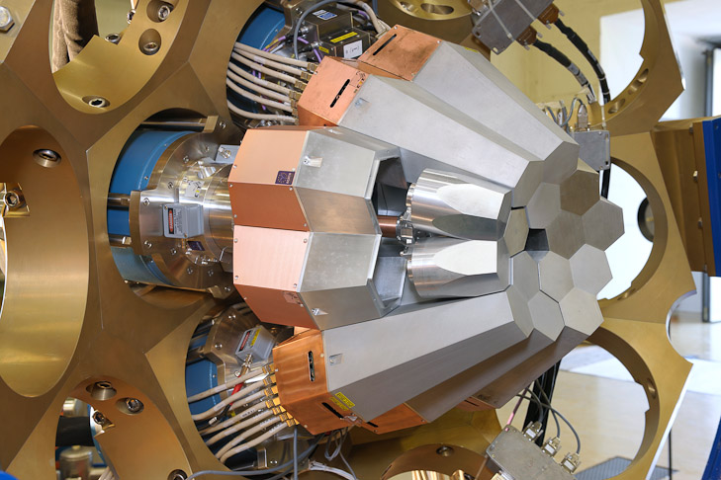


Pulse Shape Analysis
and γ-RayTracking
With the
AGATA DEMONSTRATOR
Schleching, März 2011
Bart Bruyneel, B. Birkenbach,
J. Eberth, H. Hess, D. Lersch,
G. Pascovici, P. Reiter, A. Wiens,
IKP - Uni zu Köln

Slide 2
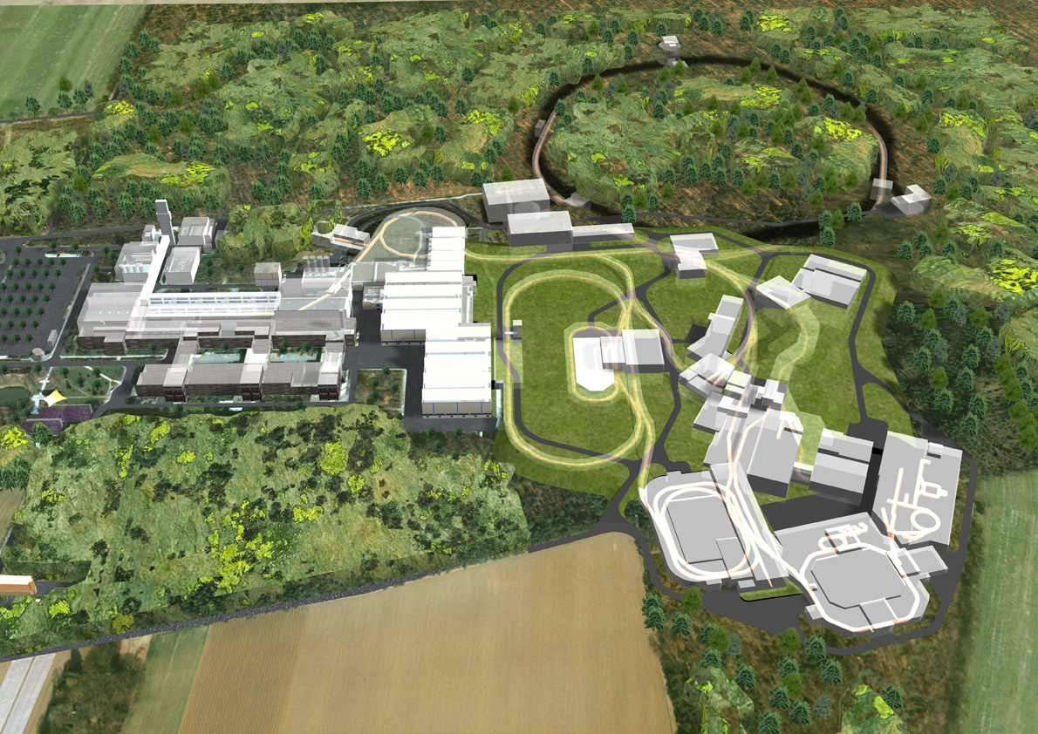


New Facilities, New challenges
SPIRAL2 - HIE-ISOLDE - EURISOL - ECOS
Relativistic exotic beams …
Low beam intensity
High backgrounds
Large Doppler broadening
High γ-ray multiplicities
High counting rates
…Need :
High efficiency
High sensitivity
High position resolution
High Peak/Total
High throughput
Notes:
Future facilities like FAIR will provide us access to the most exotic reaction channels.
This means: >>
Low beam intensities combined with high backgrounds.
In specific for Fair one is speaking about relativistic beams.
One might be interested in reactions with high gamma ray multiplicities.
In combination with an increased efficiency, one will have to deal with high count rates.
Thus if one wants to develop a new spectrometer at this location, it will need: >>
High efficiency, High sensitivity, High position sensitivity for Doppler correction.
A good peak to total is always a must and high counting rates will need a high throughput.
The keyword that will allow to combine all of this in a single spectrometer is tracking >>

Slide 3
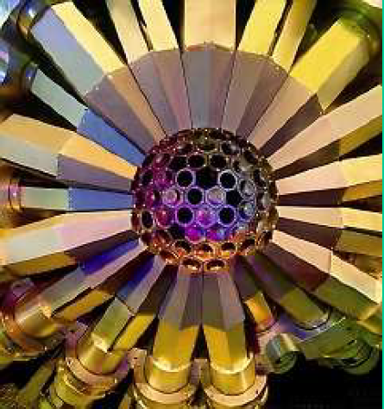
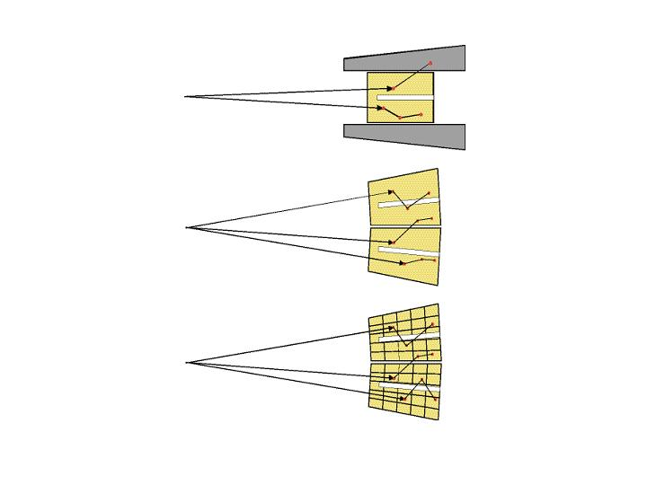
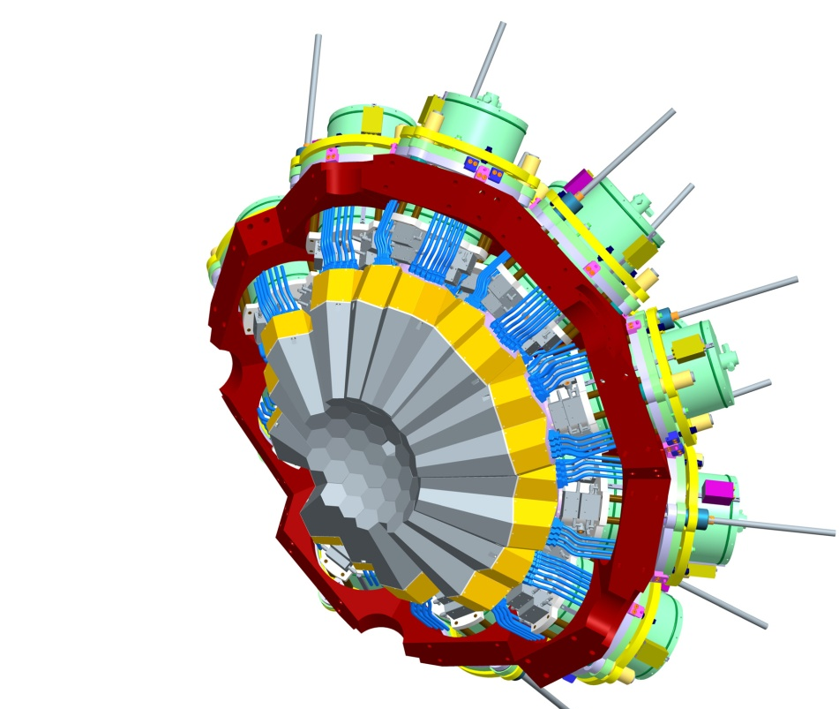

The idea of $$-ray tracking
Compton Shielded Ge
Euroball / Gammasphere
ε_{ph} ~ 10%
N_{det} ~ 100
~ 40%
θ ~ 8º
large opening angle means poor energy resolution at high recoil velocity.
Previously scattered gammas were wasted.
Technology is available now to track them.
Ge Tracking Array
ε_{ph} ~ 50%
N_{det} ~ 100
~ 80%
θ ~ 1º
Combination of:
segmented detectors
digital electronics
pulse processing
tracking the γ-rays
AGATA / GRETA
Notes:
Present spectrometer technology relies on anti-compton shields to increase the peak to total ratio:
Gammas that scatter out of the detector are detected in the compton shields. When this happens, the event is thrown away.
Throwing away means a loss in efficiency.
Moreover, such detector has a relative large opening angle, and therefore these spectrometers are not optimized for relativistic beams.
Nowadays, technology is available to track such gammas.
What one needs is – instead of compton shields – is a full array of highly segmented detectors.
Tracking will tell us then that these three interactions belong together, such that there energy, collected in separate segments can be added, and none of these events has to be thrown away.
Moreover, tracking will also tell us which of these three interactions happened first. The high position sensitivity of this first interaction will than allow good Doppler correction. >>

Slide 4
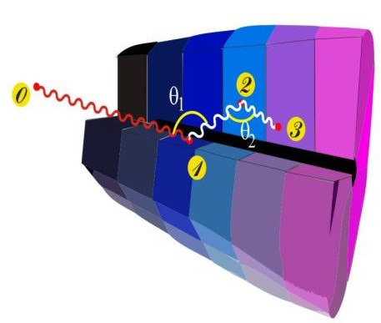
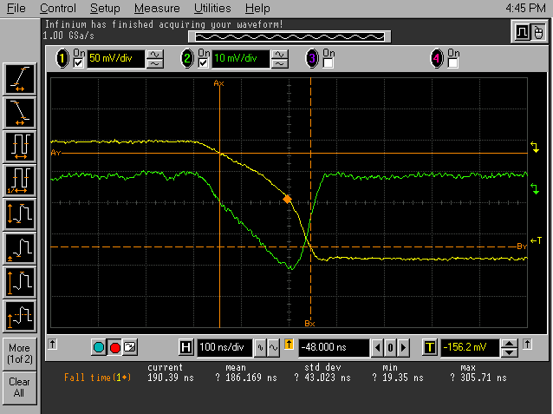
Ingredients of Gamma–Ray Tracking
1
4
Highly segmented
HPGe detectors
Identified
interaction points
Reconstruction of tracks
evaluating permutations
of interaction points
(x,y,z,E,t)_{i}
·
Pulse Shape Analysis
to decompose
recorded waves
·
3
2
Digital electronics
to record and
process segment signals
Reconstructed
gamma-rays
Notes:
3/7/2011 10:57 AM
© 2007 Microsoft Corporation. All rights reserved. Microsoft, Windows, Windows Vista and other product names are or may be registered trademarks and/or trademarks in the U.S. and/or other countries.
The information herein is for informational purposes only and represents the current view of Microsoft Corporation as of the date of this presentation. Because Microsoft must respond to changing market conditions, it should not be interpreted to be a commitment on the part of Microsoft, and Microsoft cannot guarantee the accuracy of any information provided after the date of this presentation.
MICROSOFT MAKES NO WARRANTIES, EXPRESS, IMPLIED OR STATUTORY, AS TO THE INFORMATION IN THIS PRESENTATION.
4

Slide 5
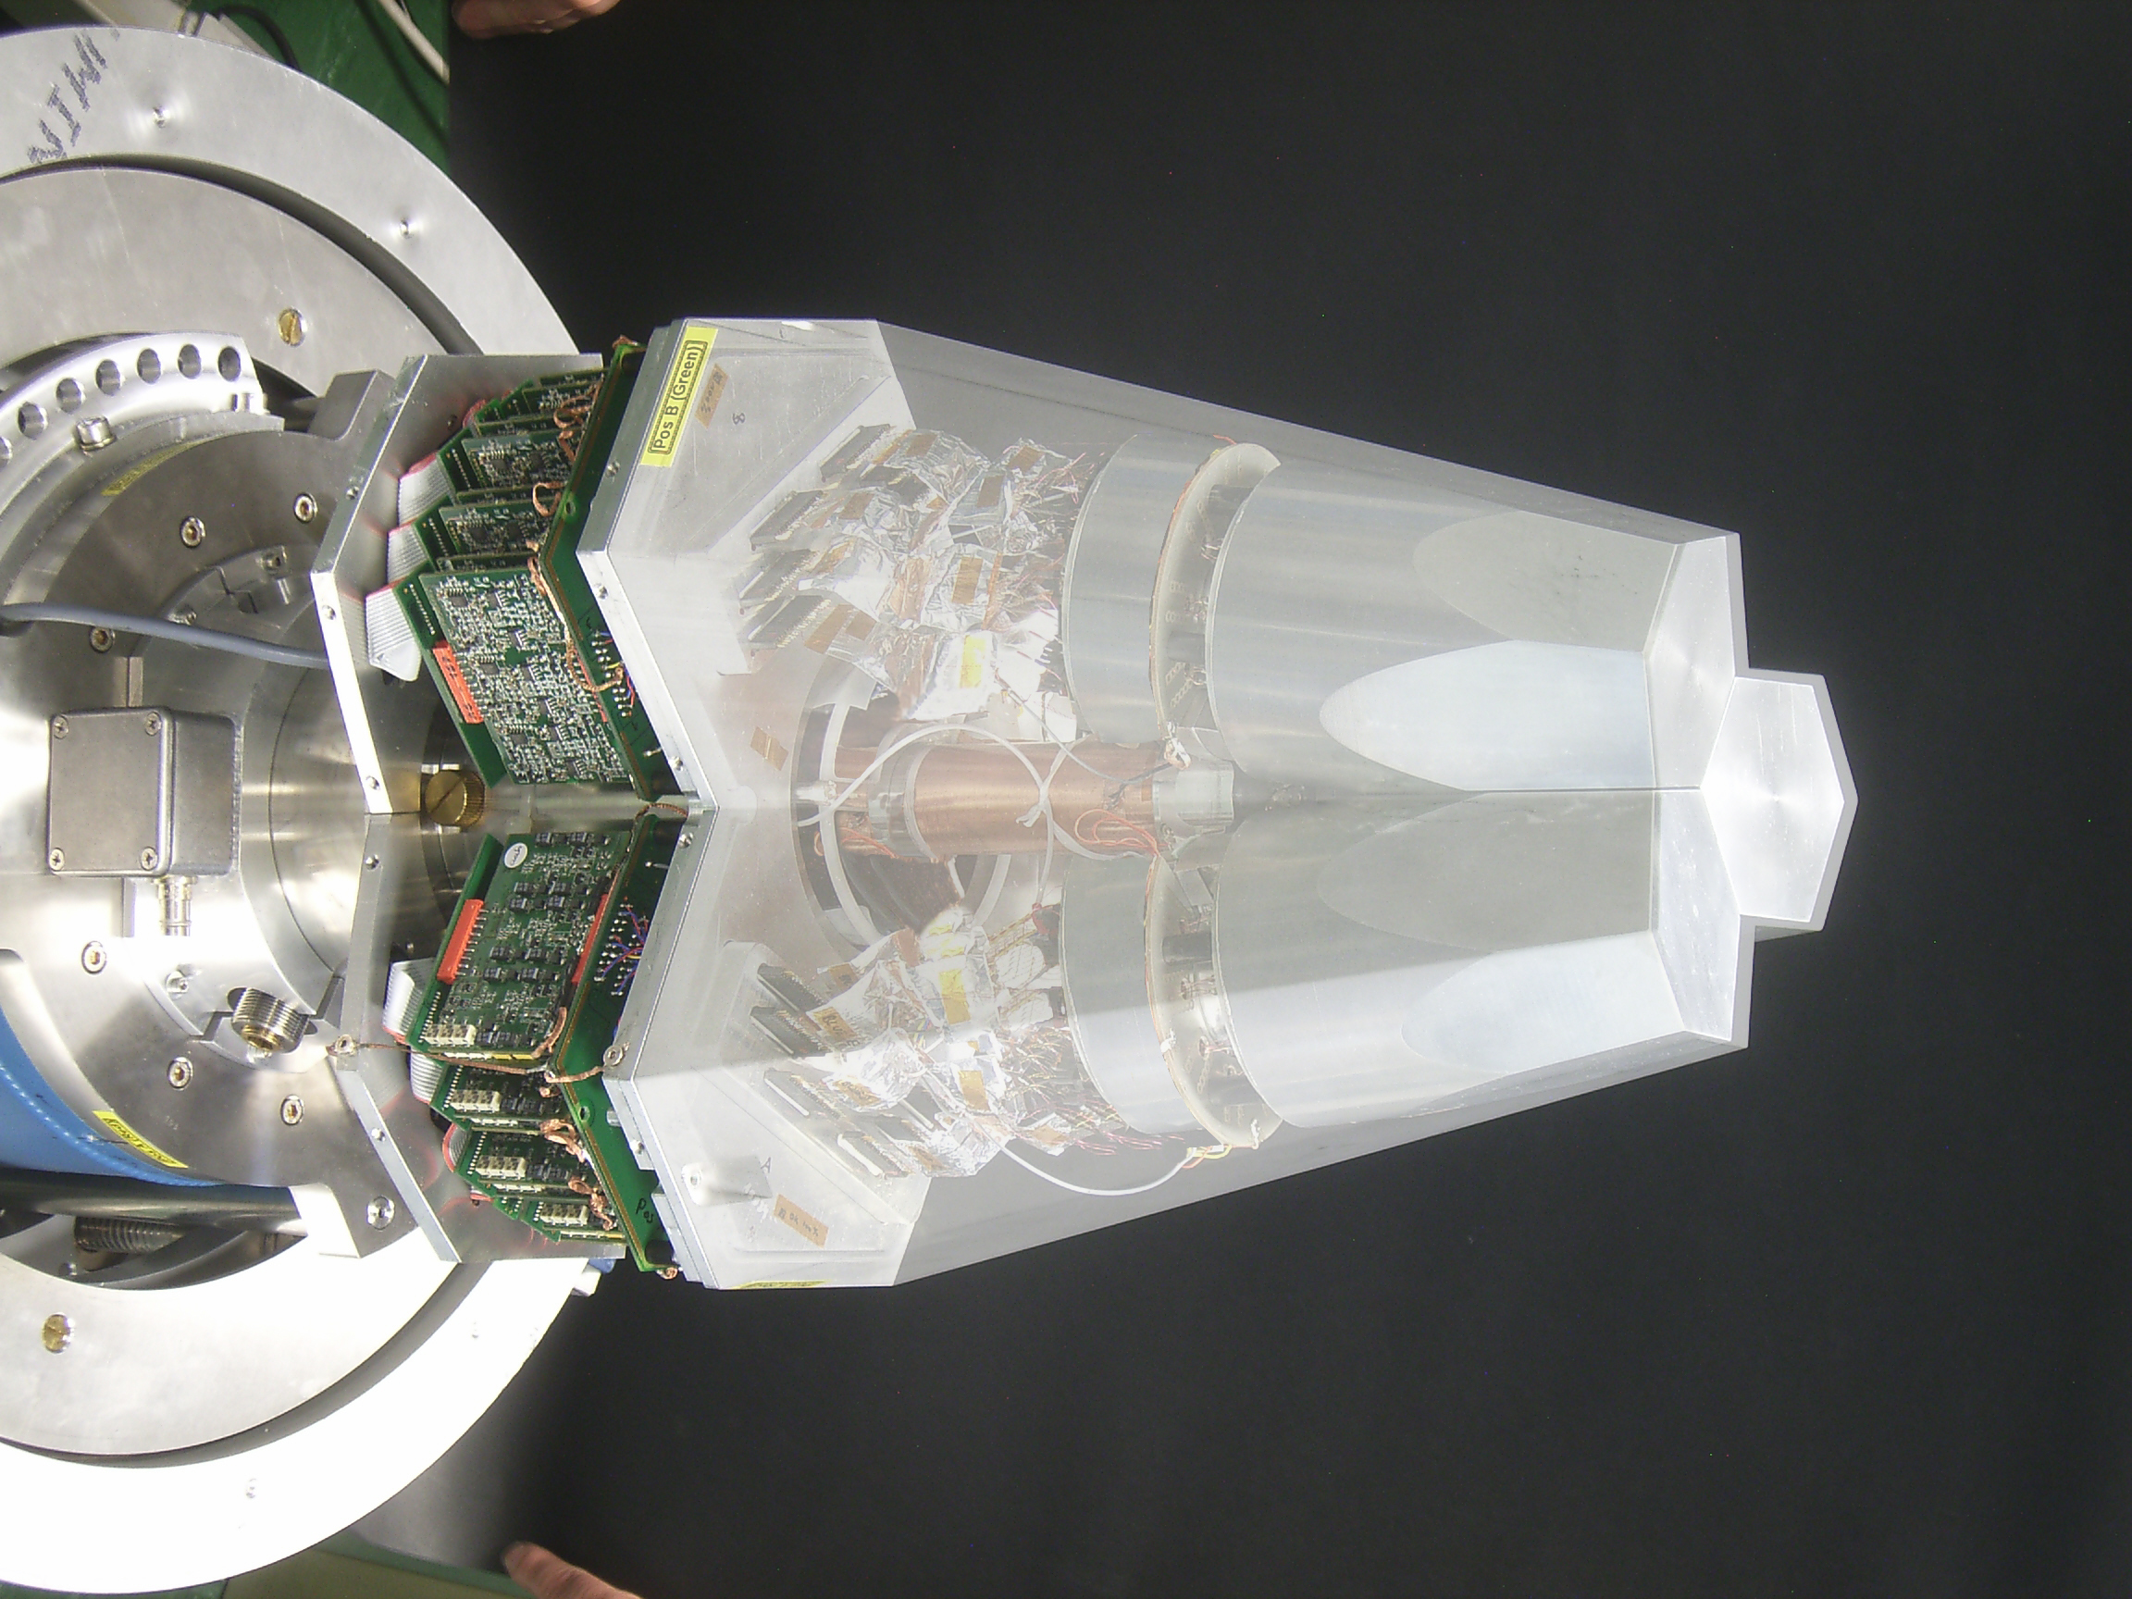
Asymmetric AGATA Tripel Cryostat
-integration of 111 high resolution spectroscopy channels
-cold FET technology for all signals
Challenges:
-mechanical precision
-microphonics
-noise, high frequencies
-LN2 consumption
- A. Wiens et al. NIM A 618 (2010) 223–233
- D. Lersch et al. NIM A (2011) accepted

Slide 6
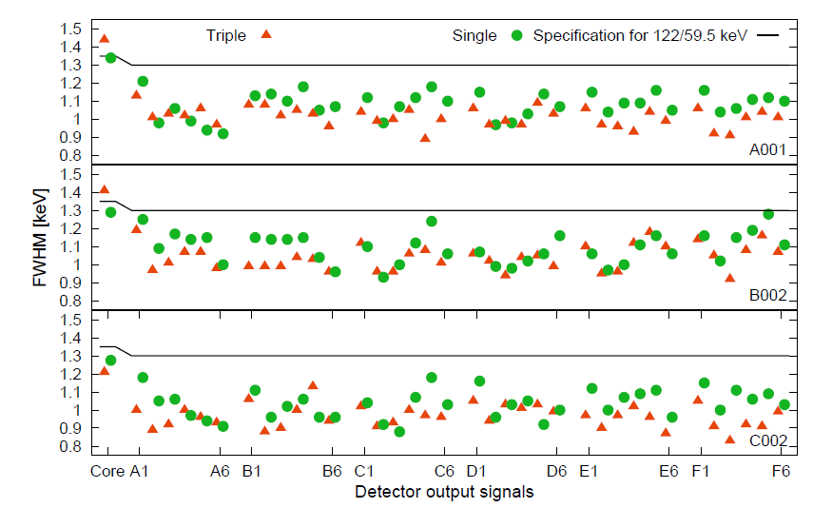
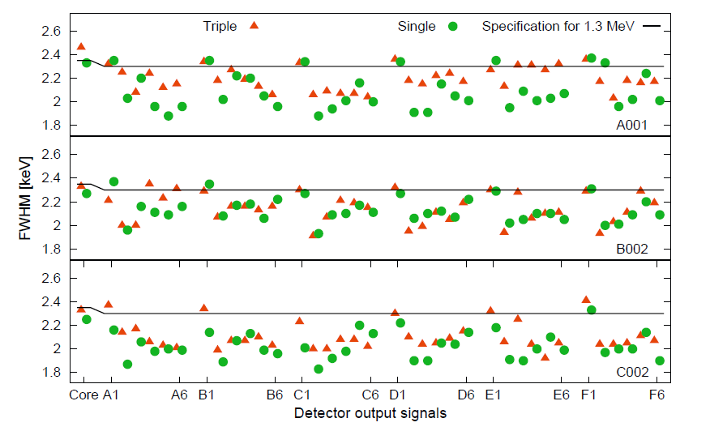
Performance: Energy resolution
@ 60 keV
@ 1333 keV
Averages of the segment resolutions
@ 60 keV :
A001: 1011 +/- 53 eV B002: 1039 +/- 70 eV C002: 965 +/- 63 eV
Averages of the segment resolutions
Measured in Köln and Legnaro
@ 1333 keV :
IKP / Legnaro
A001: 2,19 keV / 2,00 keV
B002: 2,09 keV / 1,98 keV
C002: 2,1 keV / 1,94 keV
Segment labeling

Slide 7
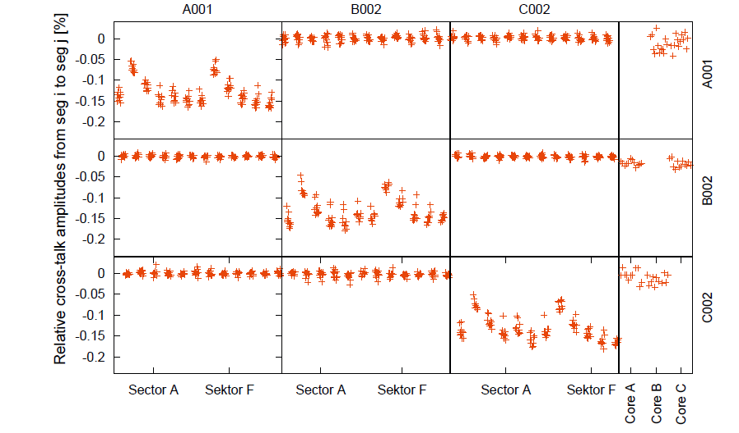
Performance: Crosstalk
No crosstalk observed between detectors
Within one detector, the theoretical crosstalk limit is reached
Online cross talk correction implemented

Slide 8
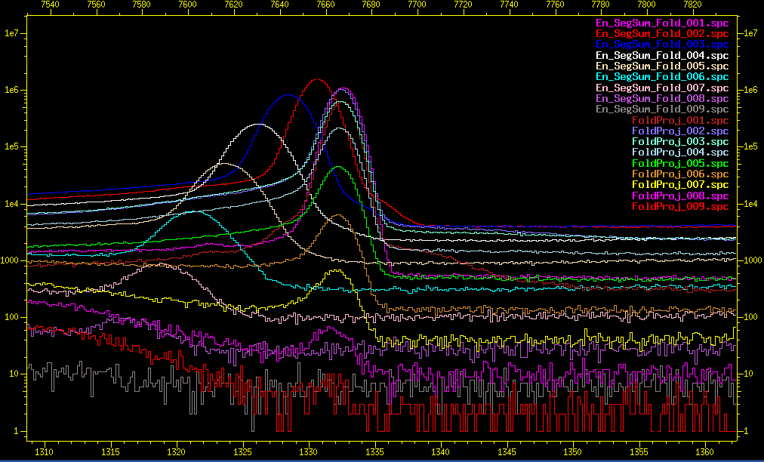
On line Cross Talk Correction
B. Bruyneel et al., NIM A 599 (2009) 196
FWHM 60keV: 1.20 → 1.02 !
Details: 1.3MeV line
Xtalk Corrected
2
3
Uncorrected
4
5
6
7
Notes:
To conclude the improvement on the 1.3MeV cobalt line.
Before and after correction.
One observes that at fold 7 one already improved a factor of 2 compared to the uncorrected segment sum.
But even at fold 1 there is a slight improvement by combining core and segment energy.
This even gets bigger for lower energies, as then the electronic noise becomes more important.
>>

Slide 9
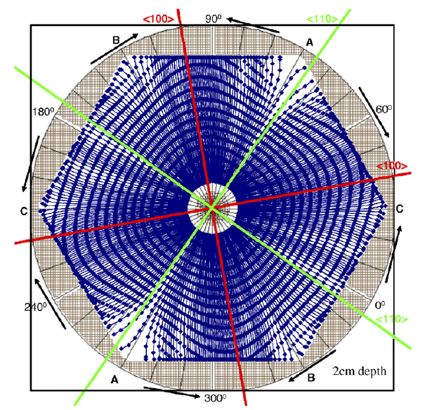
How to simulate HPGe detector signals
Requirements:
Weighting potentials
Electrical field ↔ space charge
Anisotropic Mobility
Response of electronics
Weighting potential
for this segment
Solution to
Laplace equation
10 … 90%
1 … 9%
0.1 … 0.9%
B. Bruyneel NIMA 569 (2006) 764-773
B. Bruyneel NIMA 569 (2006) 774-789
Example: hole trajectories
Notes:
The characterization procedure I developed were tested on a 12-fold segmented MINIBALL detector.
To characterize such crystal, one needs to know first of all how much mirror charge is induced in each of these
Electrodes when a unit of charge is placed at a specific point in the detector.
This information is provided by the Weighting potentials.
The weigting potential for “this” segment is show here for a true coaxial detector.
These potentials can be calculated as solution of the Laplace equation,
With the boundary conditions that they have to be 1 at “this” electrode and 0 at all the other electrodes.
How to calculate the Weighting potentials is well described in litterature, so I will not disscuss this further.

Slide 10
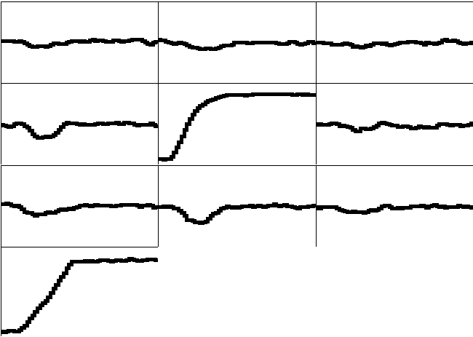
Pulse Shape Analysis Concept
A3
A4
A5
B3
B4
B5
Library
C3
C4
C5
y
CORE
C4
B4
measured
D4
A4
x
791 keV deposited in segment B4
E4
F4
z = 46 mm
Notes:
3/7/2011 10:57 AM
© 2007 Microsoft Corporation. All rights reserved. Microsoft, Windows, Windows Vista and other product names are or may be registered trademarks and/or trademarks in the U.S. and/or other countries.
The information herein is for informational purposes only and represents the current view of Microsoft Corporation as of the date of this presentation. Because Microsoft must respond to changing market conditions, it should not be interpreted to be a commitment on the part of Microsoft, and Microsoft cannot guarantee the accuracy of any information provided after the date of this presentation.
MICROSOFT MAKES NO WARRANTIES, EXPRESS, IMPLIED OR STATUTORY, AS TO THE INFORMATION IN THIS PRESENTATION.
10

Slide 11
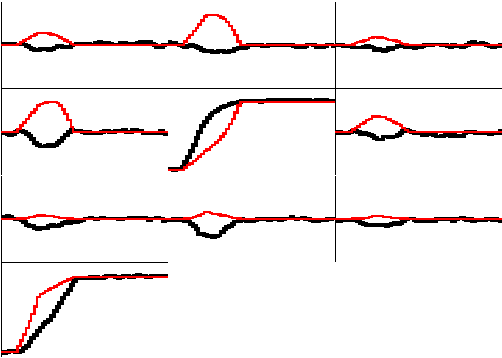
Pulse Shape Analysis Concept
A3
A4
A5
B3
B4
B5
(10,10,46)
C3
C4
C5
y
CORE
C4
B4
measured
calculated
D4
A4
x
791 keV deposited in segment B4
E4
F4
z = 46 mm
Notes:
3/7/2011 10:57 AM
© 2007 Microsoft Corporation. All rights reserved. Microsoft, Windows, Windows Vista and other product names are or may be registered trademarks and/or trademarks in the U.S. and/or other countries.
The information herein is for informational purposes only and represents the current view of Microsoft Corporation as of the date of this presentation. Because Microsoft must respond to changing market conditions, it should not be interpreted to be a commitment on the part of Microsoft, and Microsoft cannot guarantee the accuracy of any information provided after the date of this presentation.
MICROSOFT MAKES NO WARRANTIES, EXPRESS, IMPLIED OR STATUTORY, AS TO THE INFORMATION IN THIS PRESENTATION.
11

Slide 12
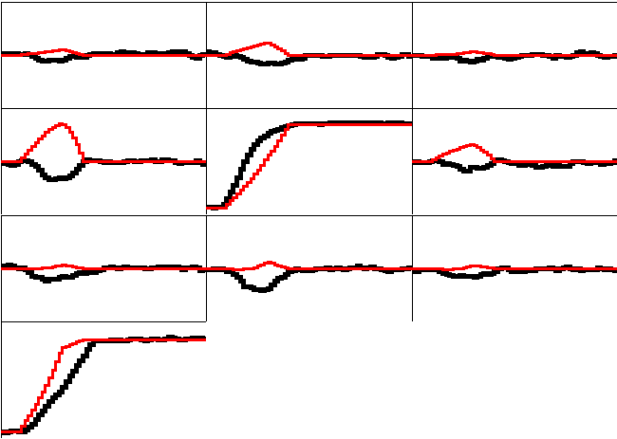
Pulse Shape Analysis Concept
A3
A4
A5
B3
B4
B5
(10,15,46)
C3
C4
C5
y
CORE
C4
B4
measured
calculated
D4
A4
x
791 keV deposited in segment B4
E4
F4
z = 46 mm
Notes:
3/7/2011 10:57 AM
© 2007 Microsoft Corporation. All rights reserved. Microsoft, Windows, Windows Vista and other product names are or may be registered trademarks and/or trademarks in the U.S. and/or other countries.
The information herein is for informational purposes only and represents the current view of Microsoft Corporation as of the date of this presentation. Because Microsoft must respond to changing market conditions, it should not be interpreted to be a commitment on the part of Microsoft, and Microsoft cannot guarantee the accuracy of any information provided after the date of this presentation.
MICROSOFT MAKES NO WARRANTIES, EXPRESS, IMPLIED OR STATUTORY, AS TO THE INFORMATION IN THIS PRESENTATION.
12

Slide 13
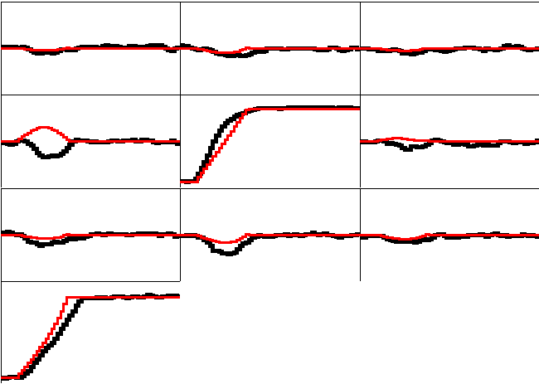
Pulse Shape Analysis Concept
A3
A4
A5
B3
B4
B5
(10,20,46)
C3
C4
C5
y
CORE
C4
B4
measured
calculated
D4
A4
x
791 keV deposited in segment B4
E4
F4
z = 46 mm
Notes:
3/7/2011 10:57 AM
© 2007 Microsoft Corporation. All rights reserved. Microsoft, Windows, Windows Vista and other product names are or may be registered trademarks and/or trademarks in the U.S. and/or other countries.
The information herein is for informational purposes only and represents the current view of Microsoft Corporation as of the date of this presentation. Because Microsoft must respond to changing market conditions, it should not be interpreted to be a commitment on the part of Microsoft, and Microsoft cannot guarantee the accuracy of any information provided after the date of this presentation.
MICROSOFT MAKES NO WARRANTIES, EXPRESS, IMPLIED OR STATUTORY, AS TO THE INFORMATION IN THIS PRESENTATION.
13

Slide 14
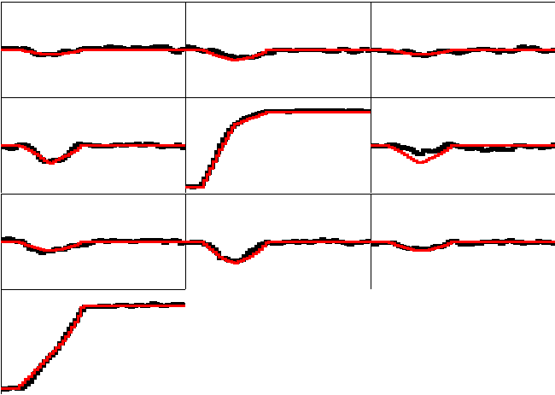
Pulse Shape Analysis Concept
A3
A4
A5
B3
B4
B5
(10,25,46)
C3
C4
C5
y
CORE
C4
B4
measured
calculated
D4
A4
x
791 keV deposited in segment B4
E4
F4
z = 46 mm
Notes:
3/7/2011 10:57 AM
© 2007 Microsoft Corporation. All rights reserved. Microsoft, Windows, Windows Vista and other product names are or may be registered trademarks and/or trademarks in the U.S. and/or other countries.
The information herein is for informational purposes only and represents the current view of Microsoft Corporation as of the date of this presentation. Because Microsoft must respond to changing market conditions, it should not be interpreted to be a commitment on the part of Microsoft, and Microsoft cannot guarantee the accuracy of any information provided after the date of this presentation.
MICROSOFT MAKES NO WARRANTIES, EXPRESS, IMPLIED OR STATUTORY, AS TO THE INFORMATION IN THIS PRESENTATION.
14

Slide 15
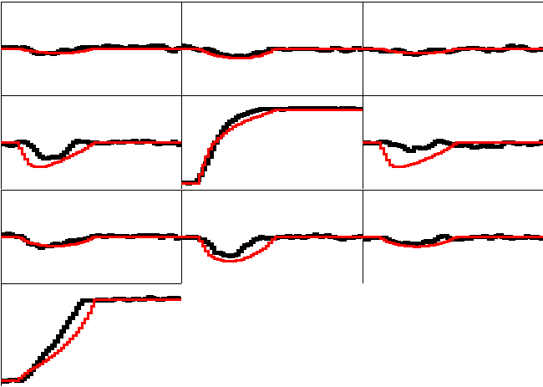
Pulse Shape Analysis Concept
A3
A4
A5
B3
B4
B5
(10,30,46)
C3
C4
C5
y
CORE
C4
B4
measured
calculated
D4
A4
x
791 keV deposited in segment B4
E4
F4
z = 46 mm
Notes:
3/7/2011 10:57 AM
© 2007 Microsoft Corporation. All rights reserved. Microsoft, Windows, Windows Vista and other product names are or may be registered trademarks and/or trademarks in the U.S. and/or other countries.
The information herein is for informational purposes only and represents the current view of Microsoft Corporation as of the date of this presentation. Because Microsoft must respond to changing market conditions, it should not be interpreted to be a commitment on the part of Microsoft, and Microsoft cannot guarantee the accuracy of any information provided after the date of this presentation.
MICROSOFT MAKES NO WARRANTIES, EXPRESS, IMPLIED OR STATUTORY, AS TO THE INFORMATION IN THIS PRESENTATION.
15

Slide 16
Pulse Shape Analysis Concept
A3
A4
A5
Result of
Grid Search
algorithm
R. Venturelli
B3
B4
B5
(10,25,46)
C3
C4
C5
y
CORE
C4
B4
measured
calculated
D4
A4
x
791 keV deposited in segment B4
E4
F4
z = 46 mm
Notes:
3/7/2011 10:57 AM
© 2007 Microsoft Corporation. All rights reserved. Microsoft, Windows, Windows Vista and other product names are or may be registered trademarks and/or trademarks in the U.S. and/or other countries.
The information herein is for informational purposes only and represents the current view of Microsoft Corporation as of the date of this presentation. Because Microsoft must respond to changing market conditions, it should not be interpreted to be a commitment on the part of Microsoft, and Microsoft cannot guarantee the accuracy of any information provided after the date of this presentation.
MICROSOFT MAKES NO WARRANTIES, EXPRESS, IMPLIED OR STATUTORY, AS TO THE INFORMATION IN THIS PRESENTATION.
16

Slide 17
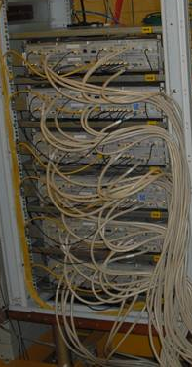
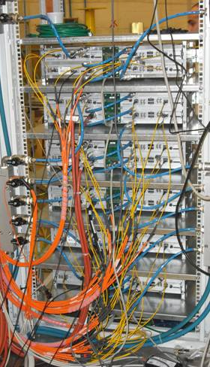
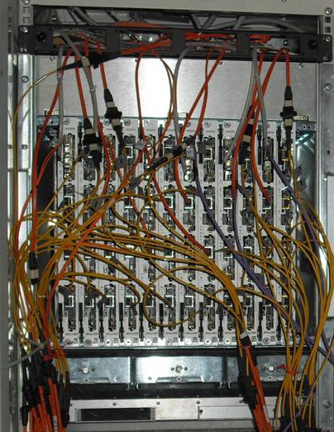
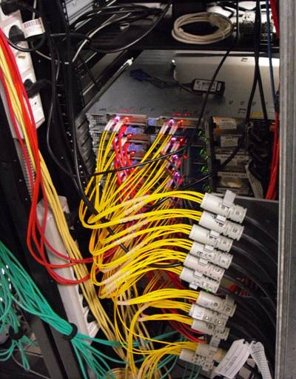
AGATA: Digital Electronics
Digitisers
in the experimental hall
Digital proc. electronics
in the users area
Computer farm
in the computing room
10 m long MDR cables
80 m long optical fibers
20 m long optical fibers
LAN to the disk servers
100Mhz, 14 bit
Synchronous &
continuous
Triggering
Energy
Trace capture
Preprocessing
PSA
Tracking
(7.6GB/s/crystal)
(10 kB/evt/crystal)
Global
Triggering
System
GTS
Clock &
Trigger validation

Slide 18
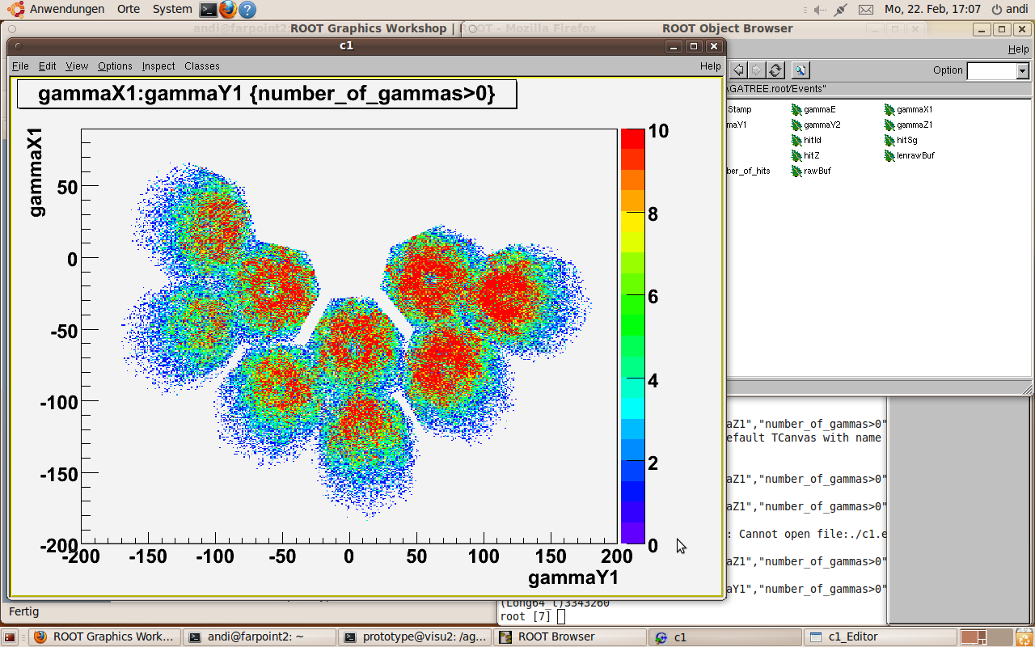
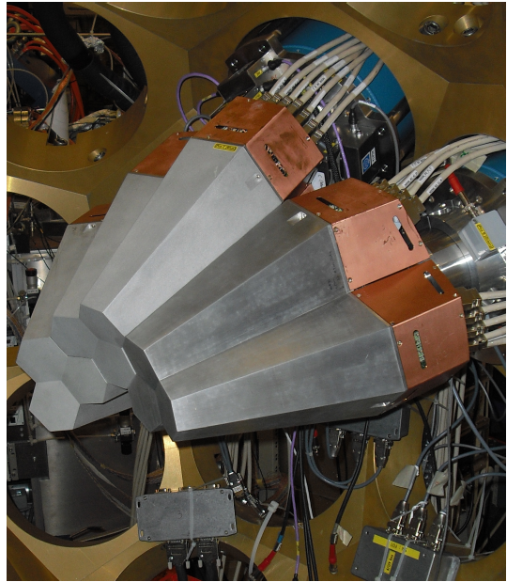
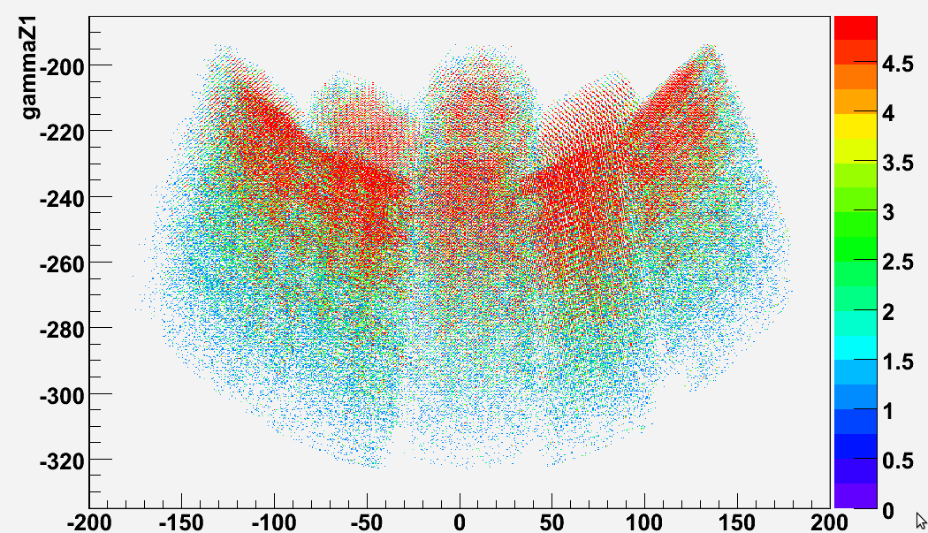
AGATA online
1st experiment with AGATA (18/02/10)
< 5mm FWHM resolution obtained
psa online at rates > 5kHz per crystal
Notes:
18

Slide 19
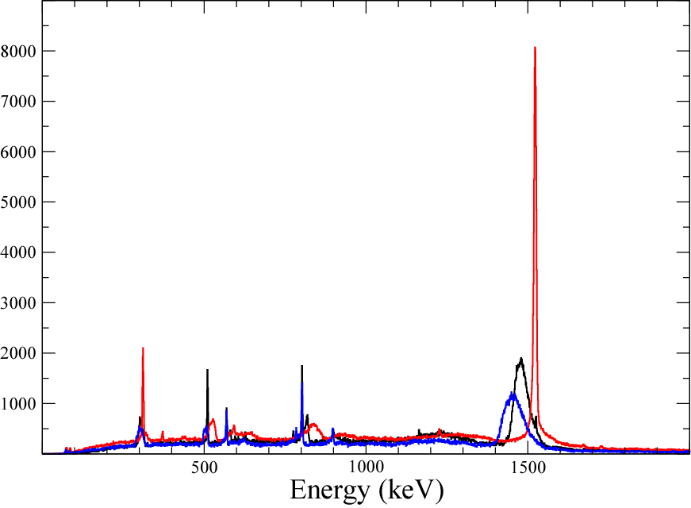
AGATA online result
⁴²Ca@170MeV+²⁰⁸Pb
1524,7 keV
2⁺ - 0⁺
Uncorrected
Doppler-corrected (Ca)
Doppler-corrected (Pb)
1228 keV
4⁺ - 2⁺

Slide 20
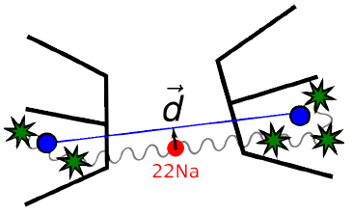
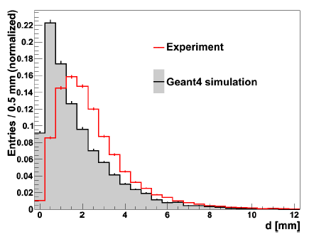
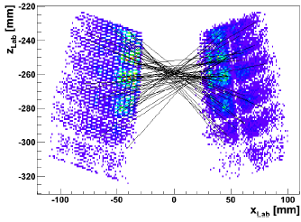
Position Resolution of AGATA
FWHM Method Reference
5.2mm Doppler correction meas. F. Recchia et al. NIM A (2009)
4.0mm Doppler correction meas P.-A. Söderström et al. NIM A (2011)
3.5mm 511keV source meas. S. Klupp, M.Schlarb, R. Gernhauser, (in prep.)
Resolutions improve over time by improvement on PSA libraries
time
PSA calibration using 511keV source:

Slide 21
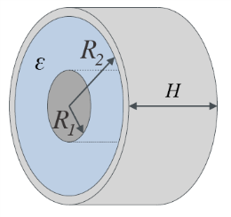
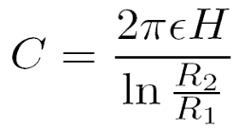
Impurity from C-V measurements
How it works (e.g. cylindrical geometry):
C(V) gives depletion boundary R₁:
C(V), dC/dV give impurity concentration at R₁
Capacitance [log pF]
Bias voltage[log v]

Slide 22
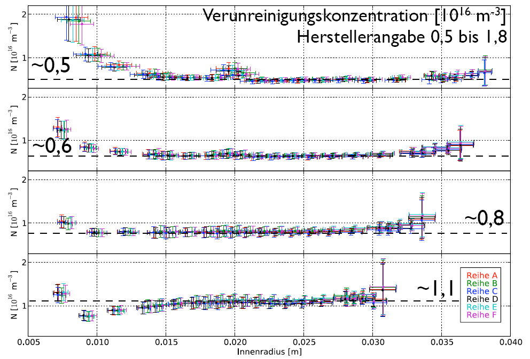
Results with the cylindrical approximation
Impurity concentration [10¹⁰ cm⁻³]
Values from Canberra: 0.5 till 1.8
Impurity concentration in coaxial part (Last 4 rings)
Inner radius[m]
Birkenbach et al. NIM A (2011) accepted

Slide 23
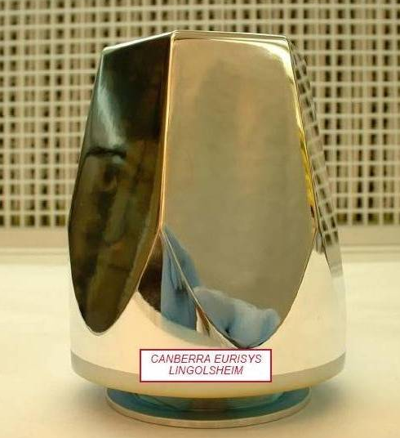
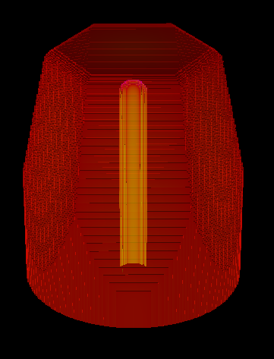
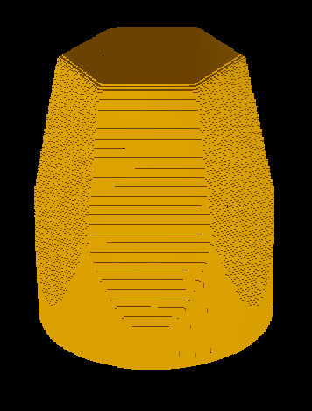
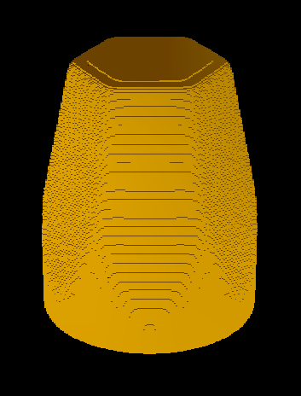
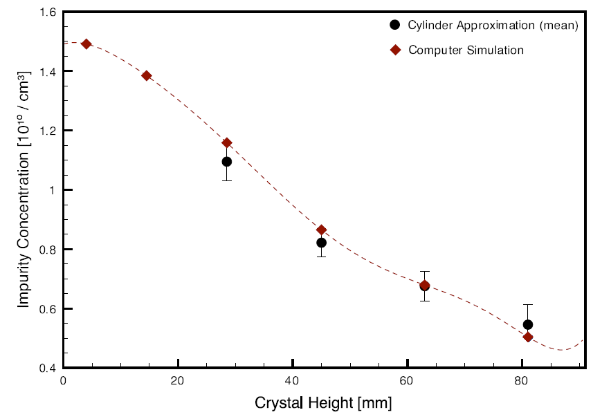
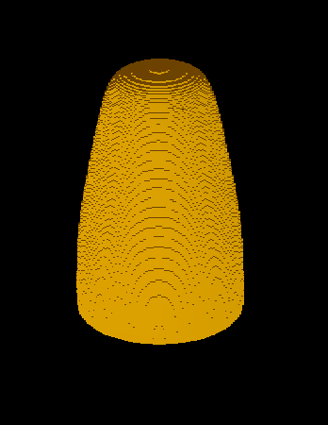
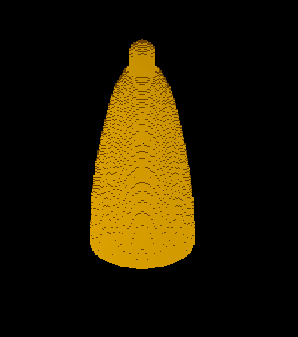
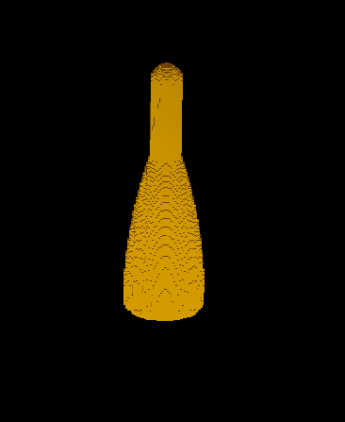
A B C: HV = 10V D: HV = 100V
Depletion of a HPGe detector
A: Bare HPGe germanium crystal
symmetric AGATA detector
B: Geometry in simulation
The HV contact is colored yellow
C-G: Undepleted volume
as function of HV.
(assumption: 10¹⁰ impurities / cm³)
E: HV = 1kV F: HV = 2kV G: HV = 3kV
Bruyneel et al. NIM A (2011) accepted

Slide 24
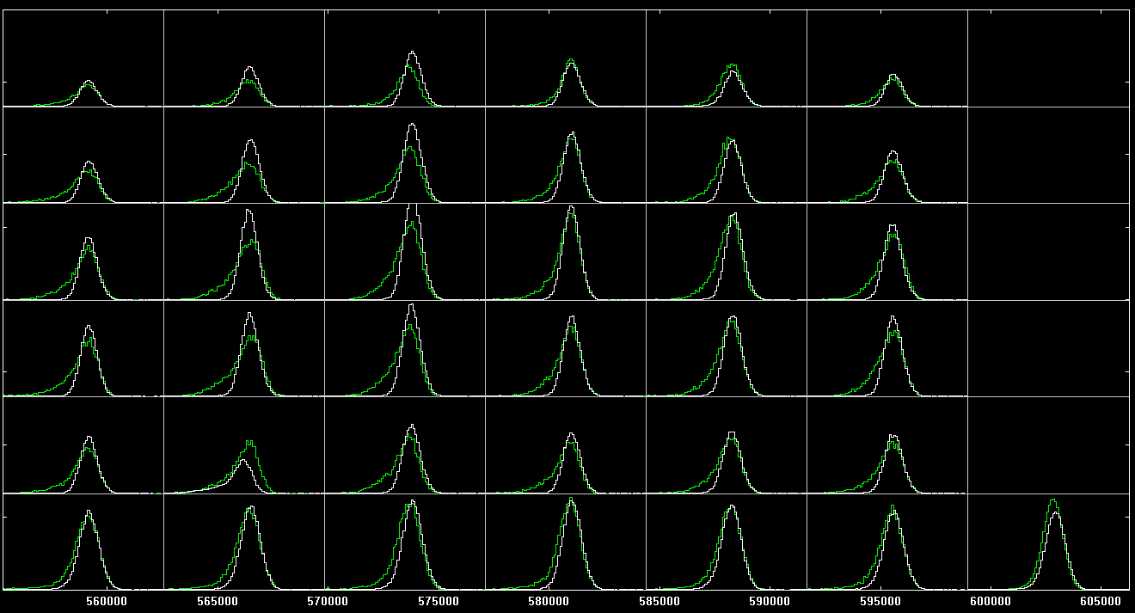
Det. 1B - Shape of the 1332 keV line
6
5
4
3
2
1
A B C D E F CC
White: April 2010 → FWHM(core) ~ 2.3 keV FWHM(segments) ~2.0 keV
Green: July 2010 → FWHM(core) ~2.4 keV FWHM(segments) ~2.8 keV
Damage after 3 high-rate experiments (3 weeks of beam at 30-80 kHz singles)

Slide 25
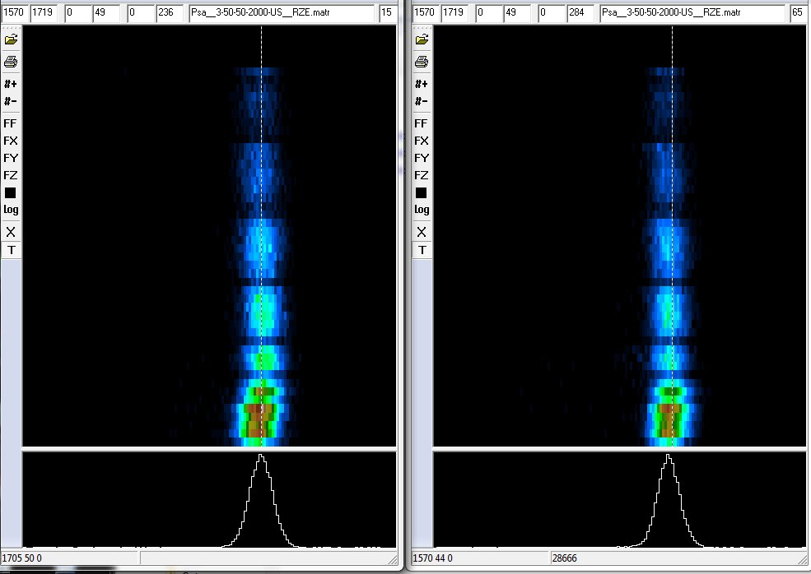
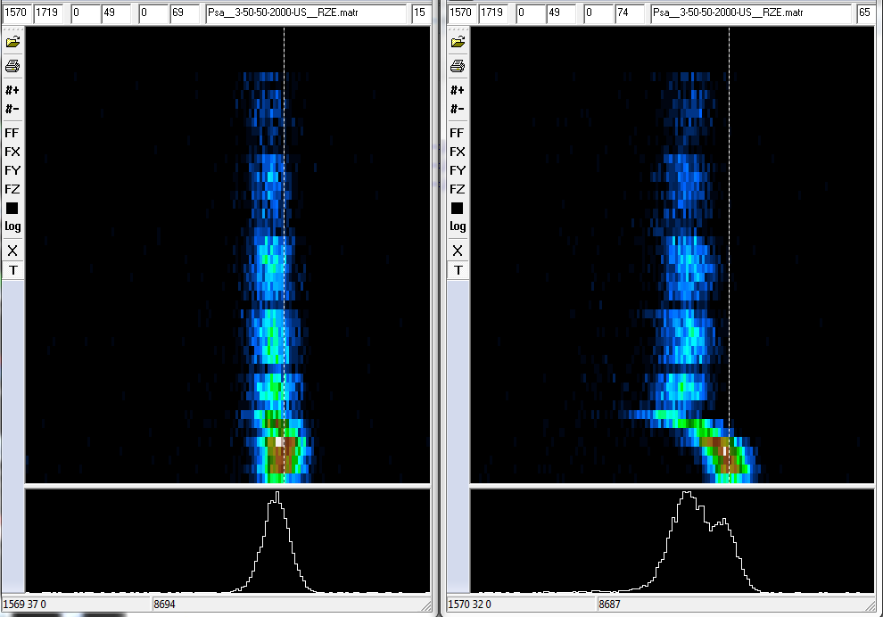
Crystal 1B (C002)
April 2010
July 2010
Core
r=15mm
Seg
r=15mm
Core
r=15mm
Seg
r=15mm
Depth (z)
energy
The 1332 keV peak as a function of crystal depth (z)
for interactions at r = 15mm
The charge loss due to neutron damage is proportional to the path length to the electrodes. This is provided by the PSA, which is barely affected by the amplitude loss.
Knowing the interaction position,
the charge trapping can be calculated and corrected away

Slide 26
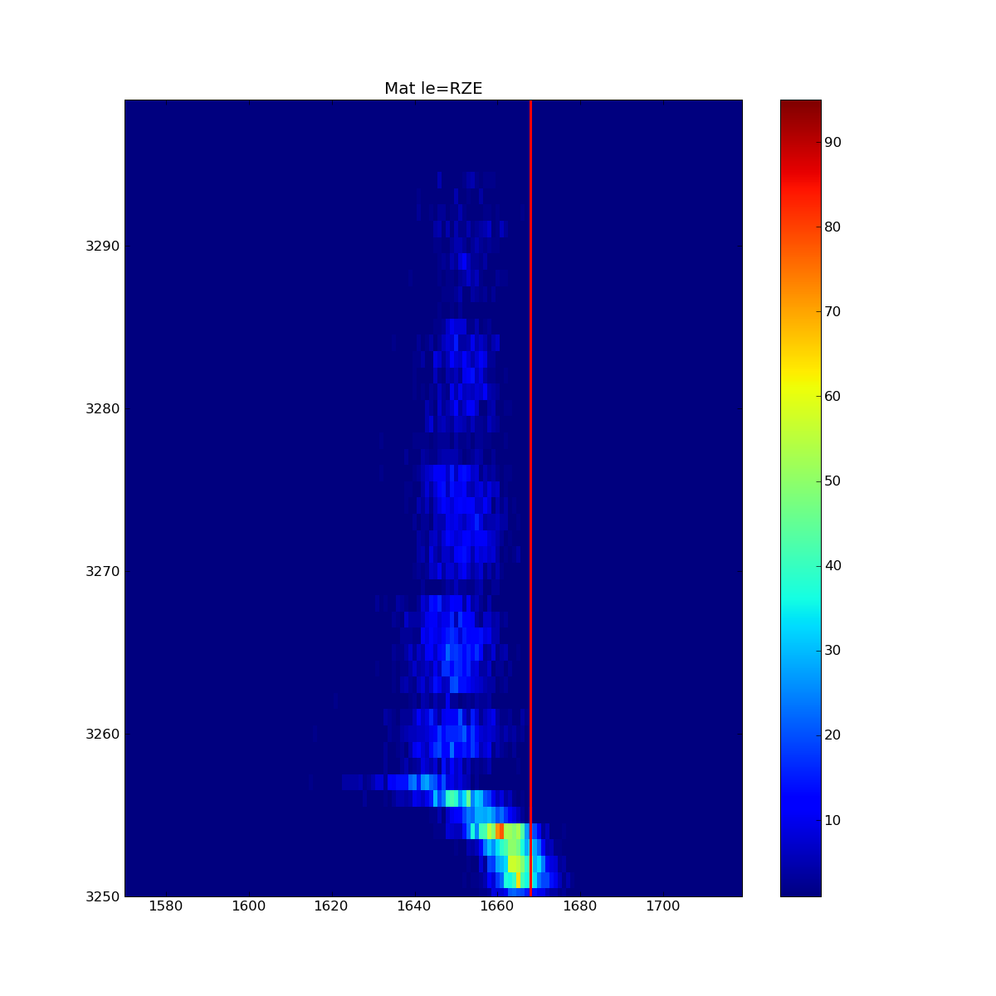
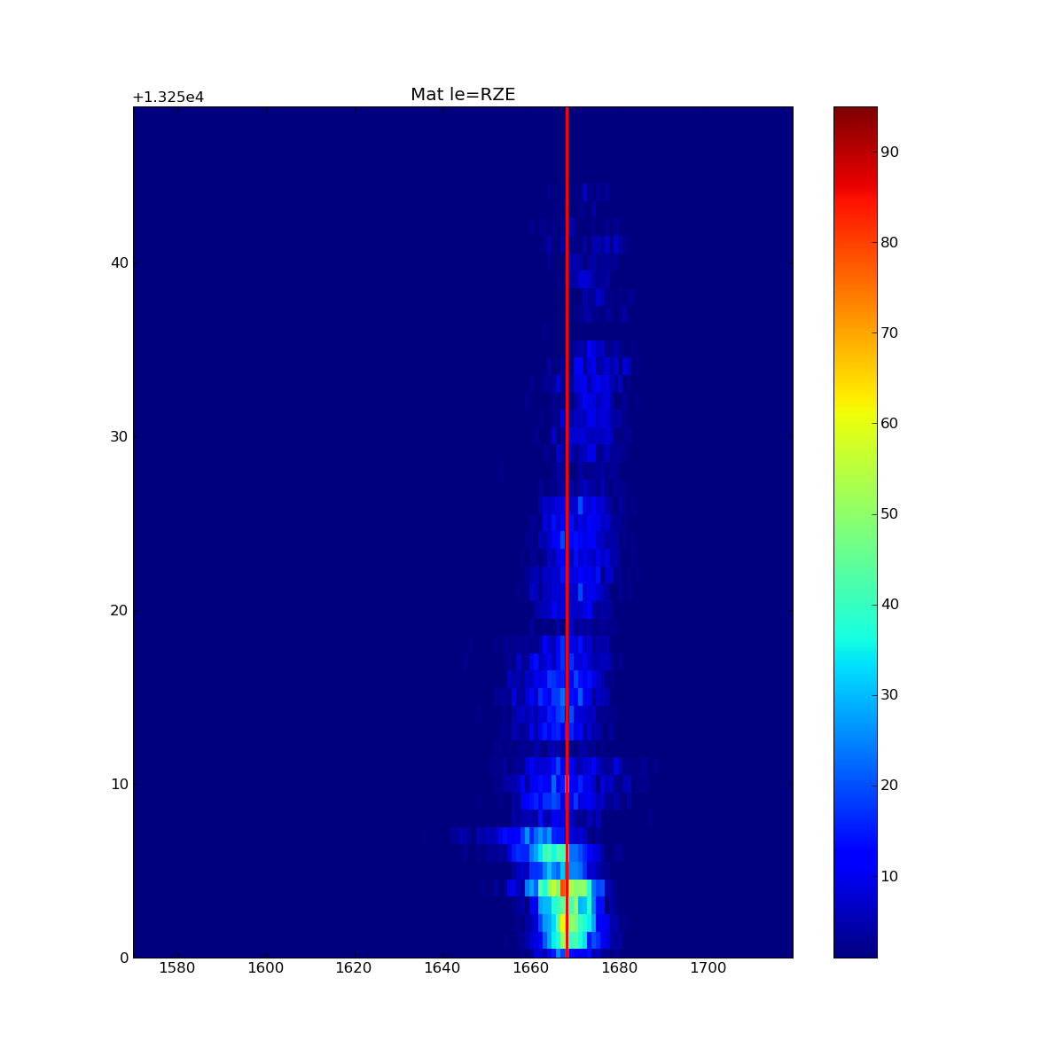
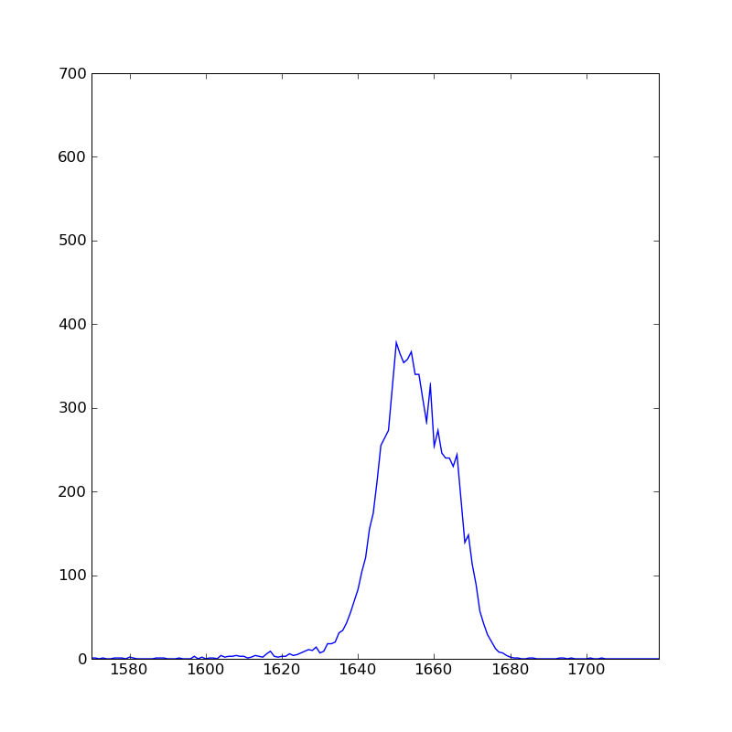
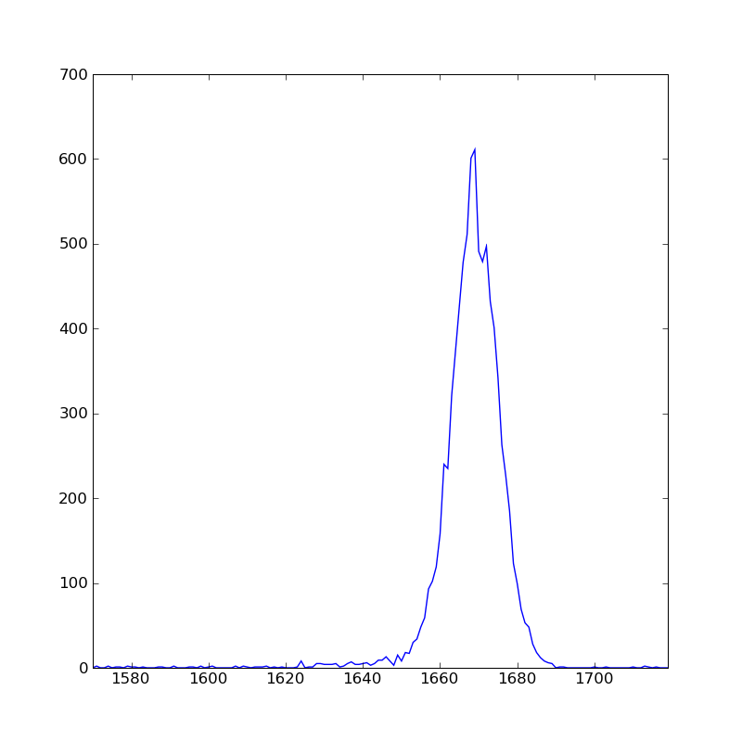
The 1332 keV peak as a function of crystal depth (z)
for interactions at r = 15mm (worst case !)
Before After
Depth (z)
Depth (z)
energy
energy
FWHM 4.14
FWHM 2.85

Slide 27
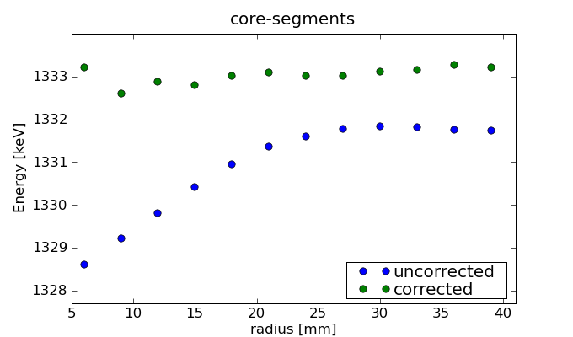
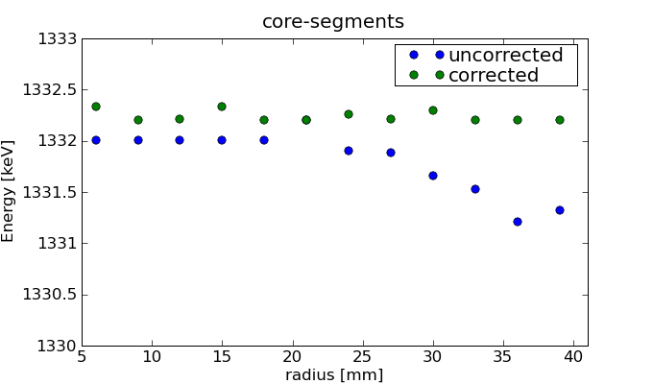
Correction for trapping
Neutron damaged detector:
2 parameter fit describes
whole detector
FWHM FWHM
1.3MeV FWTM
Corrected: 2.06 1.91
Uncorrected: 2.44 1.83
Hole traps
NEW detector:
FWHM FWHM
1.3MeV FWTM
Corrected: 1.80 1.85
Uncorrected: 1.87 1.85
Electron traps

Slide 28

Conclusion
AGATA Demonstrator + PRISMA
(Legnaro National Lab, Italy)
installation started mid 2008, completed mid 2009
Detectors brought to optimal performance using digital electronics
PSA resolution alows tracking, and still improves in time
Test runs completed - electronics + DAC in operation
4ATCs in operation at LNL
First 8 experiments performed succesfully
31 March 2010
Notes:
3/7/2011 10:57 AM
© 2007 Microsoft Corporation. All rights reserved. Microsoft, Windows, Windows Vista and other product names are or may be registered trademarks and/or trademarks in the U.S. and/or other countries.
The information herein is for informational purposes only and represents the current view of Microsoft Corporation as of the date of this presentation. Because Microsoft must respond to changing market conditions, it should not be interpreted to be a commitment on the part of Microsoft, and Microsoft cannot guarantee the accuracy of any information provided after the date of this presentation.
MICROSOFT MAKES NO WARRANTIES, EXPRESS, IMPLIED OR STATUTORY, AS TO THE INFORMATION IN THIS PRESENTATION.
28

Slide 29



OUTLOOK: Plans for the next few years
LNL: 2010-2011
5 TC
Total Eff. ~6%
GSI: 2012-2013
≥ 8 TC
Total Eff. > 10%
GANIL: 2014-2015
15 TC
Total Eff. > 20%
AGATA D.
+ PRISMA
AGATA + FRS
AGATA + VAMOS

Slide 30




Trapping cross sections
L. Reggiani – Rev. del Nuovo Cimento 12 nr 11 (1989)
Most popular is model by Lax:
Cross sections are velocity dependent
Cross sections are field dependent -
e.g. Poole – Frenkel effect
Lax: cascade model
1) electron emits phonon near trap center
2) electron in interaction with phonon field:
or: struggles out of trap
or: collapses to ground state
But also other (recent) models exist:
e.g. L. S. Darken – PRL 69 (1992) 19 p 2842
Sticking
probability
hole velocity
after Pinson and Bray
data on <v^{y}> basically not existing
difficult to know which model to use
only data

Slide 31




Trapping cross section: neutron damage specific
L. S. Darken et al. NIM 171 (1980)
Specific model for fast neutron induced traps:
Cross section from field line disturbance:
Balance between E field and Coulomb force:
Defect cluster
∼ 200Å
Q
r_{max}
Assumptions:
Trapping only by disordered regions
Macroscopic model: drift velocity!
Q ∼ 100e equilibrium charge state
r_{max}∼ 2 μm cross section (E=2kV/cm)
l_{e} ∼ 0.2 μm dist. betw. optical phonon emission
used:

Slide 32



Some theory: collection efficiency
Trapping rate of electrons / holes “q”:
σ : trapping cross section
v : microscopic velocity
<.>: average over ensemble
N_{t} : density of trapping centers
Collection efficiency (position dependent) of electrons / holes for electrode “i”:
x₀ : interaction position in detector
φ_{i} : weighting potential of segment i
v_{e,h} : drift velocity of electrons / holes
t_{e} : collection time
= Integral [ current to seg i per unit charge ]
= total recorded charge by e/h after collection
Total collection efficiency for electrode “i” at position x₀ :
Partial collection efficiencies
mainly report on weighting potential

Slide 33


Trapping sensitivity*
(*personal definition – don’t google! )
DEFINITION: electron / hole sensitivity of electrode i to trapping
Relation to total collection efficiency:
Ne : density of electron traps, Nh: density of hole traps
O(2) – higher order terms in taylor expansion - negligible
sensitivities can be calculated in advance
Ne, Nh are fit parameters
= fraction missing due to trapping
+ induced charge due to trail of trapped charges

Slide 34




Sensitivity
To electron trapping
To hole trapping
For Core
-0.1 -0.5
-0.1 -0.5 -1.0 -1.5
S_{e}⁰
S_{h}⁰
Core more sensitive to E-trapping
Segs more sensitive to H-trapping
E- trapping maximal at large radius
H-trapping minimal at large radius
For Segments
-0.1 -0.5 -1.0 -1.5
-0.1 -0.5
S_{e}^{i>0}
S_{h}^{i>0}

Slide 35
Sensitivity
For Core
For Segments
S_{e}⁰
S_{e}^{i>0}
- -1.5
-0.7 -
- -1.3
-0.5 -
Electron trapping
- -1.0
-0.3 -
Electron trapping
- -0.7
- -0.5
-0.1 -
- -0.3
- -0.1
- -0.7
-1.5 -
- -0.5
-1.3 -
Hole trapping
-1.0 -
Hole trapping
- -0.3
-0.7 -
- -0.2
-0.5 -
- -0.1
-0.3 -
-0.1 -
S_{h}⁰
S_{h}^{i>0}
Core more sensitive to E-trapping
Segs more sensitive to H-trapping
E-trapping maximal at large radius
H-trapping minimal at large radius

Slide 36




Correction of neutron damage
FWHM
1.3MeV
2.06
2.44
2.51
2.88
2.30
2.34
FWTM FWHM
1.91
1.83
1.83
2.34
1.83
1.83
C+S
Corr.
Uncorr.
Radius
Seg
Corr.
Uncorr.
Radius
Core
Corr.
Uncorr.
Radius
energy

Slide 37



Trapping in new detectors
Electron trapping present in any detector
Source of scattering on Fano factors
FWHM
1.3MeV
1.80
1.87
1.93
1.98
2.12
2.25
FWTM FWHM
1.85
1.85
1.86
1.83
1.81
1.83
C+S
Corr.
Uncorr.
Radius
Seg
Corr.
Uncorr.
Radius
Core
Corr.
Uncorr.
Radius
energy

Slide 38


Correction of neutron damage
Segment S_{h}^{i}(x) vs energy:
N_{e} fixed, Scan for N_{h} :
Segments
Core+Seg
Core
FWHM [keV]
S_{h}^{i>0}
Mean free path ( ∼1/N_{h} )
Energy [keV] (1.3MeV line)

Slide 39

AGATA: Digital Electronics
Digitizers:
One module per crystal: 36 segment channels + dual core (high + low gain)
100Ms/s, 14 bit, all running on the same clock
Synchronous readout to digital electronics of all samples (7.6GB/s/crystal)

Slide 40
AGATA: Digital Electronics
Digital processing electronics:
2 ATCA carriers per crystal: 4-slot carrier boards and processing mezzanines
Local trigger on the core signal
Trapezoidal shaping with baseline restoration
Trace capture (100 samples/channel = 10 kB/event/crystal)

Slide 41
AGATA: Digital Electronics
Data processing farm:
1 pizza-box per crystal: Readout / Pre-processing / PSA (< 4.5 kEvt/s)
(Pre-processing = gain matching, time alignment, Xtalk correction,…)
10 pizza-boxes: Event Builder / Online tracking, analysis & storage
120 TB of storage + Archiving on Grid T1

Slide 42

AGATA: Digital Electronics
Global Triggering System (GTS):
Provides a 100 MHz clock and a 48 bit timestamp
Collects local triggers, determines global trigger
Returns validation/rejection

Slide 43
Mobilities : Intro
[001]
[001]
E
[001]
v_{d}
v_{r}
E
[010]
[010]
[010]
[100]
[001]
E//[sym]
⇓
Vd//[sym]
Monocrystalline Ge
Periodic potential
⇓
Bloch electrons:
Wave vector k in
first Brillouin zone
Band index n
Velocity:
Longitudinal anisotropy
|v_{r}| angle dependent
Tangential anisotropy
[010]
crystal symmetry:
[100], [110], [111]
[001]
E
v_{d}
[010]
Notes:
To understand the motion of the electrons, one has understand the germanium structure.
A germanium detector has a single crystalline structure as shown in (the first picture)
The movement of Electrons in such higly periodic potentials can be described by Bloch wave-functions and associated energies:
These are indexed by a wave vector, which can be limited to the first brillouin zone,
And a band index n. The velocity asociated with such an eigenstate is proportional to the gradient of the k-dependence of the energy.
Free electrons and holes can now travel the fastest through the lattice along the four equivalent [100] directions.
Therefore, the radial drift velocity is larger when a field is applied along a [100] direction than when an equally strong field is applied in another direction. This causes a longitudinal anisotropic pattern as illustrated.
It also causes that when a field is not oriented along a [100] axis, that tangential components can exist: the electrons take a “short cut”:
Electrons and holes tend towards the nearest [100] direction. (2 cases shown)
If the electrical field is aligned with a crystal symmetry axis, the system transforms in itself under a certain fixed rotation around the field direction: therefore drift velocity also has to show this rotation invariance and thus the tangential component necessarily has to vanish when the field is aligned with such symmetry axis.

Slide 44



Electron and Hole Mobility in Ge
Electrons
Holes
[001]
Electrons
Holes
[010]
[100]
Γ
-Phys.Rev. 130(6):2201-2204,1963
-distributed over 4 ellipsoidal valleys
-each valley is MB distributed, T(E)
-intervalley scattering ν(E) defines valley population
-v₁₀₀(E) and ν(E) defines all.
-B. Bruyneel et al. NIM A 569 (2006) 764-773-:
-only “warped” heavy hole band is important
-“Streaming motion” → drifted MB distribution:
- v₁₀₀(E) and v₁₁₁(E) defines all.
Band Gap
Energy [eV]
[111] ½[111] 0 ½ [010] [010] [110] ½[110] 0
Notes:
The electrons are populating the valleys around the four equivalent conduction band minima at points L in the Brillouin zone.
Each of these valleys are Maxwell Boltzman distributed, having their own temperature, depending on the field orientation.
Intervalley transitions will define the relative population of each valley.
For the electrons an applicable model exists in literature.
In this model, the mobility along the 100 axis and the intervalley scattering rate is sufficient information to know the mobility in any direction.
The holes populate the states near the center of the Brillouin zone.
From the two bands present, only the heavy hole band turns out to be important.
Because this band is mathematically somewhat difficultly shaped, the mobility was mainly investigated through monte carlo simulation,
Therefore no applicable model existed before, and the simulations up to now did not include the hole anisotropy.
So I developed my own model, based on the assumption that the holes are distributed according to a drifted Maxwellian.
The drift velocity can be calculated by averaging the velocity over the drifted maxwellian distribution.
With this model, the knowledge on the mobility along the 100 and 111 axis is sufficient to predict the mobility in any direction.

Slide 45
The anisotropic Hole mobility model
Anisotropy: Longitudinal Tangential
Example: hole trajectories
<100>
<110>
[001]
[001]
Electrons
[010]
<100>
[010]
[100]
<110>
[001]
[001]
Electrons v_{r} mainly slower near [111], Holes v_{r} mainly faster near [100]
Tangential components 0 along symmetry axes and largest near same directions of largest v_{r} differences
Holes
[010]
[010]
[100]
Notes:
Here you see a comparison between the electron mobility and the hole mobility:
What is plotted is a three dimensional version of the illustration given earlier (remember introduction).
The radial components are mainly slower for the electrons in the 111 direction,
while for the holes, the radial component is mainly larger along the 100 direction.
As proven earlier, along symmetry axis, the tangential component is zero.
Idem to the longitudinal anisotropy, the tangential anisotropy is again most pronounced near the 111 direction for the electrons,
And near the 100 directions for the holes.

Slide 46



AGATA: analog electronics
Core preamp + pulser :
(G. Pascovici, IKP Cologne)
Requirement core preamp:
low noise (energy + PSA)
large bandwidth (PSA -> 30ns rise time)
Wide dynamic range:
+ dual gain: 5MeV + 20MeV
+ desaturation circuitry (throughput x4)
+ TOT technique (~200MeV)
Segment preams (3channel):
Milano, Ganil:
Differential out
+MDR cable
G. Pascovici et al. WSEAS trans. on circuits and systems (2008) Iss.6 Vol.7 p.470

Slide 47
Mixed reset technique: continuous + pulsed
Ideal non-saturated output without pulsed-reset
Saturated output without pulsed-reset
ADC overflow voltage level
Preamplifier output with continuous-reset (50μs decay time constant)
Output with pulsed-reset
An ADC overflow condition would saturate the system for a long while
Pulsed-reset mechanism allows fast recovery of the output
Notes:
If a high energetic signal occurs in the detector, the output of the preamp could go in saturation for a long time,
such that one is not able to process the next pulses.
With our de-saturation circuitry, one is able to detect such pulses and to restore the output quickly to zero.
One is then immediately ready to accept the next pulse.
But instead of just waiting till the baseline is restored, we can do more…
>>

Slide 48


²⁴¹Am+Be spectrum
“reset” mode (by TOT technique)
Energy | Resolution (fwhm) in pulse-height mode |  | Resolution (fwhm) in reset mode
5.6 MeV | 10.5 keV | 0.14 % | 18.8 keV | 0.34 %
6.1 MeV | 15.1 keV | 0.17 % | 17.1 keV | 0.28 %
7.6 MeV | 11 keV | 0.14 % | 18.8 keV | 0.25 %
9.0 MeV | 15 keV | 0.17 % | 18.9 keV | 0.21 %
Reset threshold
At high energies (> 10 MeV)
TOT mode ~ pulse-height mode
“pulse-height” mode
Notes:
Here are some results obtained with this new method.
Above you see a spectrum taken with the new Time ove Threshold method.
The reset threshold was set to 3MeV.
Below you see the same spectrum taken with the common “pulse-height” method.
You see that, although al lower energies the pulse-height method performs better,
From 9/10 MeV on, TOT really performs as good as the pulse-height method.
>>

Slide 49

Performance: Cross talk
Crosstalk is present in any segmented detector
Creates strong energy shifts proportional to fold
Tracking needs segment energies !
Sum of segment Energies vs fold
Energy [keV]
Segment sum energies projected on fold
2folds : Core and Segment sum centroids vs hitpattern
…All possible 2fold combinations
Notes:
For the last part of my talk, I would like to draw the attention to a problem common to any segmented detector : namely cross talk.
This creates strong energy shifts in the segment sum energy, and this proportional to the hit multiplicity:
Doubles are shifted compared to singles. Three folds even more, and so on. >>
If one analyzes the doubles, one observes that it does not simply consists of a single peak, but:
By sorting the two folds into all possible twofold combinations, one observes that the centroids of these peaks are individually shifting according to a regular patten.
The same happens in the core,however there is no such offset observed as is in the segments.
There is thus real physics behind this phenomenon.
>>

Slide 50
Origin of Crosstalk
Pure Xtalk signal:
Proportional Xtalk (50μs decay) → Energy
Differential Xtalk (only during risetime) → PSA
C_{ac}
PA
V_{0,out}
Z_{in}
Z₀₁
With Z_{in} = 1/sAC_{fb} + (1/sC_{ac}) + R_{rise}
Xtalk ~ Z_{in} / Z₀₁
~ C₀₁/AC_{fb} + (C₀₁/C_{ac}) + s . R_{rise} C₀₁
= Proportional + Differential Xtalk
PA
V_{1,out}
!!! Proportional and Differential Xtalk are related !!!

Slide 51
Proportional Xtalk measurement
Segment labeling:
Sectors: A...F
Rings: 1...6
Additional contributions from Seg to seg capacitances
Core to seg capacity
A2..A6
B1
F1
X

Slide 52















AGATA
(Design and characteristics)
Main features of AGATA
Efficiency: 43% (M_{γ} =1) 28% (M_{γ} =30)
today’s arrays ~10% (gain ~4) 5% (gain ~1000)
Peak/Total: 58% (M_{γ}=1) 49% (M_{γ}=30)
today ~55% 40%
Angular Resolution: ~1º →
FWHM (1 MeV, v/c=50%) ~ 6 keV !!!
today ~ 40 keV
Rates: 3 MHz (M_{γ}=1) 300 kHz (M_{γ} =30)
today 1 MHz 20 kHz
180 large volume 36-fold segmented Ge crystals in 60 triple-clusters
Digital electronics and sophisticated Pulse Shape Analysis algorithms allow
Operation of Ge detectors in position sensitive mode → γ-ray tracking
Notes:
In numbers:
We will get an increase of a factor 4 / 5 in efficiency. This means that you will easily gain a factor 100 / 1000 in sensitivity when measuring gamma – gamma coincidences.
This with really competitive Peak to Total values: tracking performs as good as anti Compton shields.
Moreover, the high position sensitivity will allow obtaining relatively good resolutions even at relativistic beam energies.
And digital electronics will allow higher throughputs than what is possible with analog electronics.
One of the features which allows these higher throughputs will be discussed in the second part of my talk. (TOT)
>>

Slide 53
Experiments performed
Coulomb Excitation of the Presumably Super-Deformed Band in ⁴²Ca (A.Maj, F.Azaiez, P.Napiórkowski)
Precision lifetime study in the neutron-rich N=84 isotone ¹⁴⁰Ba from DSAM measurements following Coulomb-barrier alpha-transfer reactions on a ¹³⁶Xe beam (J.Leske)
Neutron-rich nuclei in the vicinity of ²⁰⁸Pb (Zs.Podolyák)
Inelastic scattering as a tool to search for highly excited states up to the region of the Giant Quadrupole Resonance (R.Nicolini)
Lifetime measurements of the neutron-rich Cr isotopes (J.J.Valiente-Dobón)
Lifetime measurement in neutron-rich Ni, Cu and Zn isotopes (E.Sahin, M.Doncel, A.Görgen)
Lifetime measurement of the 6.792MeV state in ¹⁵O (R.Menegazzo)
Order-to-chaos transition in warm rotating ¹⁷⁴W nuclei (V.Vandone)
ü
ü
ü
ü

Slide 54

Performance: Fourier Spectrum
-40
Fourier Spectrum ATC3: A002, B005, C006
-50
-60
Noise level [dB]
-70
-80
-90
-100
10
20
30
40
50
60
70
Frequency [MHz]
Clean FFT spectra up and beyond the Nyquist frequency
Low susceptibility to pickup noise (e.g. digital noise)

Slide 55
PSA Codes within AGATA
The classical PSA scheme consists of 3 components:
Figure of Merrit (FOM) e.g. Σ (event1_{i} – event2_{i})^{n} (n=0.3)
Search Routine : optimization of FOM over library
- Adaptive Grid Search (A. Venturelli)
- Particle Swarm Optimization (M. Schlarb, TU Munich)
Decomposition strategy for multiple interactions:
- assuming maximum 1 hit per segment
- segments influenced by multiple hits excluded
A. Grid search:
i ∈ ROI
implemented
A. Grid search:
Hit | X
 | X | Hit

